Slide 1
Music is… Life Long Learning
Liceul de Arte “Regina Maria” Alba Iulia
INCLUSION THROUGH MUSIC
Talk to me, not about me…
EVALUATION

Slide 2
IMPACT EVALUATION

Slide 3
IMPACT EVALUATION

Slide 4
IMPACT EVALUATION

Slide 5
IMPACT EVALUATION

Slide 6
IMPACT EVALUATION

Slide 7
IMPACT EVALUATION

Slide 8
IMPACT EVALUATION

Slide 9
IMPACT EVALUATION

Slide 10
IMPACT EVALUATION

Slide 11
IMPACT EVALUATION

Slide 12
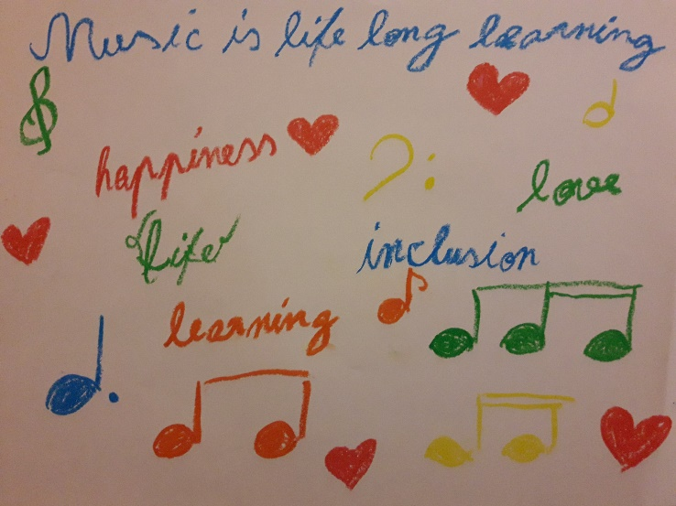
IMPACT EVALUATION

Slide 13
IMPACT EVALUATION

Slide 14
IMPACT EVALUATION

Slide 15
IMPACT EVALUATION

Slide 16
IMPACT EVALUATION

