Slide 1



Music is… Life Long Learning
MATH / ICT THROUGH MUSIC
Liceul de Arte “Regina Maria” Alba Iulia
PORTUGAL – 4th-10th November, 2017

Slide 2
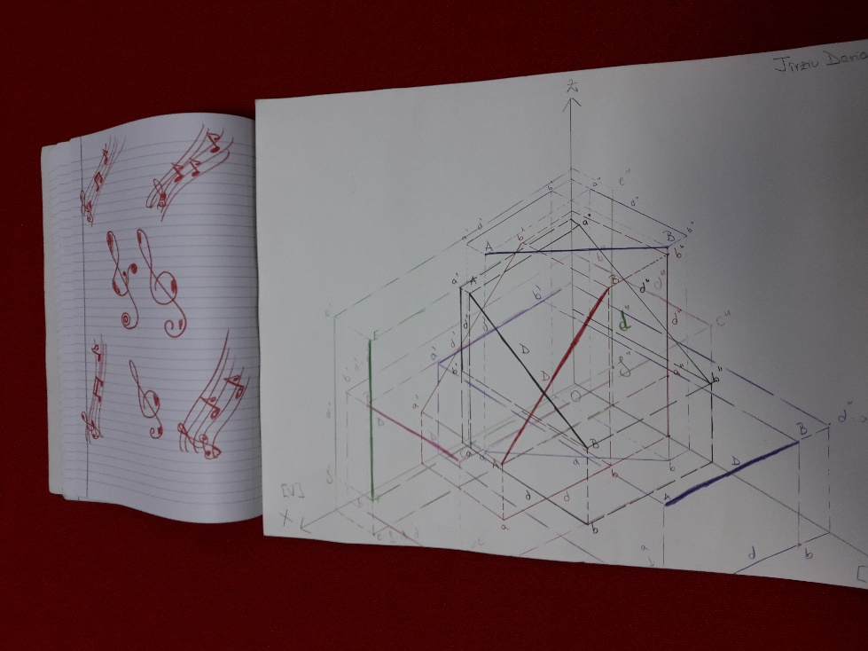
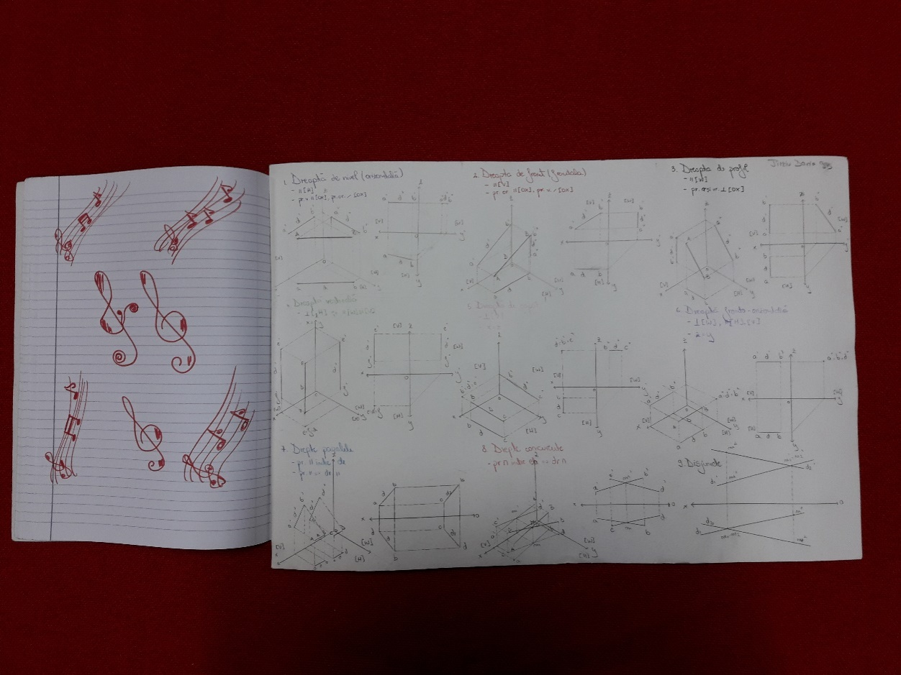
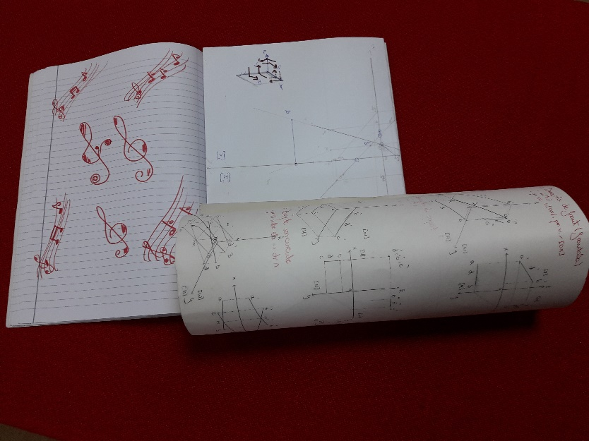

Slide 3
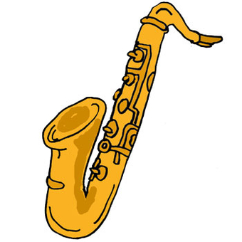
PRIMARY SCHOOL: 3rd grade
WORKING WITH NATURAL NUMBERS
PERIOD: 21 September – 6 October 2017
Number of students: 29
SUBJECT: Math
LEARNING UNIT: Natural Numbers
LESSONS: teaching, learning and consolidating natural numbers and how they are used through music

Slide 4
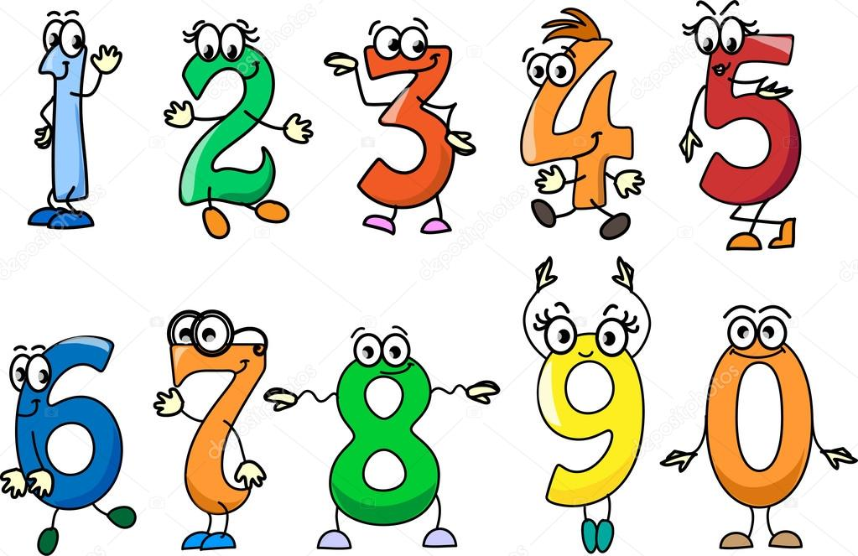
MATH COMPETENCES
Recognition and comparison of natural numbers (0-10000)
Approximation of natural numbers
Number formation, reading and writing with Roman numerals and sums and deductions

Slide 5
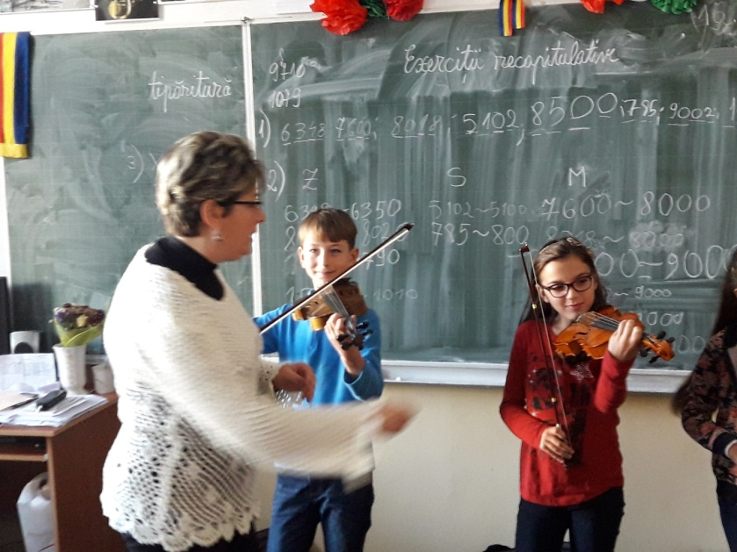
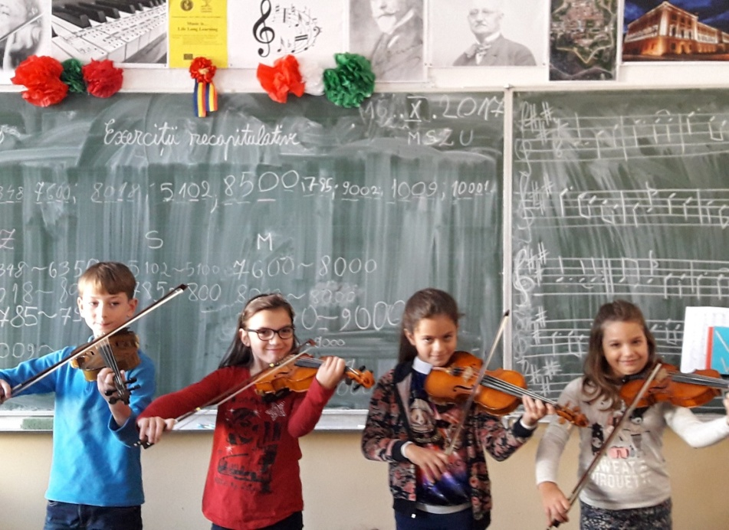

Slide 6
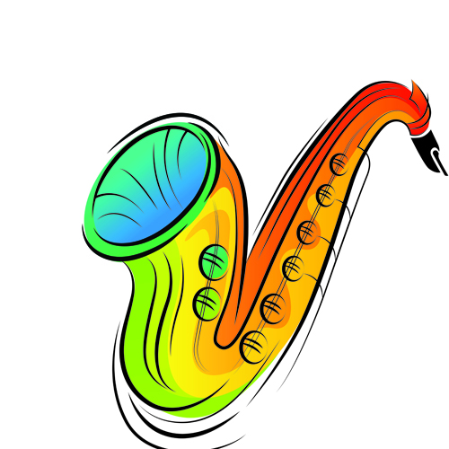
OBJECTIVES / AIMS OF THE LESSONS
Reading, writing and working with natural numbers
Comparison of numbers through musical play
Practice approximation and Roman numerals formation in musical contexts
fill in specific information with a musical background

Slide 7
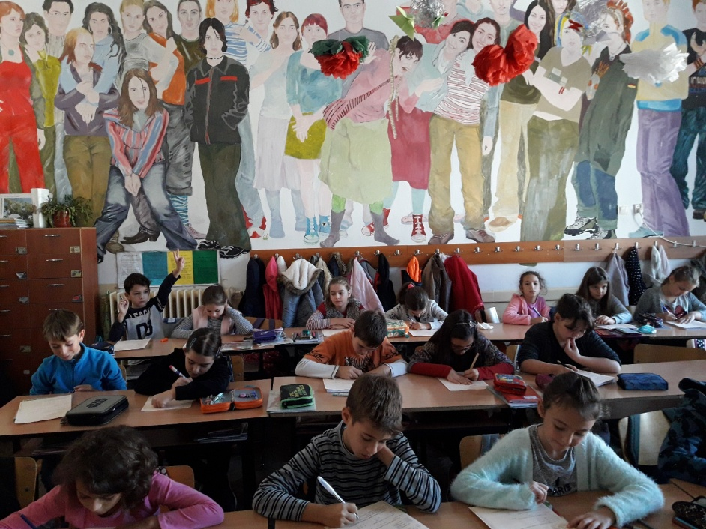
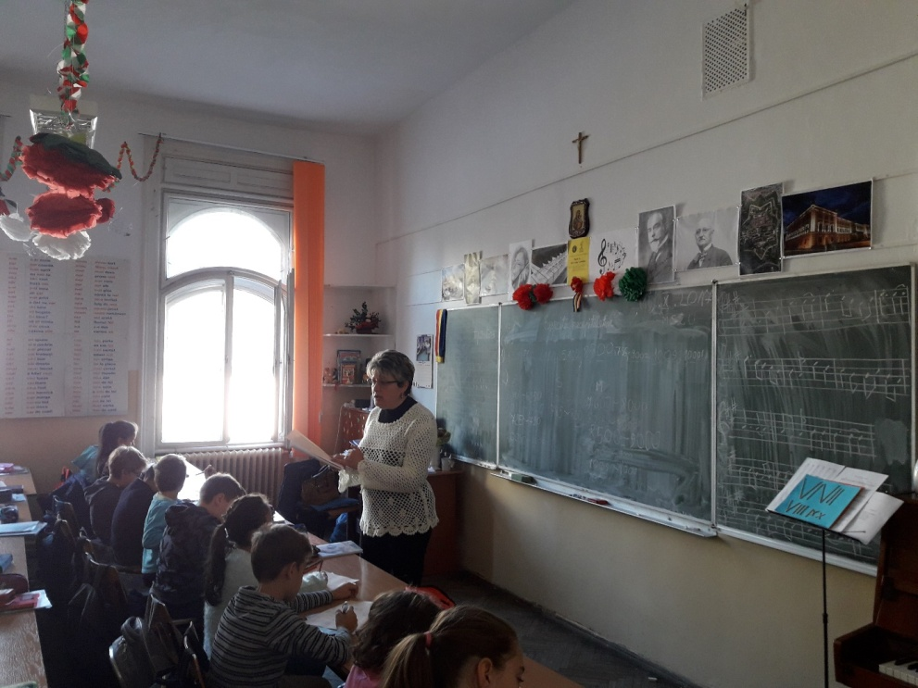

Slide 8
ORGANISATION
RESOURCES
Tables on cardboard
Musical instruments: piano, violin, cello, guitar
Computer application – Road distances
Watches, clocks, sticks, posters
Songs: The song of the Clock, Competition Song
Colourful Worksheets with exercises - contest
Individual
Group work
Whole class interaction

Slide 9
METHODS
Presentation of natural numbers and explanation of how they are read and written according to the table with the units class, thousands class
Working on the cardboard tables while playing the piano, violin, cello
Comparing numbers within musical contexts (piano, violin)
Performing musical instruments (piano, violin, guitar, cello) while doing number approximation on the computer application
Singing The Song of the Clock in order to get familiar with the Roman numerals
Completion of worksheets with musical settings and transferring the content of the worksheet in The Song Competition
Conversation, learning through discovery, didactic play in musical scequences

Slide 10
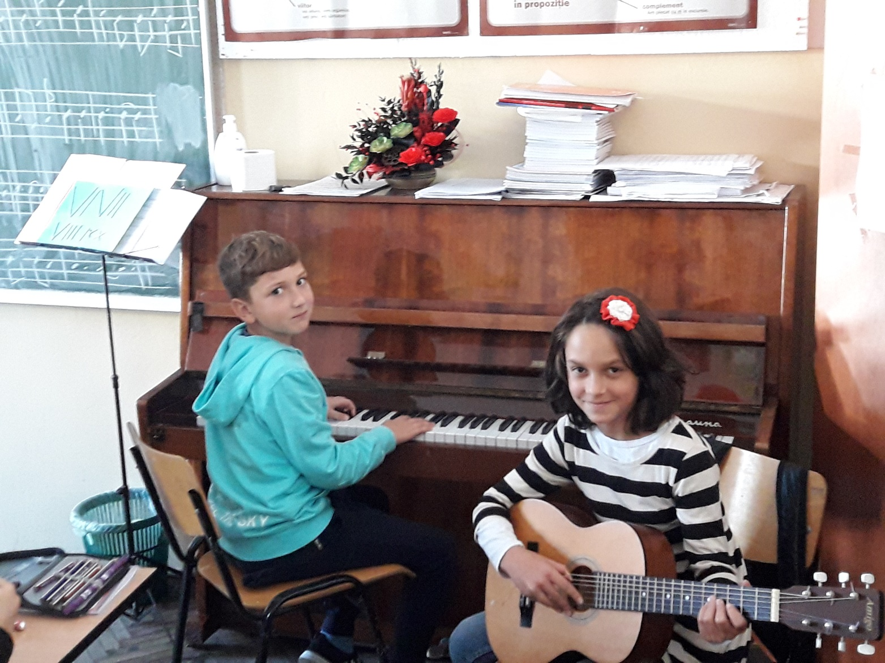

Slide 11

EVALUATION of MATH competences
Systematic observation of students
Oral assessment of students’ answers
Completion of specific tables through musical associations
Comparison of natural numbers in musical contexts and with the help of computer applications
Performing songs related to Roman numerals, sums and deductions
Written assessment of student achievement through worksheets

Slide 12
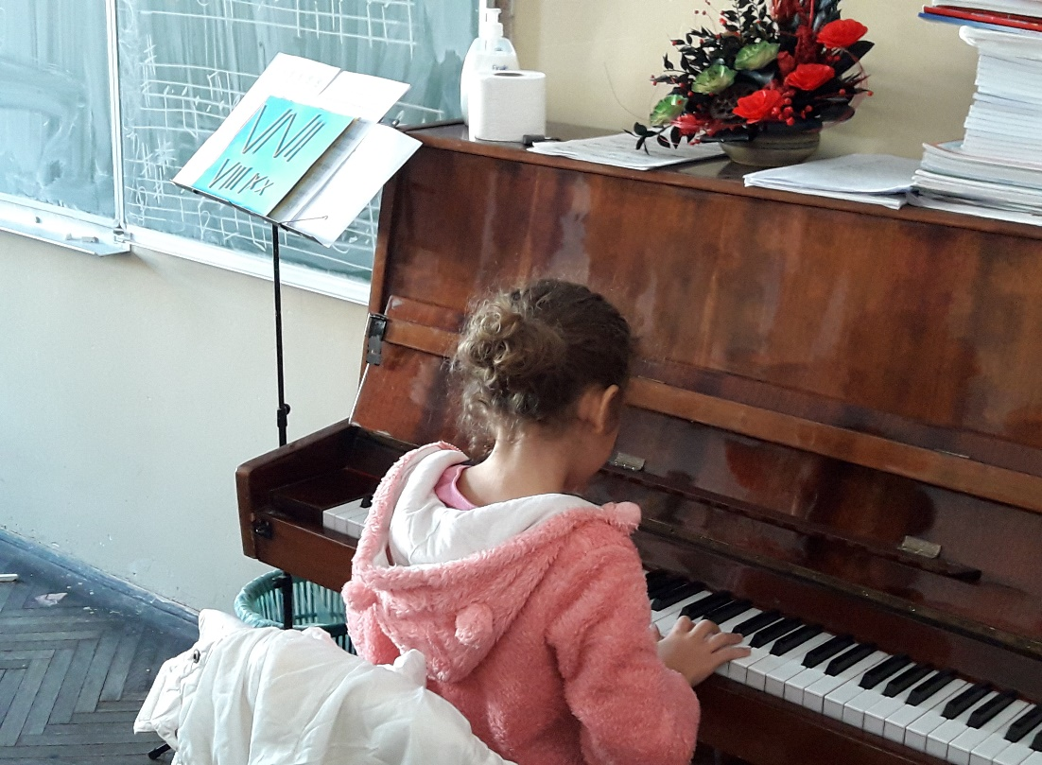
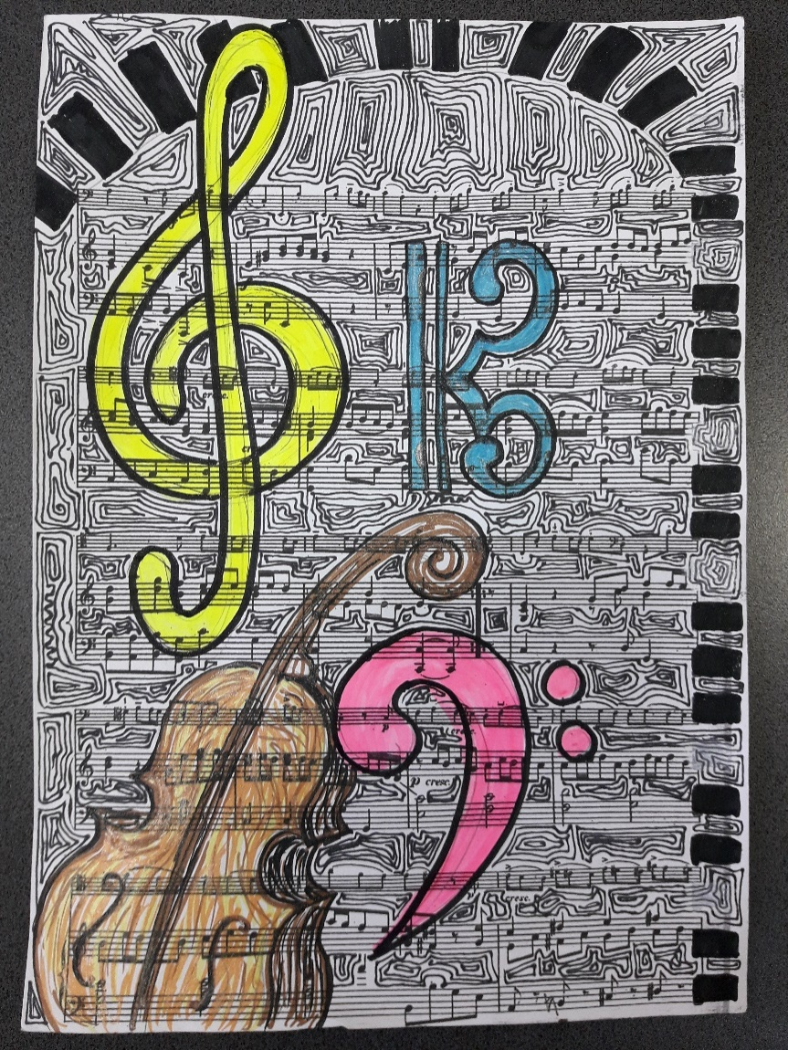

Slide 13
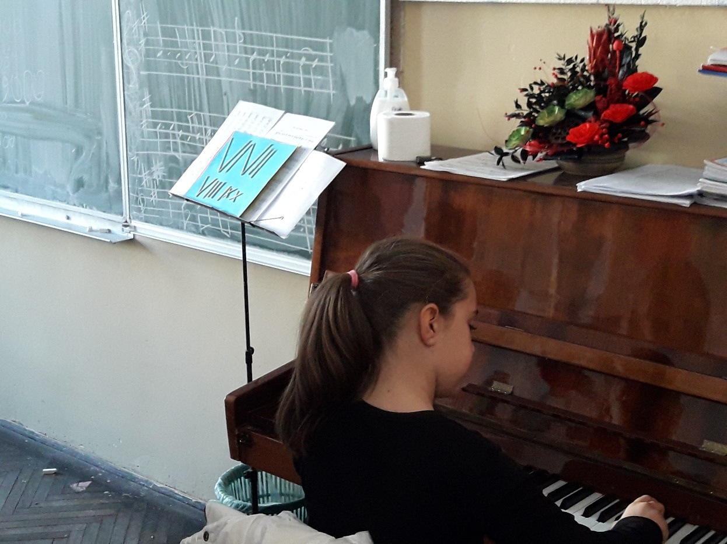
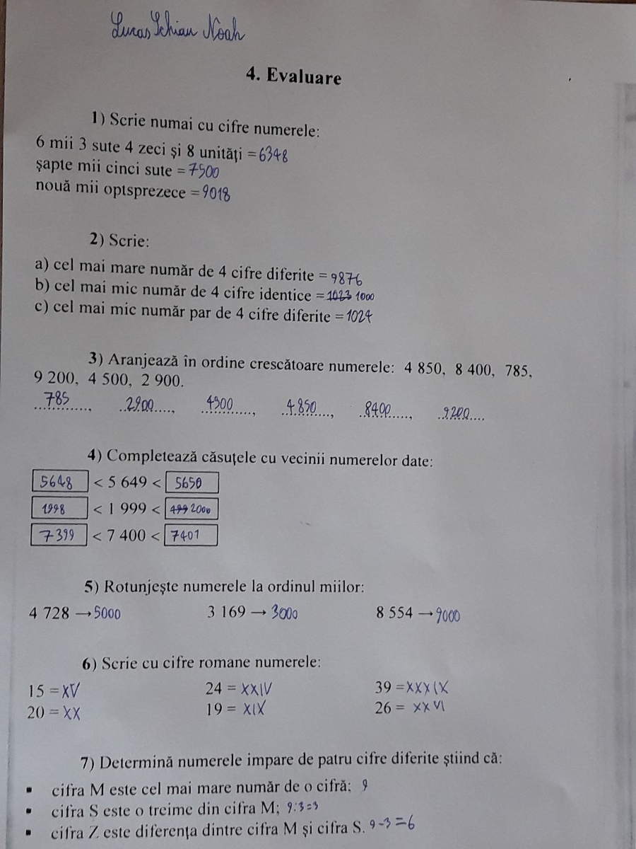

Slide 14
IMPACT EVALUATION: BEFORE AND AFTER

Slide 15
IMPACT EVALUATION: BEFORE AND AFTER

Slide 16
IMPACT EVALUATION: BEFORE AND AFTER

Slide 17
IMPACT EVALUATION: BEFORE AND AFTER

Slide 18
PRIMARY SCHOOL: 3rd -4th grade
DISCOVERING COMPUTER PARTS
PERIOD: 21 September – 6 October 2017
Number of students: 29 + 24
SUBJECT: ICT
LEARNING UNIT: PC components
LESSONS: teaching, learning and consolidating computer components and computer assembly through music

Slide 19

ICT COMPETENCES
Identification of computer hardware and software
Identification of computer input / output devices
Description of how computers work

Slide 20
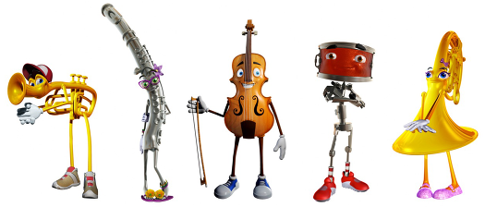
OBJECTIVES / AIMS OF THE LESSONS
discover computer components through play
identify computer components in a musical setting
fill in specific information with a musical background
perform a computer simulation assembly

Slide 21

ORGANISATION
RESOURCES
Computer components taken separately
Songs from youtube.com (A wonderful world)
Piano
Worksheets with computer hardware and software
School computers, loudspeakers
Computer simulation assembly (world-it.ro)
Individual
Whole class interaction

Slide 22
METHODS
Presentation of computer components through musical pieces, choosing different tunes according to the component selected
Performing various songs according to the components presented
Solving tasks in a musical setting meant to facilitate concentration and release of assessment stress
Singing songs accompanied by the piano followed by tasks
Connecting and consolidating ICT notions through musical rhythms
Guided discovery of computer components through musical sequences
Performing computer simulation assembly in musical settings

Slide 23

EVALUATION of ICT competences
Systematic observation of students
Song interpretation
Associations of computer components and musical pieces in order to recognize them more easily
Worksheets with basic notions and specific images
Oral assessment through short presentations of different parts of the computer
Computer simulation assembly with musical background

Slide 24
IMPACT EVALUATION: BEFORE AND AFTER

Slide 25
IMPACT EVALUATION: BEFORE AND AFTER

Slide 26
IMPACT EVALUATION: BEFORE AND AFTER

Slide 27
IMPACT EVALUATION: BEFORE AND AFTER

Slide 28
IMPACT EVALUATION: BEFORE AND AFTER

Slide 29
SECONDARY SCHOOL: 5th grade
  Computer System - Efficient Use and Safety
PERIOD: 21 September – 6 October 2017
Number of students: 25
SUBJECT: ICT
LEARNING UNIT: The structure of computer systems
LESSONS: review of computer structure , identification of basic elements of information systems through music

Slide 30

ICT COMPETENCES
Efficient use of computer and information systems within safety conditions
Identification of the elements of information systems in specific contexts

Slide 31






Slide 32

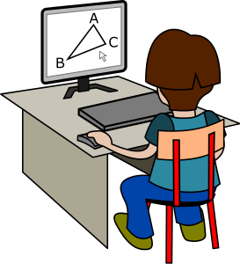

OBJECTIVES / AIMS OF THE LESSONS
Improving students’ attention and responsiveness when learning about the computer
Identification of the elements of computer systems through musical play
Increasing students motivation for learning
Acknowledgement of the safety measures needed when working with computers
Associating musical tunes to computer components
Recognition of computer structure through musical connections
Assemble a computer by following the steps given and the musical rhythm

Slide 33
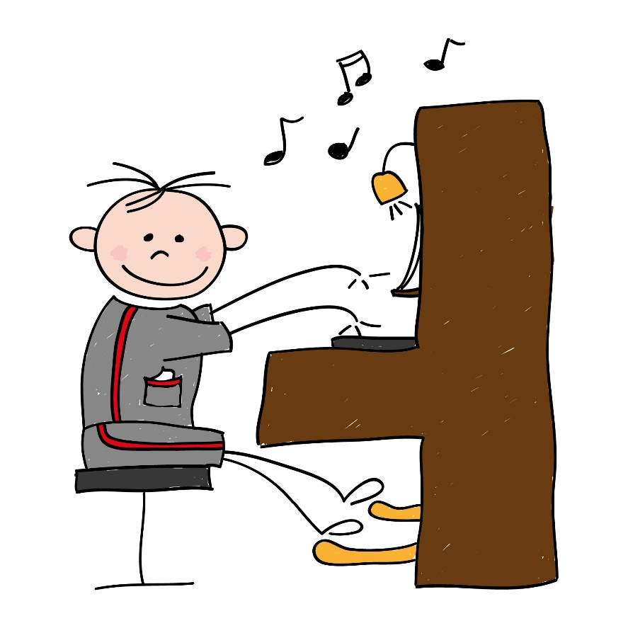


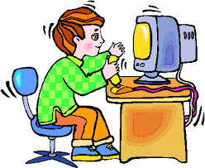

Slide 34

ORGANISATION
RESOURCES
You tube songs (Crazy Frog)
Parts of the computer taken separately
ICT sites (world-it.ro )
Board, chalk, internet links
Worksheets with the structure of computer systems
Cheerful songs (used under the form of sung dialogues) matching the information acquired
  Individual
  Whole class interaction

Slide 35
METHODS
Presentation of the basic structure of computer systems through sung dialogues
Explanation and demonstration of the working process of computer systems
Individual and whole class conversation in musical settings
Guided discovery of the structure of computer systems
Acknowledgement of safety measures when working with computer and information systems through music rhythms
Performance of musical dialogues on the topic of computer components
Assembly of computer parts with musical background

Slide 36
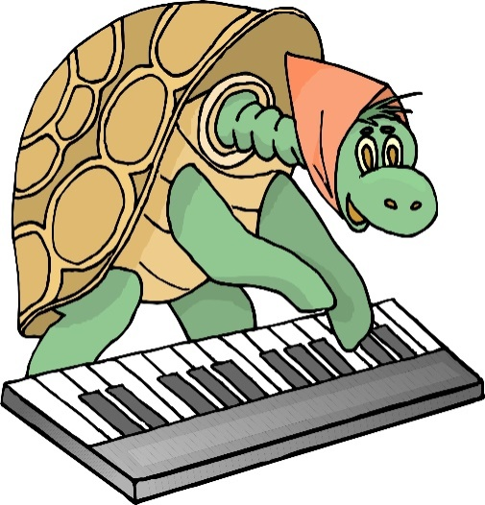
EVALUATION of ICT competences:
Systematic observation of students
Identification of computer parts through musical play
Performance of musical dialogues about computer components and structure
Associations of musical rhythms and computer parts
Recognition of safety measures and efficient use of computer systems
Completion of evaluation worksheets

Slide 37
IMPACT EVALUATION: BEFORE AND AFTER

Slide 38
IMPACT EVALUATION: BEFORE AND AFTER

Slide 39
IMPACT EVALUATION: BEFORE AND AFTER

Slide 40
IMPACT EVALUATION: BEFORE AND AFTER

Slide 41
IMPACT EVALUATION: BEFORE AND AFTER

Slide 42
SECONDARY SCHOOL: 6th grade (A, B)
Microsoft Word Documents
PERIOD: 21 September – 6 October 2017
Number of students: 20 + 30
SUBJECT: ICT
LEARNING UNIT: Microsoft Word: Text Editing – General Outline
LESSONS: teaching and learning about the elements of information systems in specific contexts, text editing and formatting a document using Microsoft Word

Slide 43

ICT COMPETENCES
Identification of the elements of information systems in specific contexts
Knowledge of the principles of basic use of the applications for text editing

Slide 44
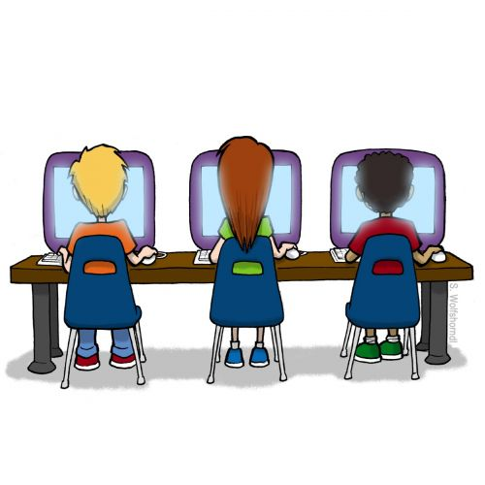
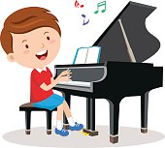

Slide 45
OBJECTIVES / AIMS OF THE LESSONS
Launch of the application Microsoft Word following the presentation on the video projector
Sing the song whose verses appear on the screen
Discover the options of the Start Menu through musical pieces
Edit different texts (poems, short paragraphs -size, colour, font) while listening to musical pieces (piano, you tube songs)
Make a presentation of the options from the Start Menu through music

Slide 46

ORGANISATION
RESOURCES
Microsoft Word application
Internet; school network of computers
You tube songs (Home - Smiley)
Video projector, loudspeakers
Musical instrument: piano
Lines of various songs written in a Word document
Worksheets with the list of the Start Menu items
  Individual
  Group work
  Whole class interaction

Slide 47
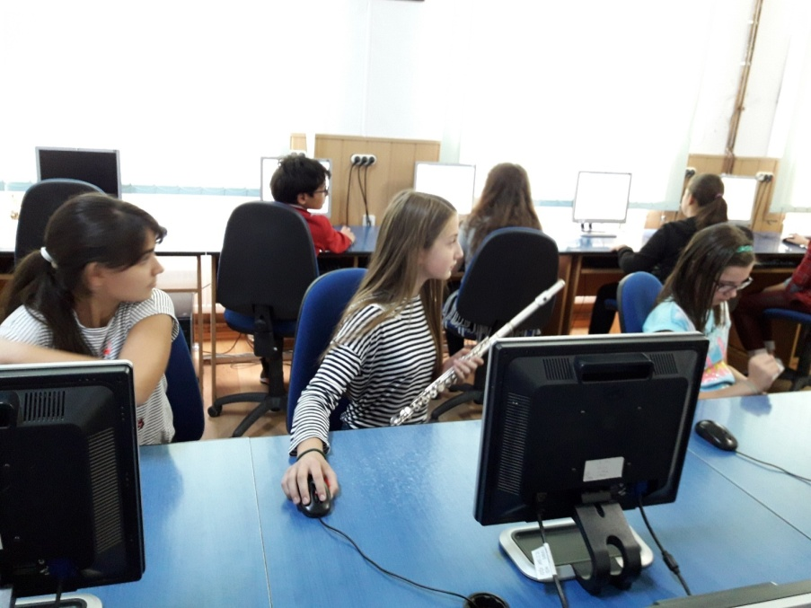
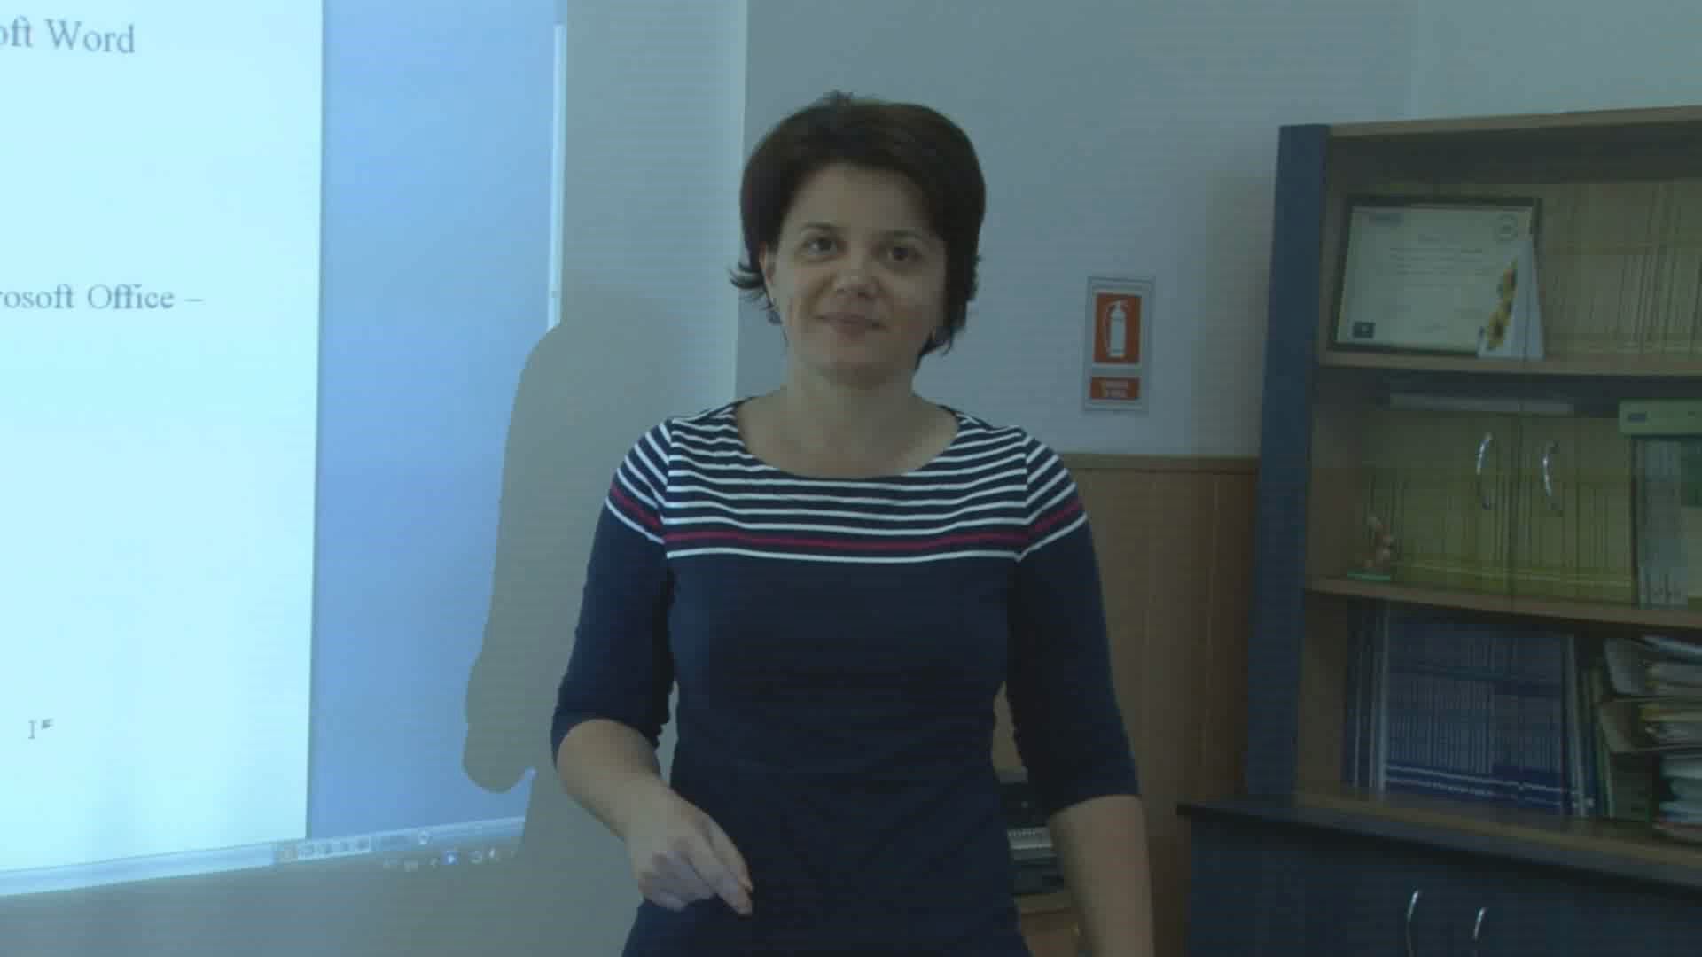

Slide 48
METHODS
Presentation of the basic elements in a Word document through songs
Demonstration of the use of text editing with musical background
Individual and whole class conversation
Guided discovery of the items of the Start Menu in Microsoft Word through musical tunes
Working in teams in order to make a presentation of a text edited according to the tasks and in the musical setting provided
Editing texts according to requirements within adapted musical settings

Slide 49

EVALUATION of ICT Competences:
Systematic observation of students
Associations of musical pieces and word document items
Oral appreciation of the results of students’ text editing
Levels of achievement regarding the text editing tasks
Knowledge of the options of the Start Menu
Completion of worksheet with tasks related to the elements taught

Slide 50
IMPACT EVALUATION: BEFORE AND AFTER

Slide 51
IMPACT EVALUATION: BEFORE AND AFTER

Slide 52
IMPACT EVALUATION: BEFORE AND AFTER

Slide 53
IMPACT EVALUATION: BEFORE AND AFTER

Slide 54
IMPACT EVALUATION: BEFORE AND AFTER

Slide 55
IMPACT EVALUATION: BEFORE AND AFTER

Slide 56
SECONDARY SCHOOL: 7th grade (A, B)
INTERNET AND WORK SAFETY MEASURES
PERIOD: 21 September – 6 October 2017
Number of students: 24 + 25
SUBJECT: ICT
LEARNING UNIT: Internet safety measures and work protection in the ICT laboratory
LESSONS: teaching and learning about the social and legislative specific norms, the efficient and safe use of the computer systems at school

Slide 57
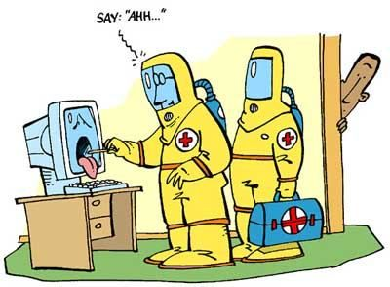
ICT COMPETENCES
Knowledge of specific norms of safety in the social and legislative spheres
Identification of specific elements of computer systems
Efficient use of computer systems within safety conditions

Slide 58
OBJECTIVES / AIMS
Identify safety measures on the internet from a rap song
Recognize the positive and negative actions depicted on the internet
Demonstrate different actions on the internet using a suggestive musical background
Render actions from the internet through musical instruments (violin, flute, guitar)
Awareness of the norms of work safety and fire prevention and extinction within a piano tune background
Adapt answers regarding the safety regulations to various musical rhythms

Slide 59
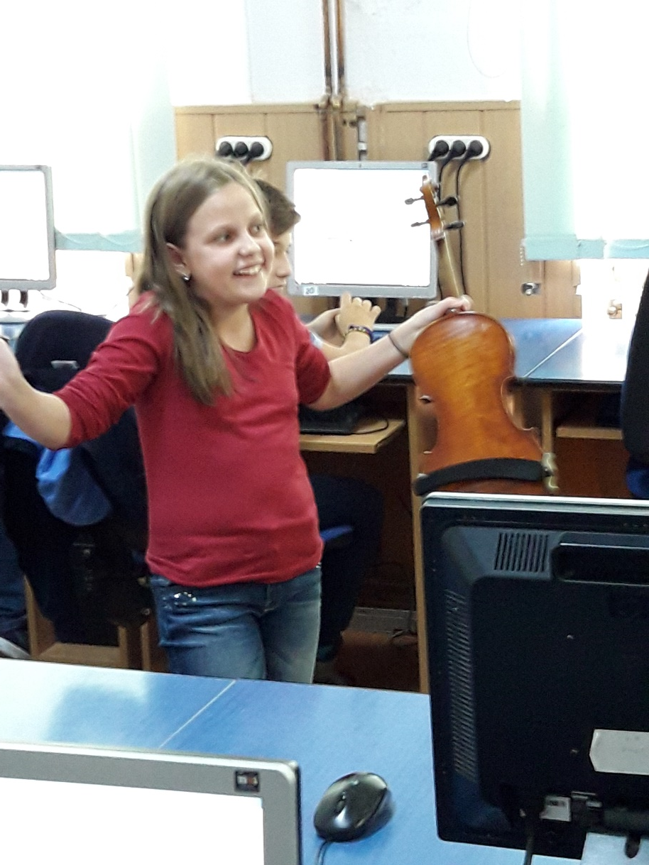
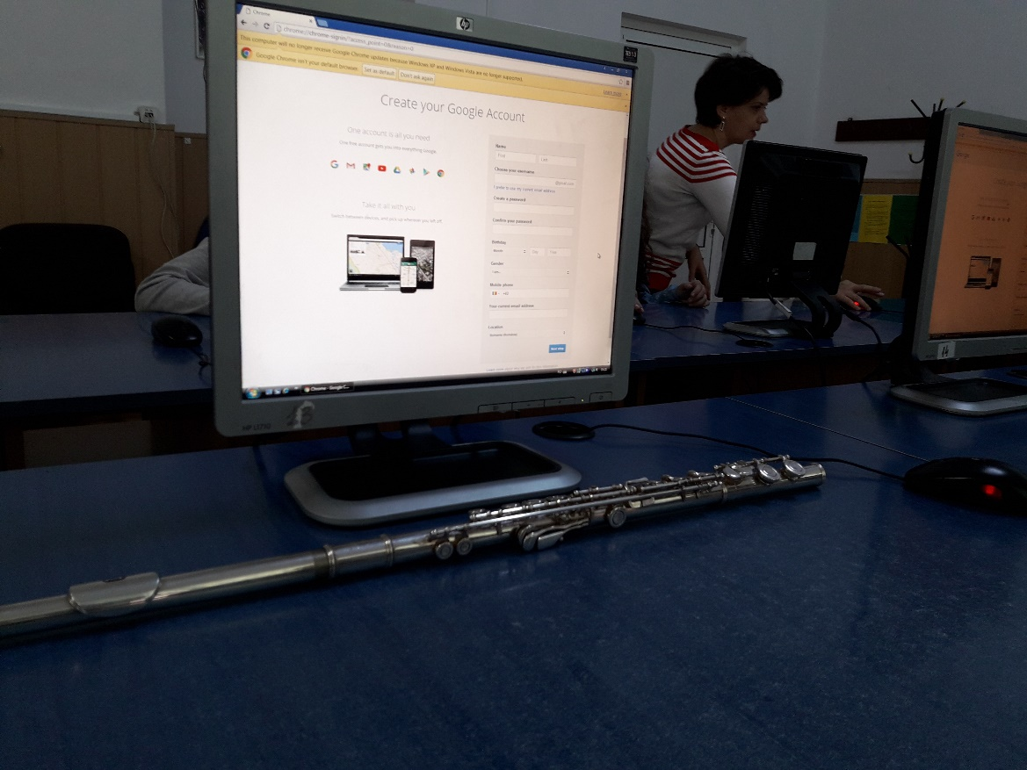

Slide 60
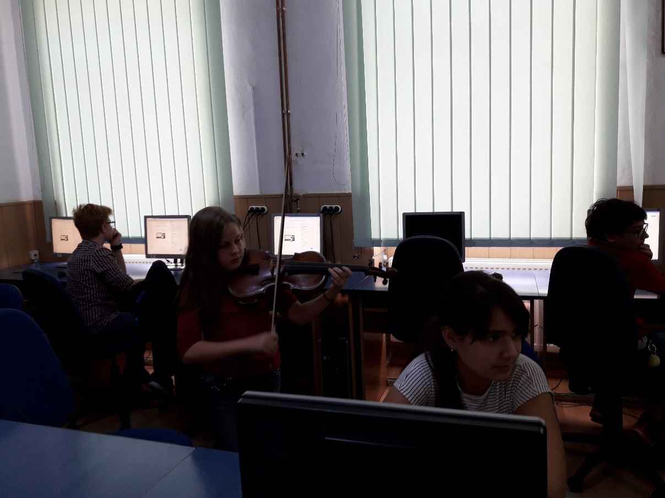
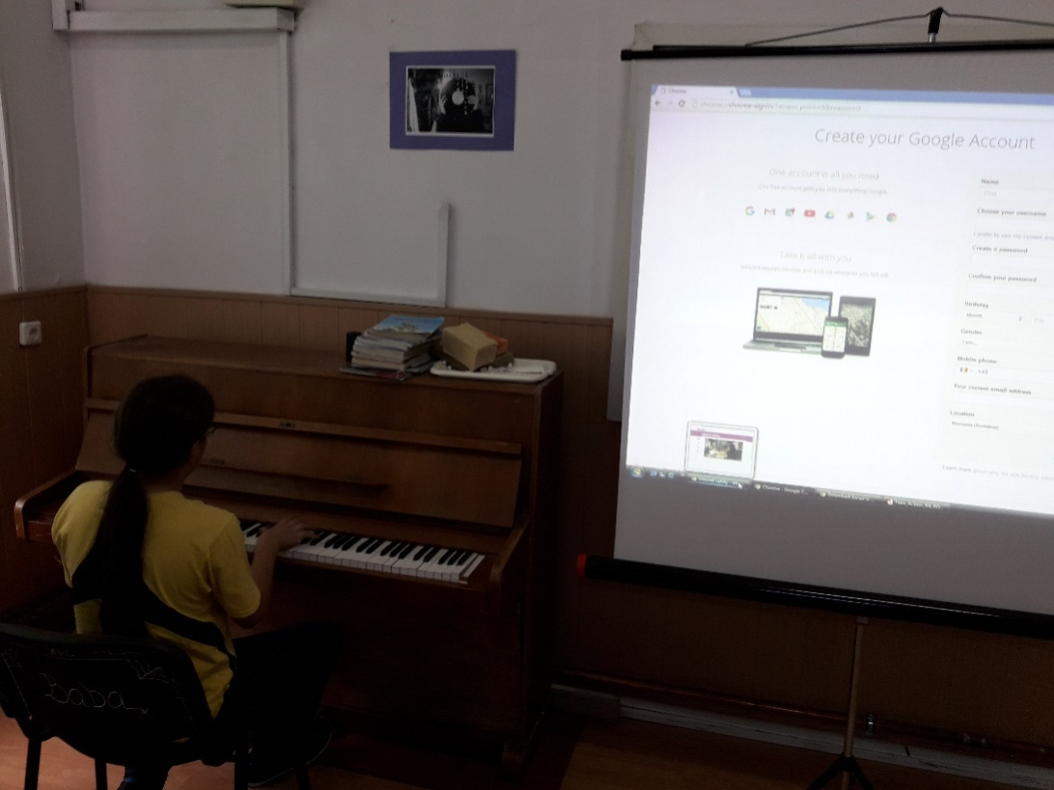

Slide 61

ORGANISATION
RESOURCES
Individual
Pair work
Whole class interaction
List of safety measures at work and fire prevention and extinction norms
Musical instruments: piano, violin, flute, guitar
Lyrics of a rap song about safety measures
Internet sites: flocabulary.com (Internet safety)
School network of computers
Video projector, loudspeakers

Slide 62
METHODS
Presentation of safety measures at work and fire prevention and extinction norms within musical setting
Listen to rap songs on the internet and select the safety measures mentioned
Associate safety measures with rap rhythms and lyrics
Demonstration of various actions depicted on the internet using an appropriate and suggestive musical background
Take notes regarding the safety measures at work and fire prevention and extinction norms within a piano tune background
Answer and use specific gestures to present the safety measures required, rendering the response in suggestive musical tunes

Slide 63
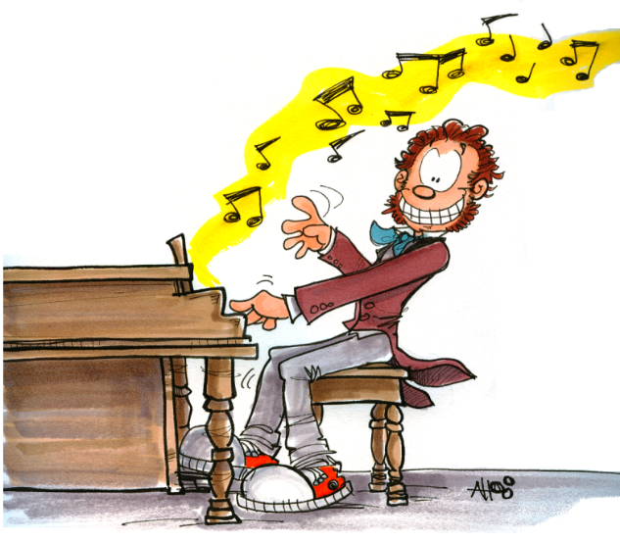
EVALUATION of competences
Systematic observation of students
Association of musical rhythms to safety measures presented
Recognition of the positive or negative value of different actions depicted on the internet through music correlations
Acquisition of safety measures to be respected when using the internet
Rendering various norms and regulations through suggestive gestures and musical pieces

Slide 64
IMPACT EVALUATION: BEFORE AND AFTER

Slide 65
IMPACT EVALUATION: BEFORE AND AFTER

Slide 66
IMPACT EVALUATION: BEFORE AND AFTER

Slide 67
IMPACT EVALUATION: BEFORE AND AFTER

Slide 68
IMPACT EVALUATION: BEFORE AND AFTER

Slide 69
IMPACT EVALUATION: BEFORE AND AFTER

Slide 70
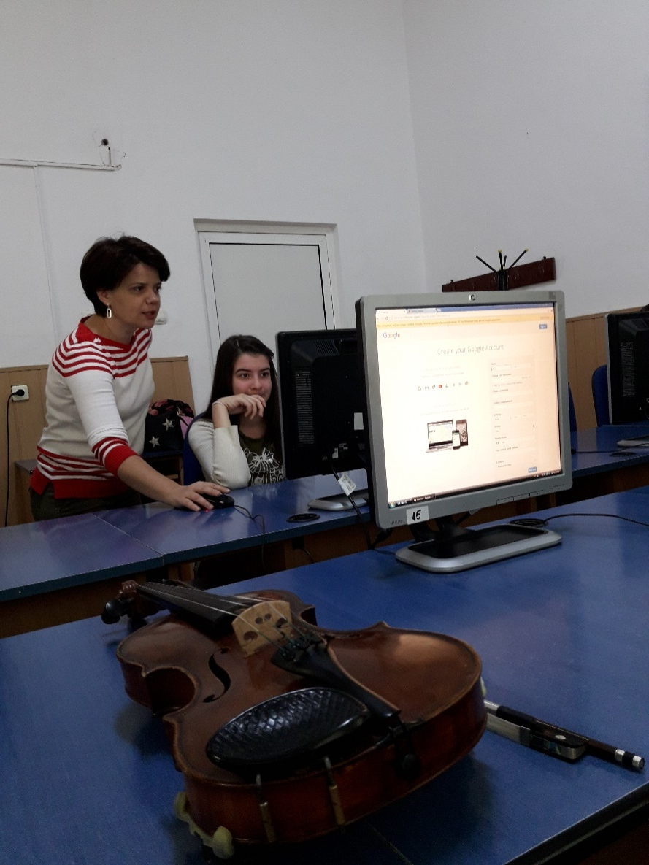
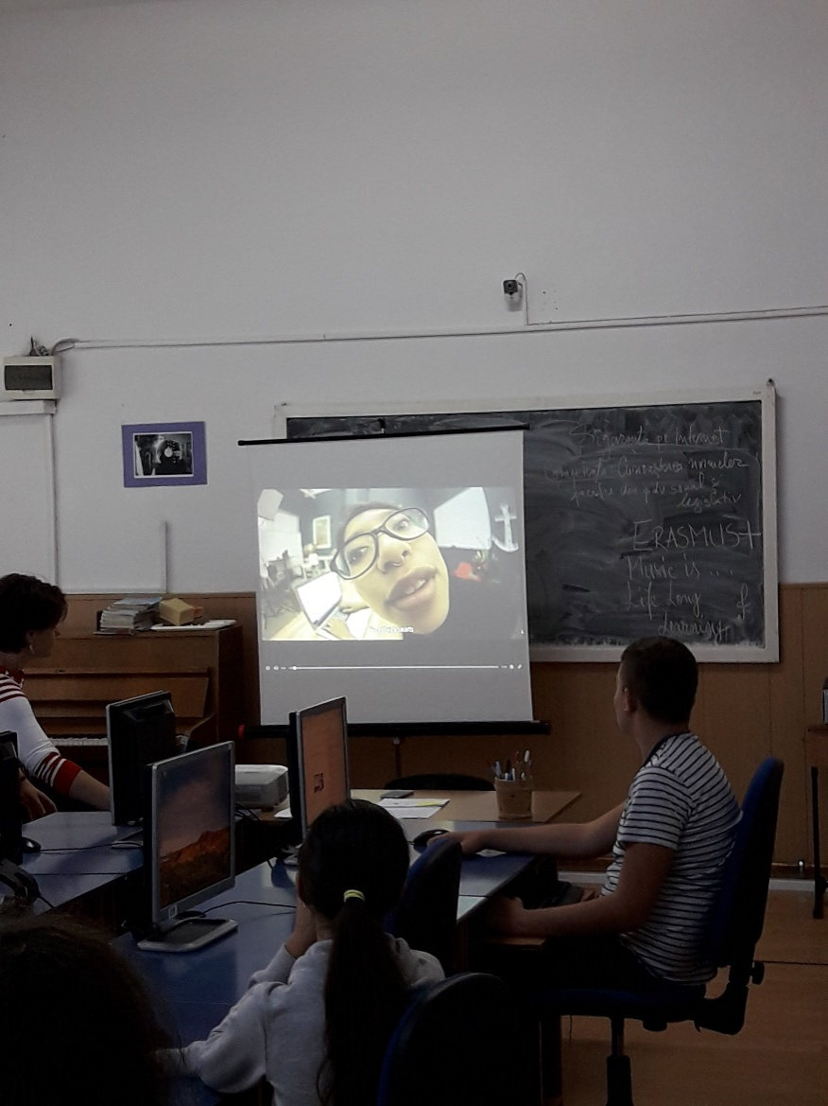

Slide 71
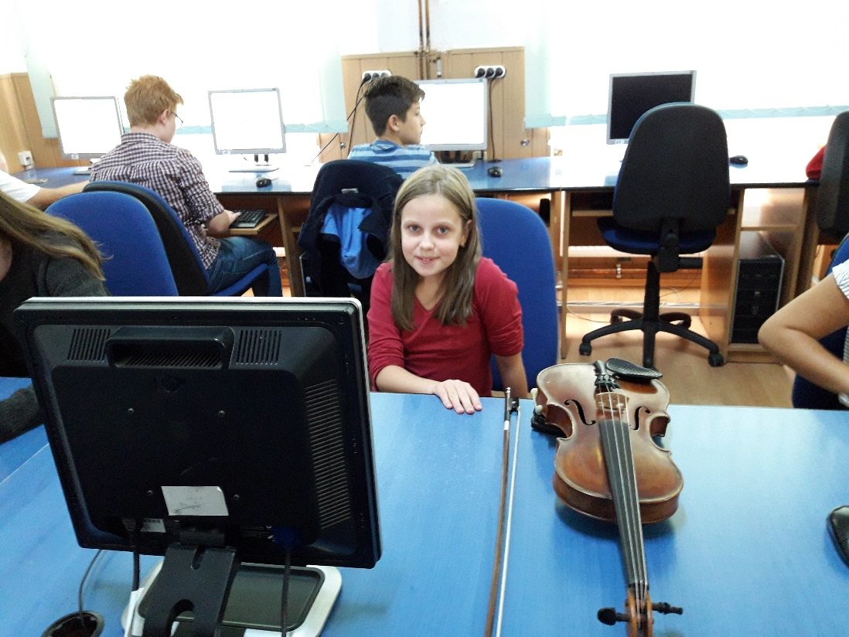
So, beware:
Internet safety first!
and… Music with every click!

