Slide 1
Music is… Life Long Learning
INCLUSION THROUGH MUSIC 1
Talk to me, not about me…
Liceul de Arte “Regina Maria” Alba Iulia
Zabki, POLAND – 19th-23th March, 2018

Slide 2
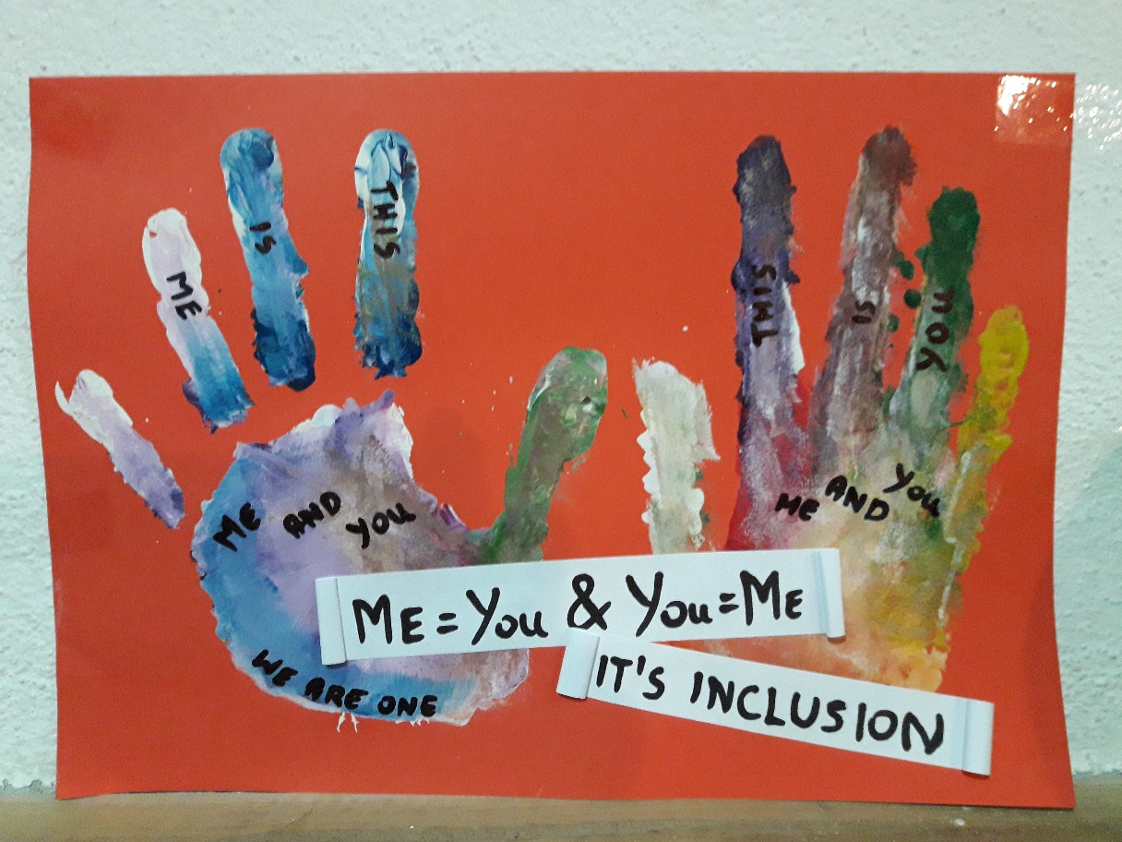
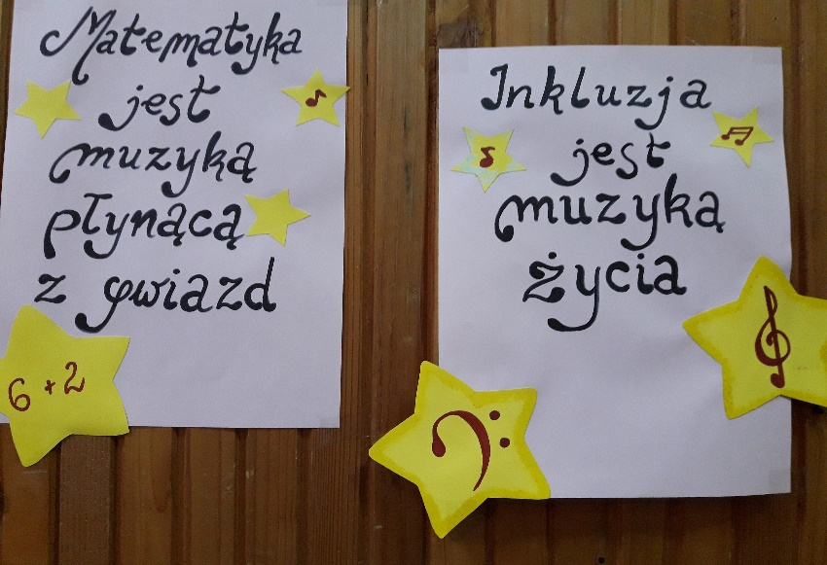

Slide 3
SECONDARY SCHOOL (all grades)
Artistic Views of Languages
PERIOD: 26th-29th September 2017
Number of students: 70 (classes 5A, 7A, 8A, 8B, 11B, 11C)
SUBJECT: Erasmus + Celebration of the European Day of Languages
ACTIVITIES: learning words in different languages, playing with words and their musicality, drawing words and guessing their stories having musical backgrounds

Slide 4
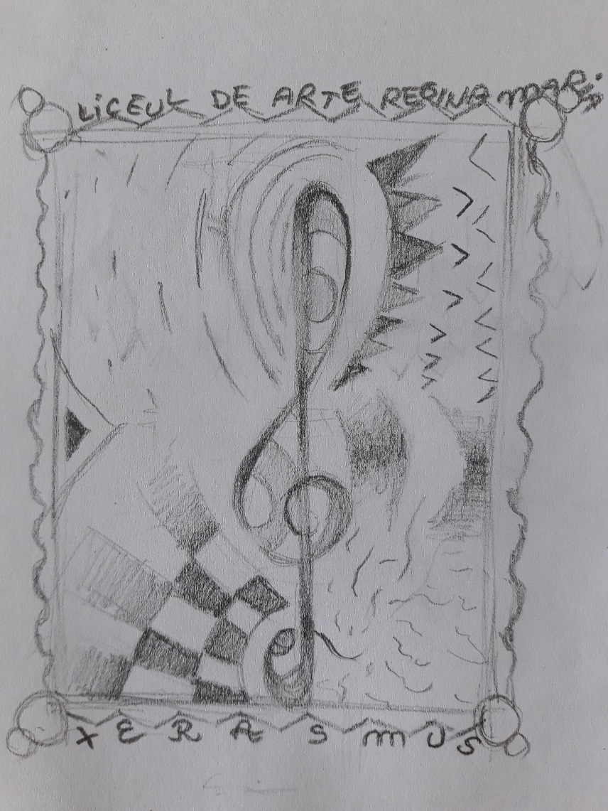
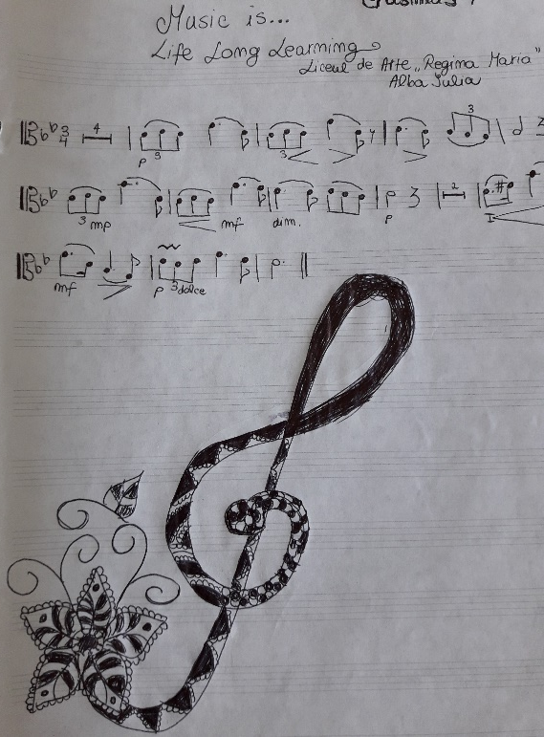

Slide 5
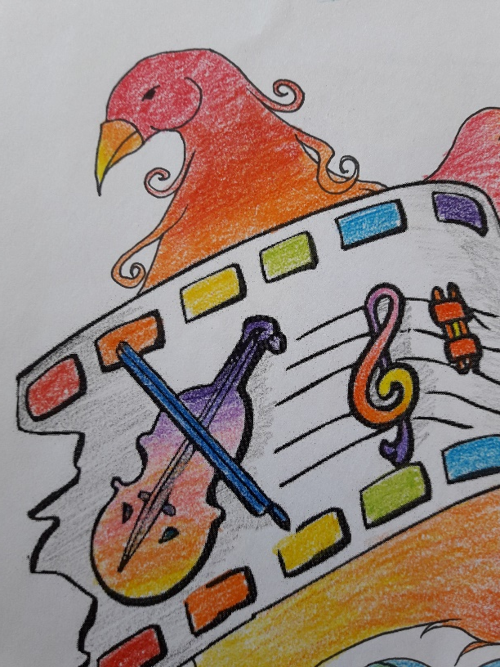
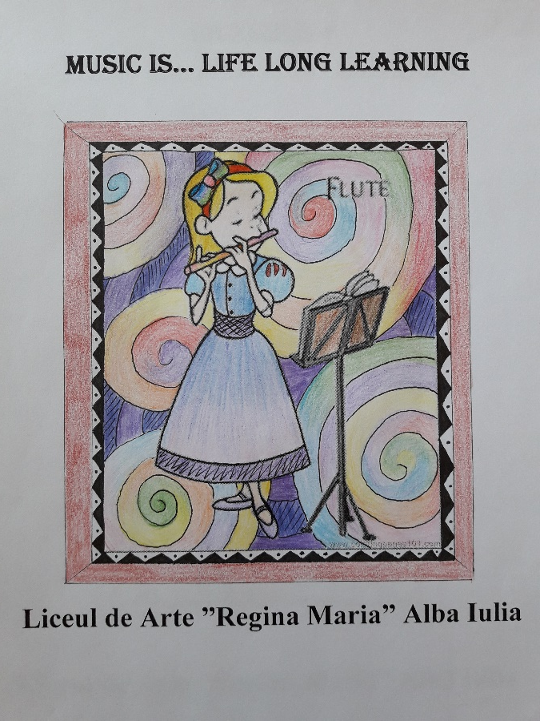
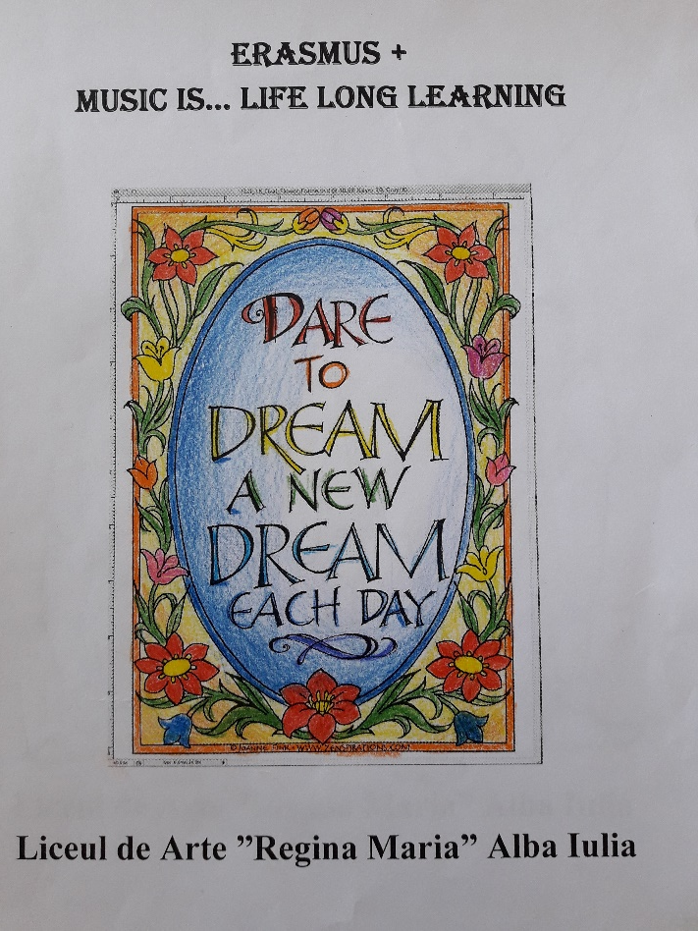
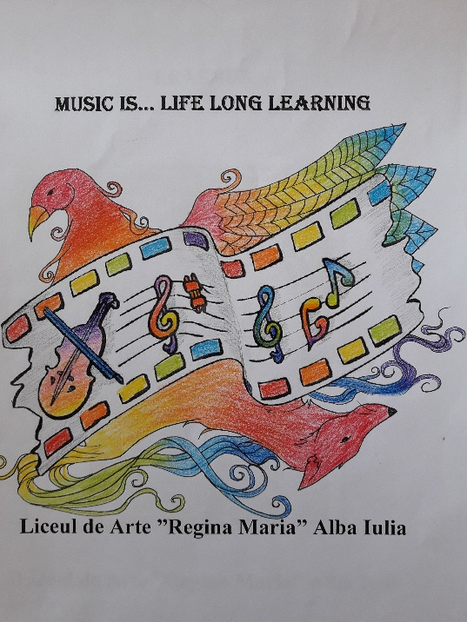

Slide 6
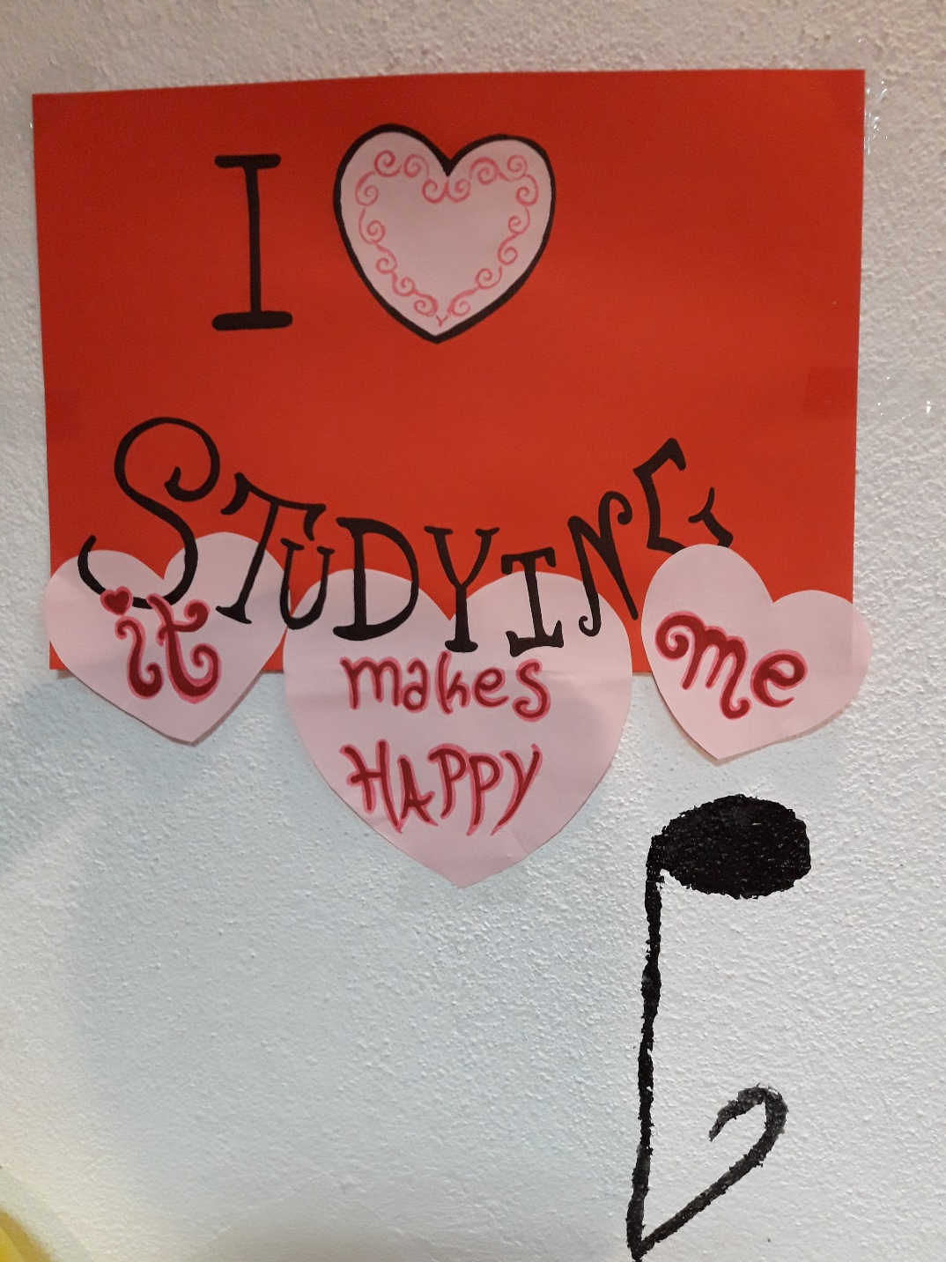
COMPETENCES
Improve the participation of students from disadvantaged groups in exchanges of ideas regarding the study of foreign languages through music, drawing, painting
Use foreign languages as means of accessing the European linguistic and cultural diversity

Slide 7
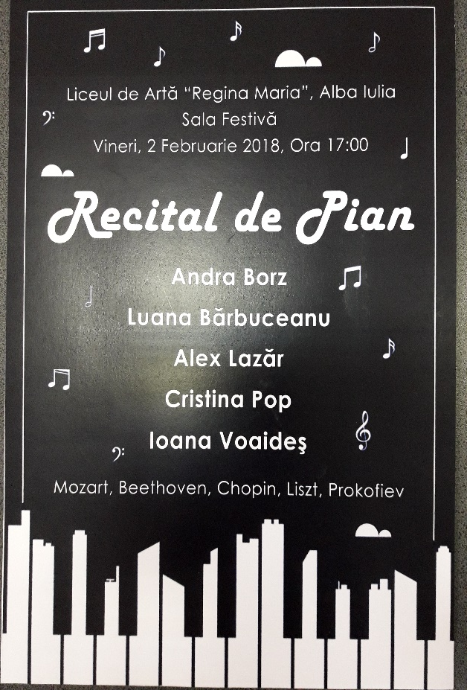
METHODOLOGY
Traditional/modern songs in English, Italian, Spanish, Polish, Portuguese, Romanian etc. with simple choreography for students to imitate
Using specific symbols of countries in musical games
Creative arrangement of words from different languages within musical backgrounds
Contest: musical performance of thematic words belonging to different languages
Exhibition: students’ works in musical settings

Slide 8
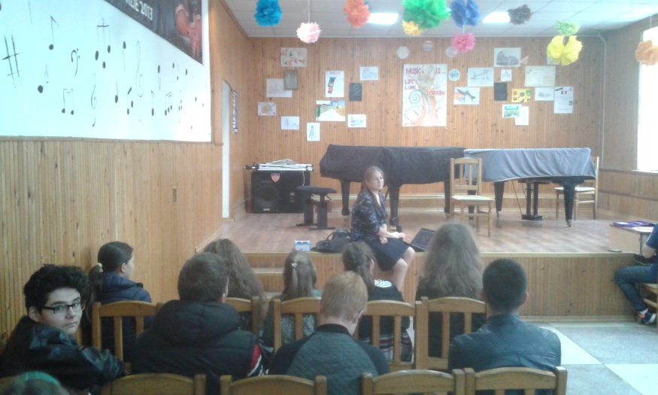
METHODOLOGY

Slide 9
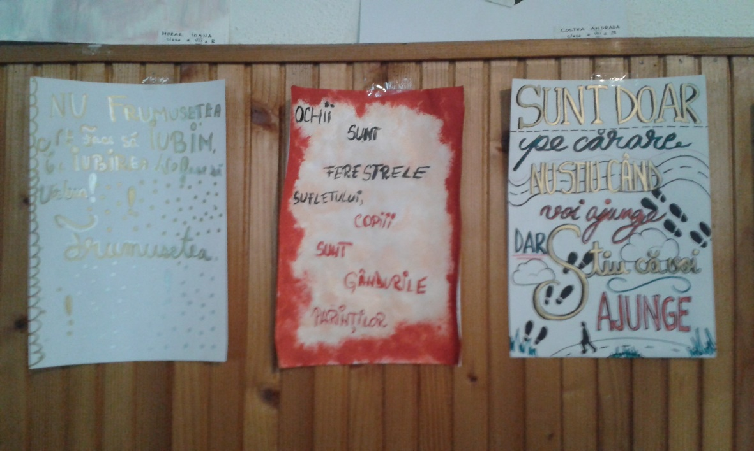
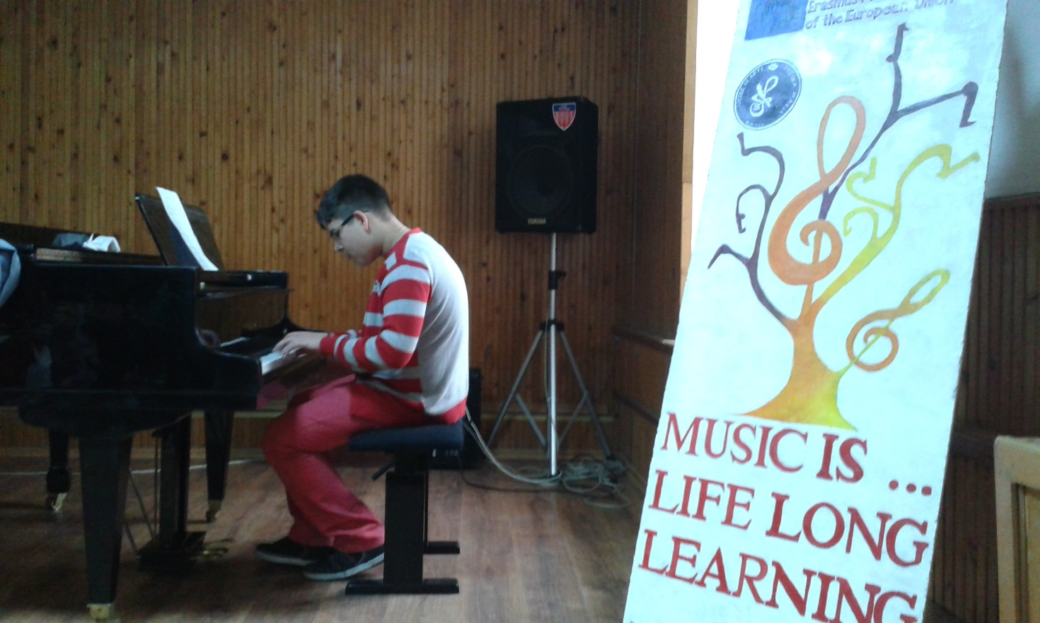

Slide 10
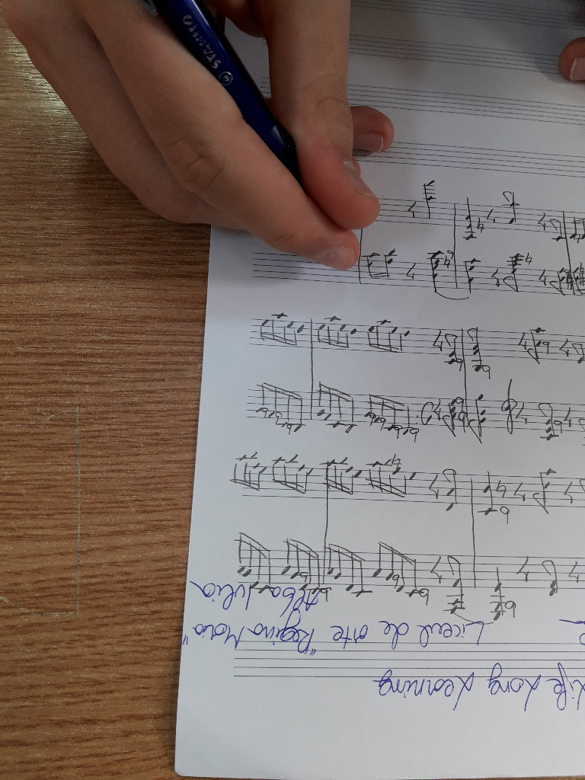
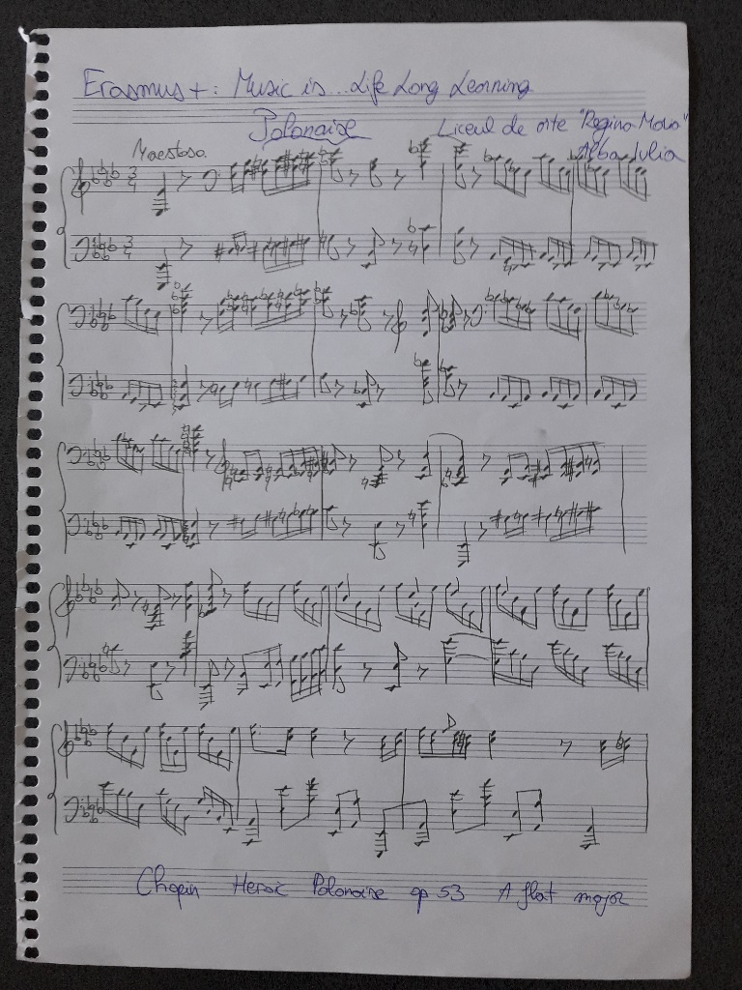
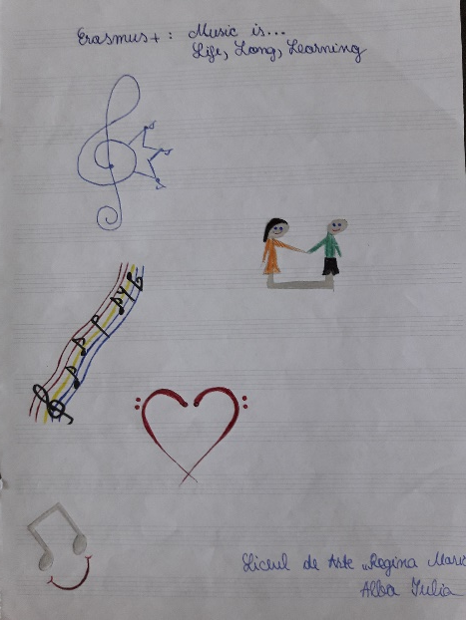
METHODOLOGY …talk to me, not about me…

Slide 11
ORGANISATION
RESOURCES
Musical instruments: piano, violin, cello, guitar
Coloured papers
Songs in different languages (English, French, Italian, Spanish, Portuguese etc.)
List of words from different languages grouped according to themes (flowers, colours, hobbies etc.)
Books about the history of different countries
Individual
Group work
Class interaction

Slide 12
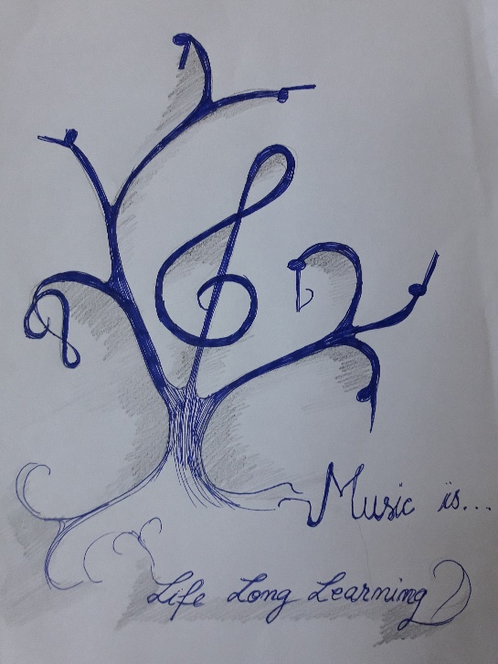
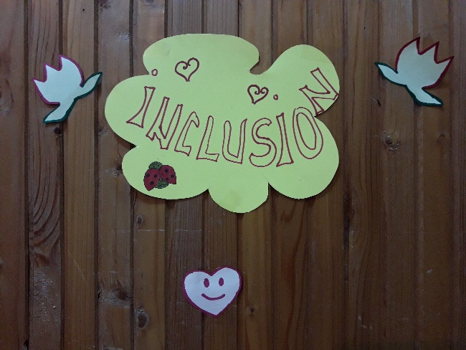
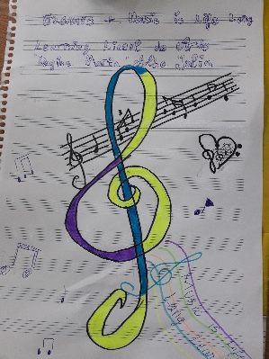
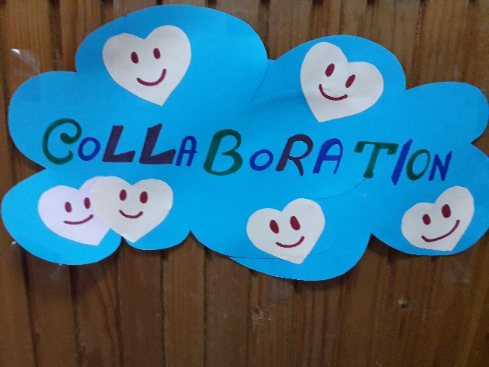
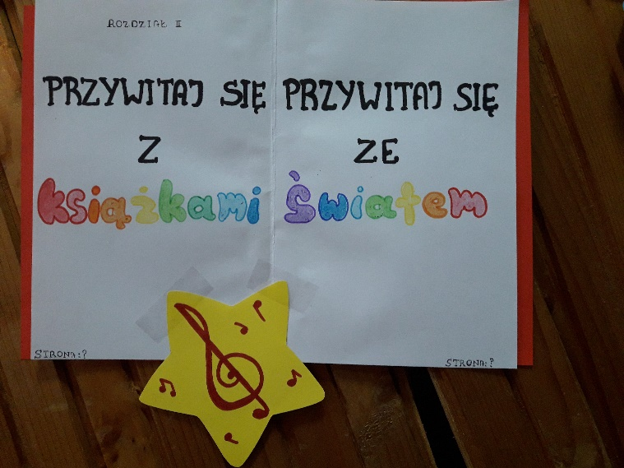

Slide 13
EVALUATION of competences
Observation of students
Representation of words from different languages in creative images
Musical performance of songs based on thematic words from different languages following the pronunciation of words in that language
Performance of various steps according to the traditional/modern song listened to
Exhibition of students’ art works

Slide 14
IMPACT EVALUATION

Slide 15
IMPACT EVALUATION

Slide 16
PRIMARY AND SECONDARY SCHOOL
Festive School Days
PERIOD: 18-20 October 2017
Number of students: 42 (classes 2A, 6A, 8A, 11A, 12B)
SUBJECT: celebrating school days
ACTIVITIES: reading stories by Queen Marie of Romania, organizing contests, connecting words and ideas through music

Slide 17
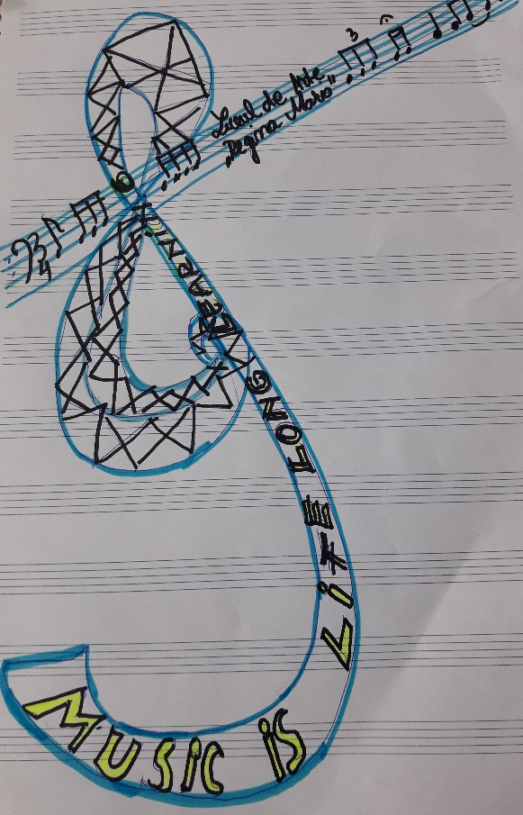
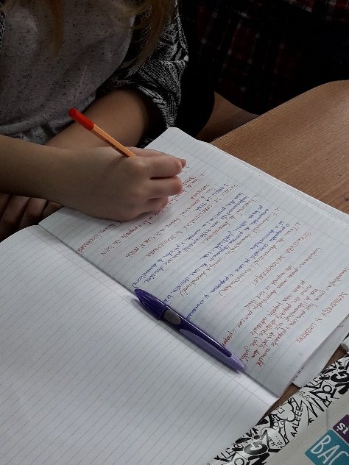
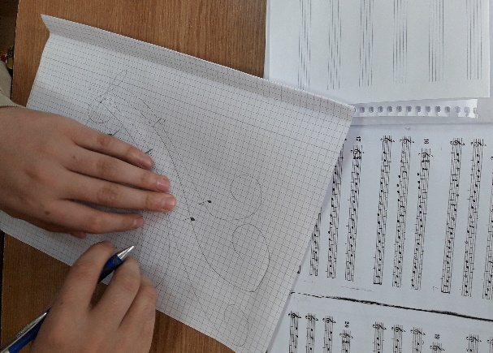
COMPETENCES
Facilitate access to literary and cultural resources in order to gain perspective on universal values reflected in the works of Queen Marie of Romania
Raise awareness regarding various types of artistic expression

Slide 18
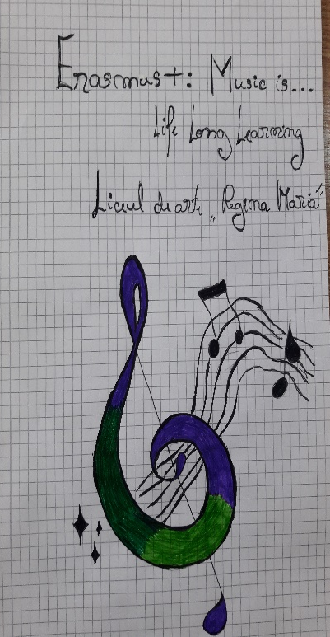
METHODOLOGY
Exploration of stories and articles by Queen Marie of Romania in musical contexts
Working with literary texts by Queen Marie of Romania through creation of songs starting from key words, association of words/expressions with certain musical tunes, performing short musical pieces based on the themes of the text
Collaborate in musical contexts in order to create musical pieces, to recognize words/expressions from the texts
Interpretation of selected quotes belonging to Queen Marie of Romania through drawing, painting, crafts
Exhibition: students’ works presented within musical frames

Slide 19
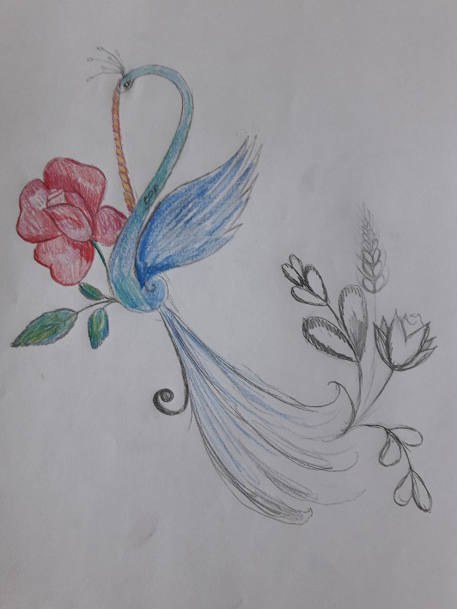
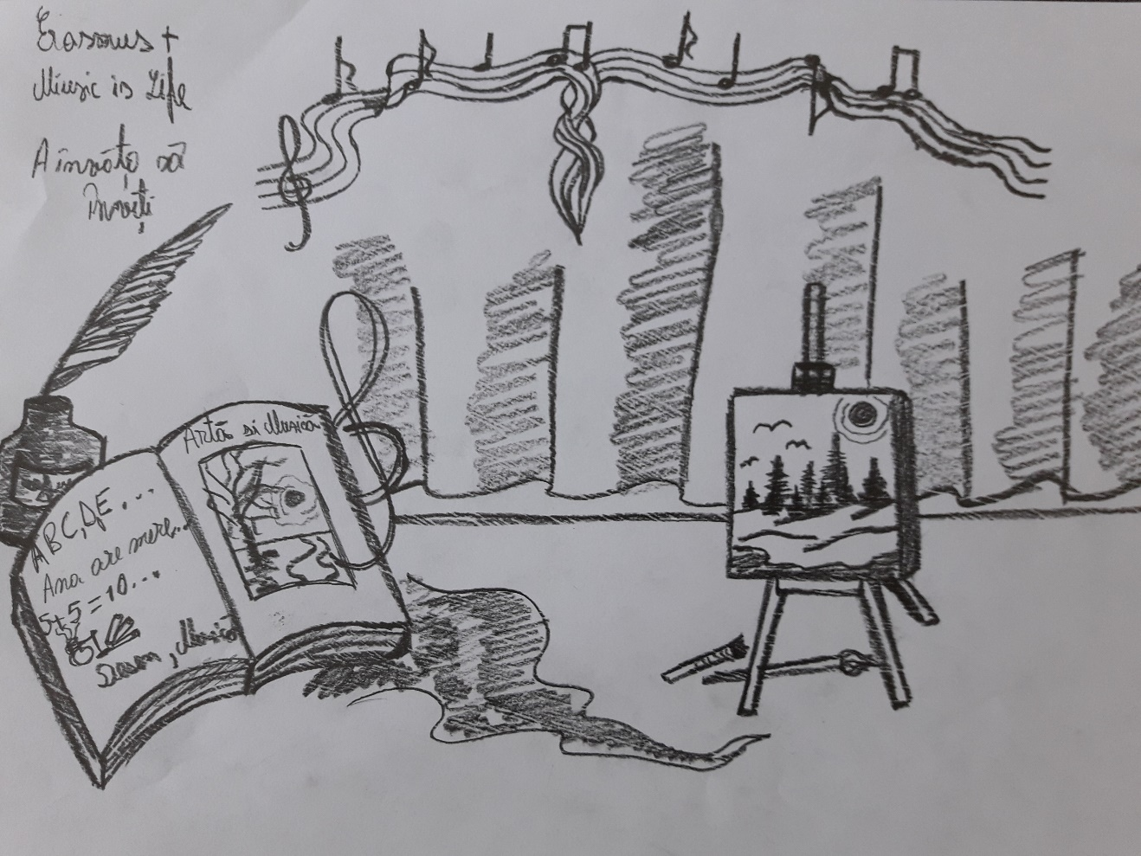
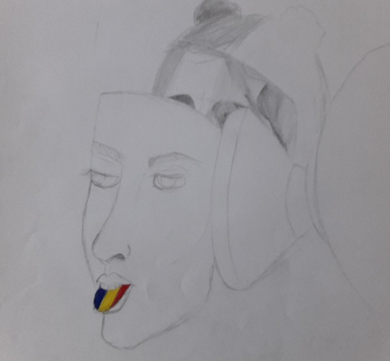
METHODOLOGY

Slide 20
ORGANISATION
RESOURCES
Musical instruments: piano, panpipe
Coloured paper, frameworks, posters
Cd player, laptop
Queen Marie of Romania – stories and articles
Lucian Boia’s writings about Queen Marie of Romania
Worksheet with a story by Queen Marie of Romania
Individual
Group work
Class interaction

Slide 21
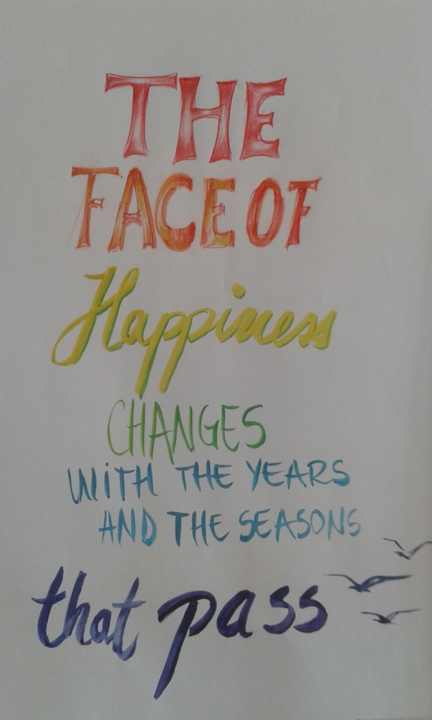
Pregatitoare

Slide 22
EVALUATION of competences
Observation of students
Representation of selected quotes by Queen Marie of Romania
Association of words/expressions with the created musical tunes
Creation of short musical pieces using words/expressions from the texts discussed
Analysis and interpretation of various thoughts of Queen Marie of Romania in musical settings
Exhibition of students’ art works

Slide 23
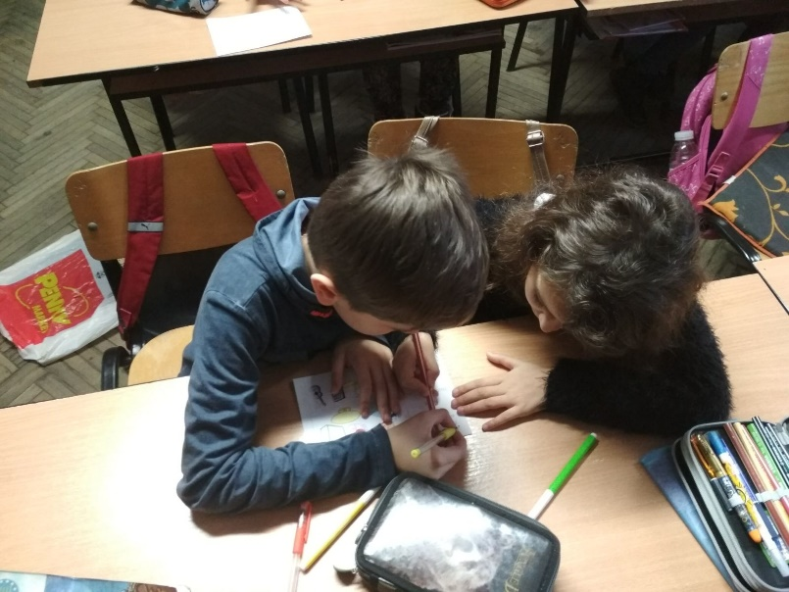
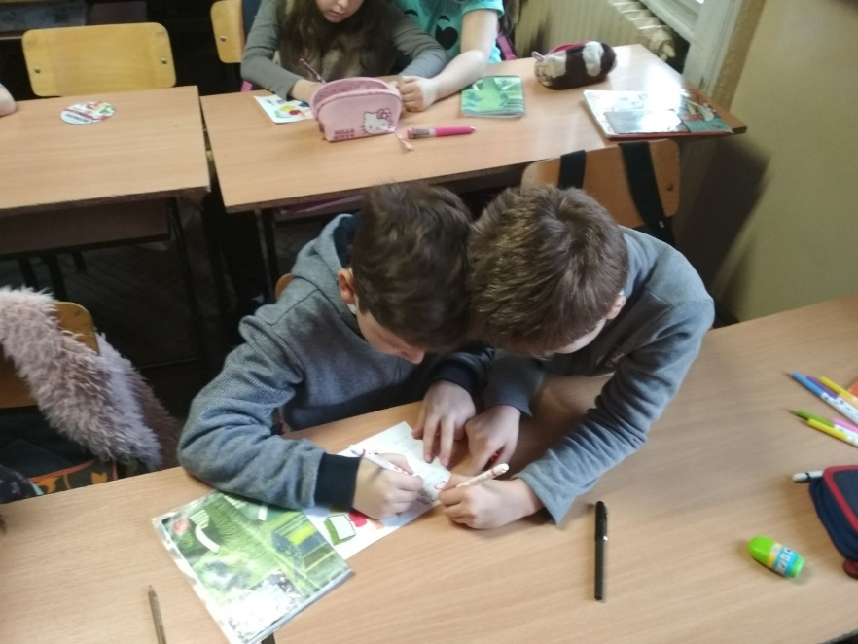
IMPACT

Slide 24
IMPACT EVALUATION

Slide 25
IMPACT EVALUATION

Slide 26
PRIMARY AND SECONDARY SCHOOL
Christmas Time… for each and every soul
PERIOD: 1-21 December 2017
Number of students: 49 (classes 3A, 5A, 6A, 7A, 8B)
SUBJECT: Christmas Plays/Carols, Christmas Wonders
ACTIVITIES: performing Christmas plays and carols, reading stories, drawing, singing

Slide 27
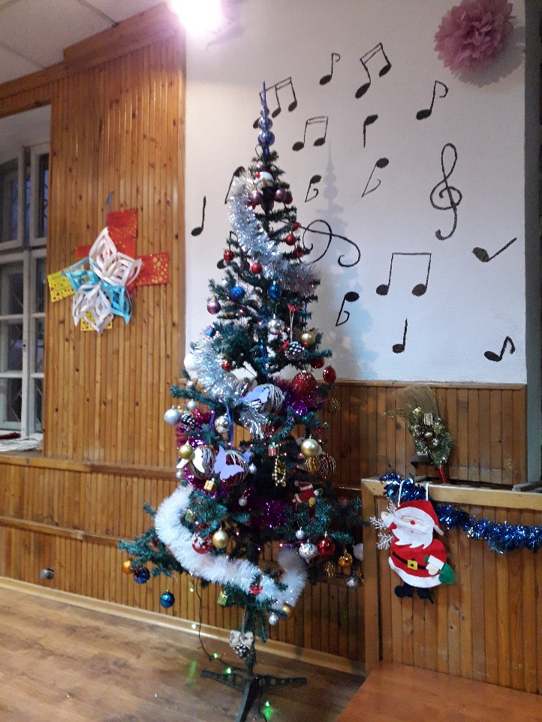
COMPETENCES
Encourage stage performance through playful and entertaining approaches to social situations
Promote linguistic and cultural specificity through interpretation of Christmas carols in various languages

Slide 28
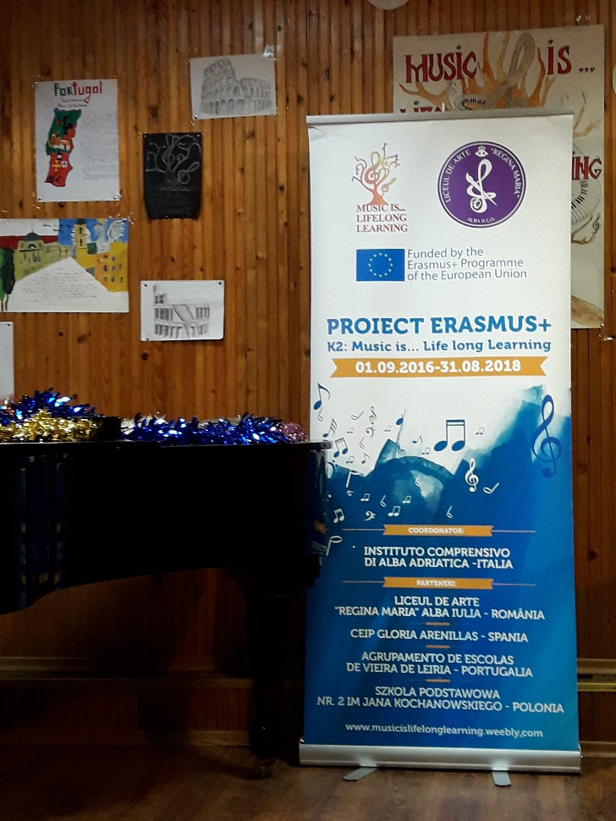
COMPETENCES

Slide 29
METHODOLOGY
Performing various stories/ plays on stage while collaborating in order to render it in an imaginative way
Combining musical pieces with the stories told
Interpretation of different carols in Romanian, English and French
Designing cards, drawings, paintings, collages having music in the background
Pantomime (3rd grade) – what’s the time?
Exhibition: students’ works presented within musical frames

Slide 30
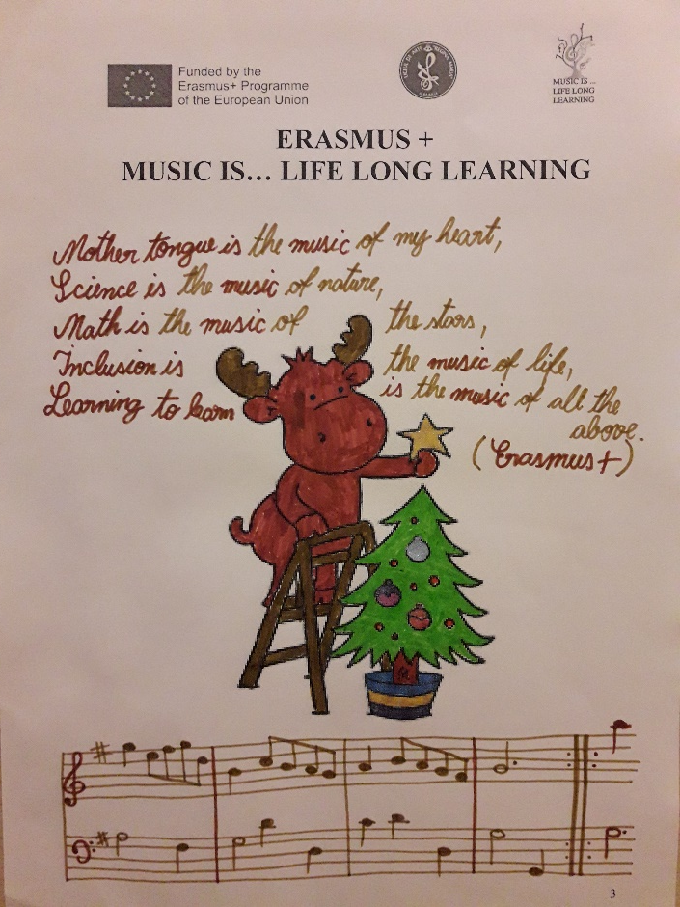
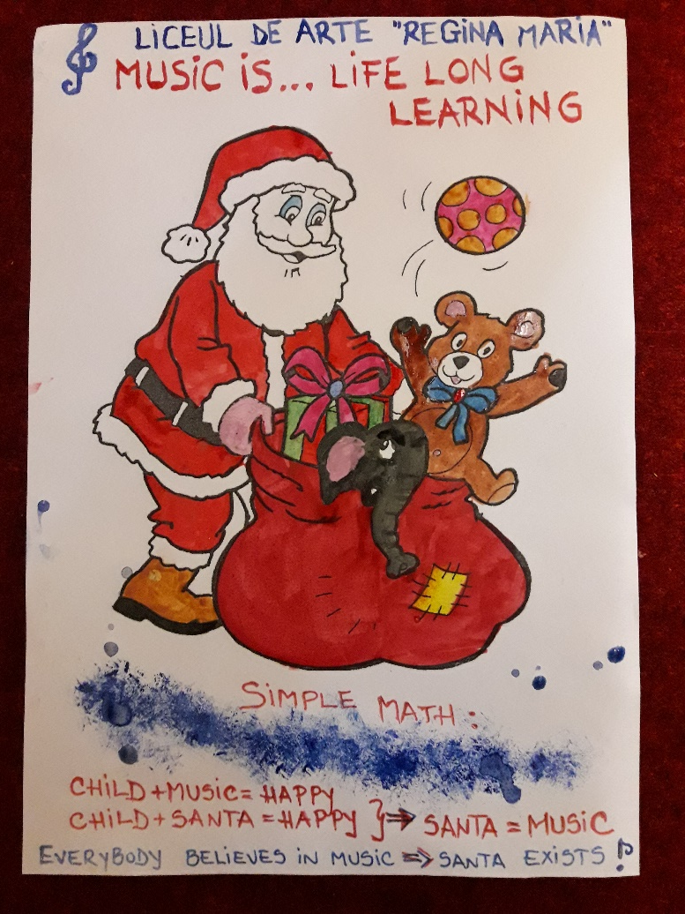
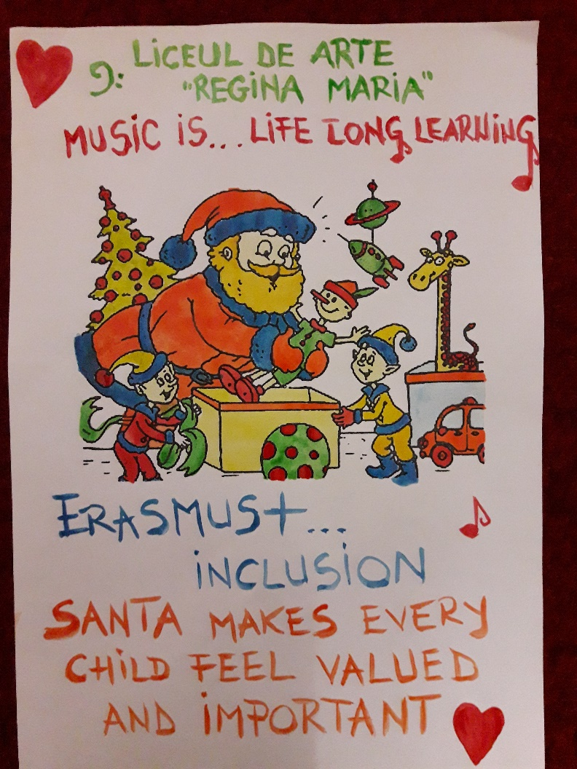
METHODOLOGY

Slide 31
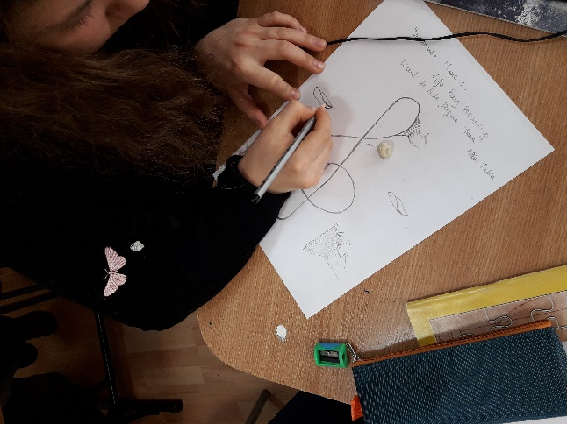
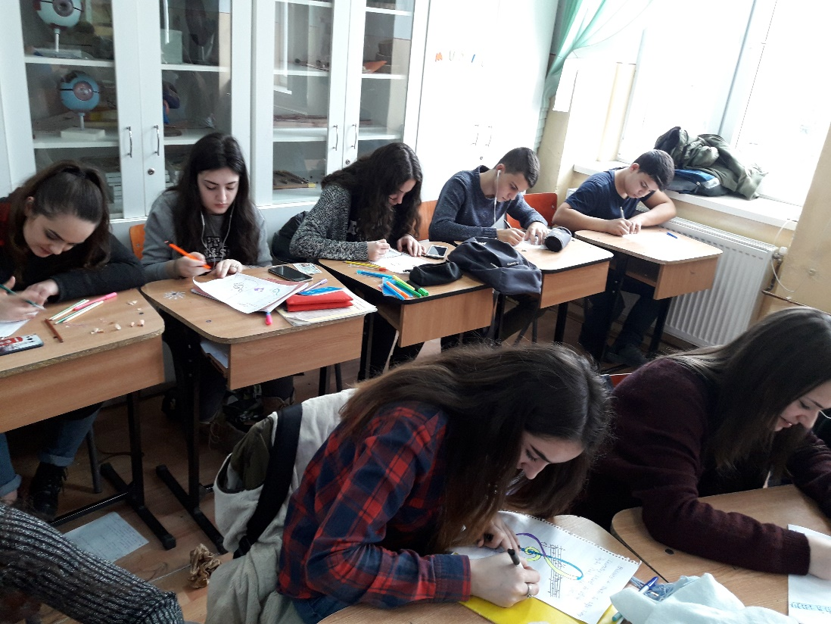
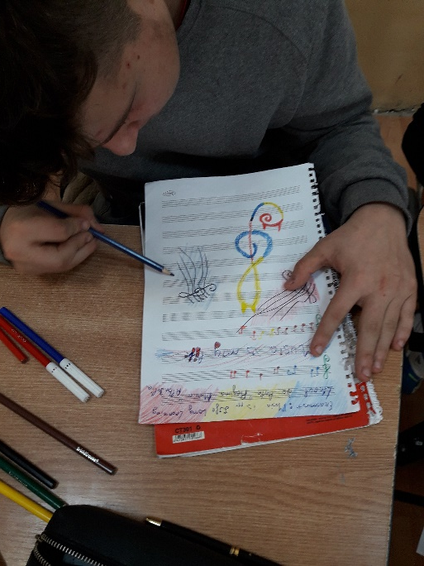
METHODOLOGY

Slide 32
ORGANISATION
RESOURCES
Musical instruments: piano, violin, cello
Coloured paper
Carols in different languages (English, French, Romanian) – traditional and modern
Christmas stories (about being grateful, about giving presents, and the value of generosity)
Christmas cards, posters, drawings, collage
Individual
Group work
Class interaction

Slide 33
METHODOLOGY
Dialogue
Mime
Carols

Slide 34
EVALUATION of competences
Observation of students
Representation of Christmas thoughts through painting, drawing, collage
Musical interpretation of traditional and modern Christmas carols
Performance of stories and plays on stage
Discussion of the messages contained by stories/ plays
Effect of pantomime on the audience
Exhibition of students’ art works

Slide 35
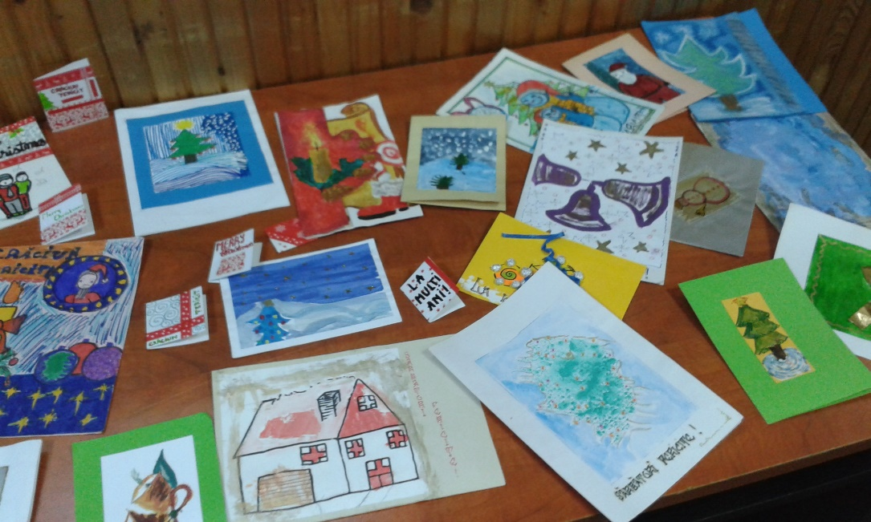
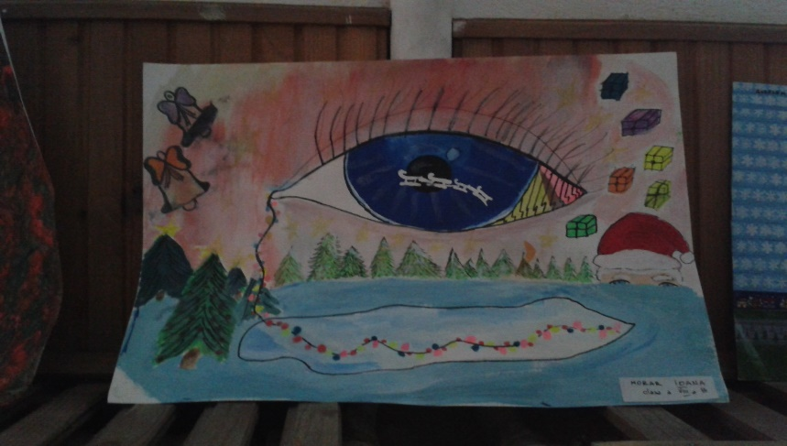

Slide 36
IMPACT EVALUATION

Slide 37
IMPACT EVALUATION

Slide 38
IMPACT EVALUATION

