Slide 1
Music is… Life Long Learning
INCLUSION THROUGH MUSIC 2
Talk to me, not about me…
Liceul de Arte “Regina Maria” Alba Iulia
Zabki, POLAND – 19th-23th March, 2018

Slide 2
SECONDARY SCHOOL (all grades)
Timeless Moments with I.L. Caragiale
PERIOD: January – February 2018
Number of students: 40 (classes 5A, 6A, 7A, 8B, 9A, 10A, 11A)
SUBJECT: Caragiale’s Views of the Romanian People
ACTIVITIES: performing plays by Caragiale, English contests, visual interpretations of Caragiale’s ideas, linking ideas, views through music

Slide 3
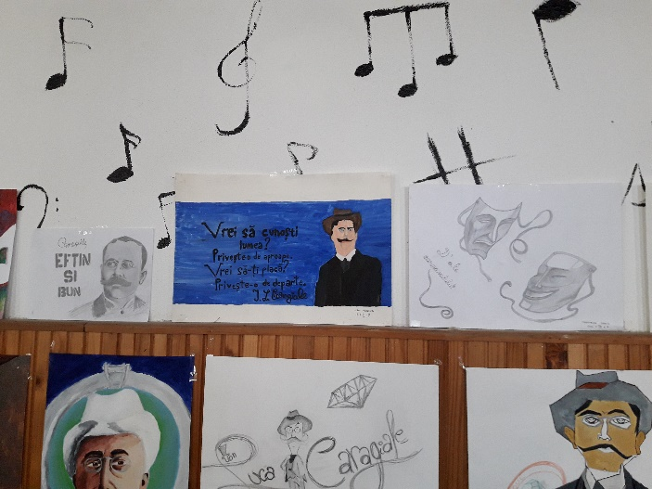
COMPETENCES
Perform (on stage) interactions based on Caragiale’s views of people and their lives
Establish connections between Caragiale’s world and the contemporary frameworks through music and visual arts

Slide 4
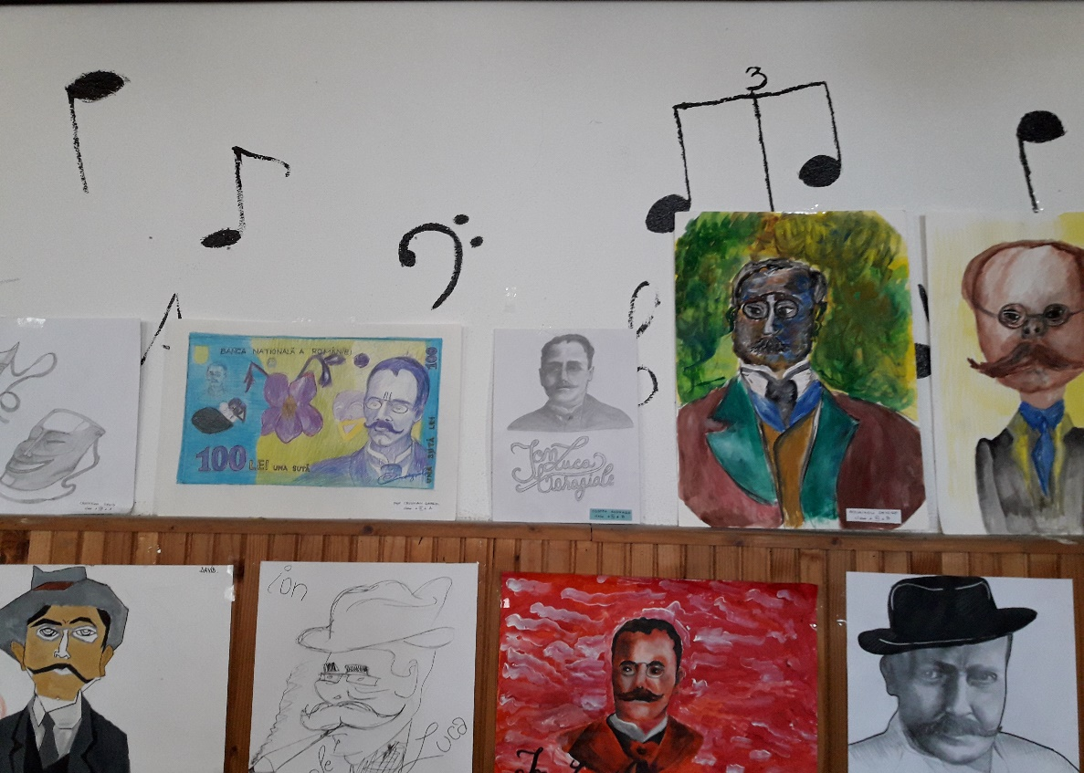
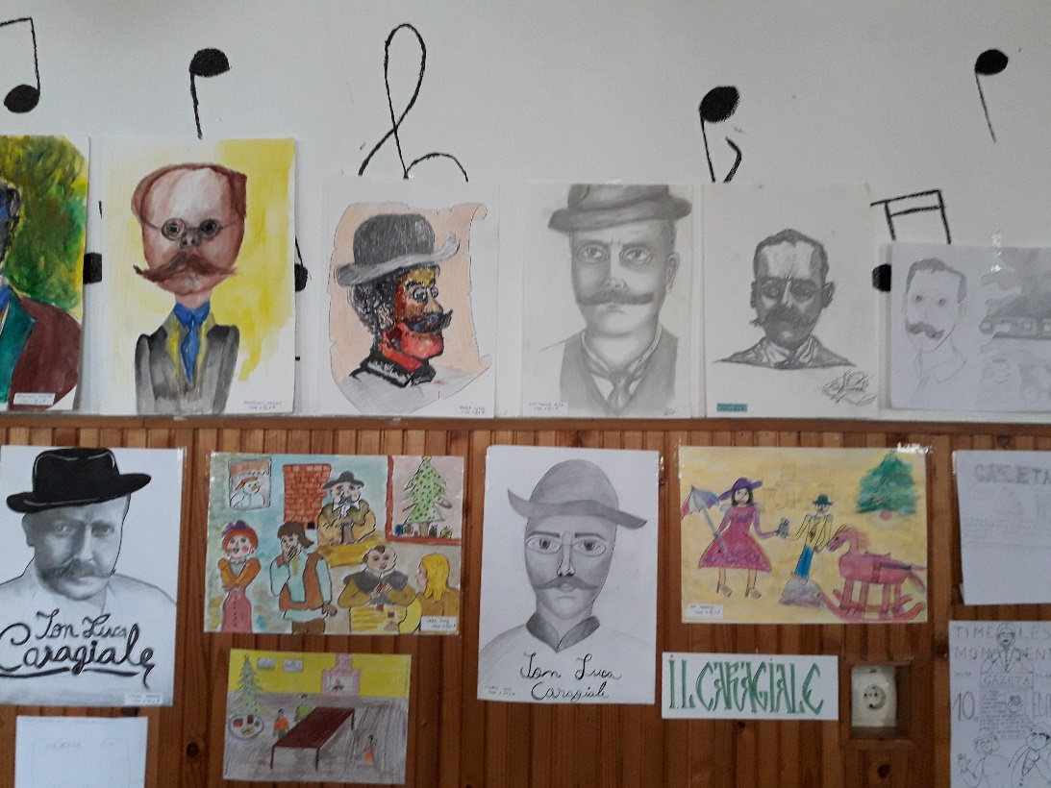
COMPETENCES

Slide 5
METHODOLOGY
(Re)discovery of the wonderful world created by the well known Romanian writer - I.L. Caragiale – through stage performance and creative interpretations of selected texts
Establishment of connections between Caragiale’s world and the contemporary society reflected in stage performance and in the visual interpretations
Participation in an English contest based on the plays performed on stage and the musical moments presented up to that point
Musical interpretations of Caragiale’s views through Romanian traditional songs and poems
Exhibition: students’ works presented within musical frames

Slide 6
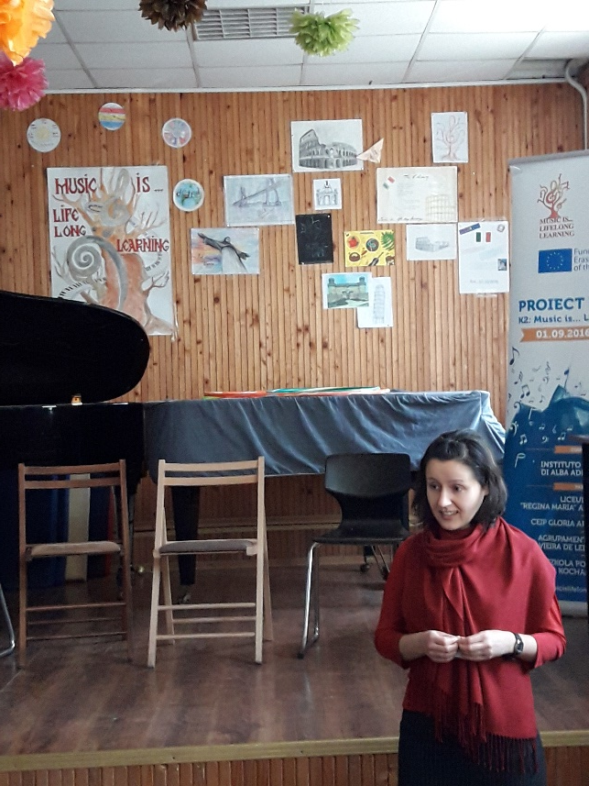
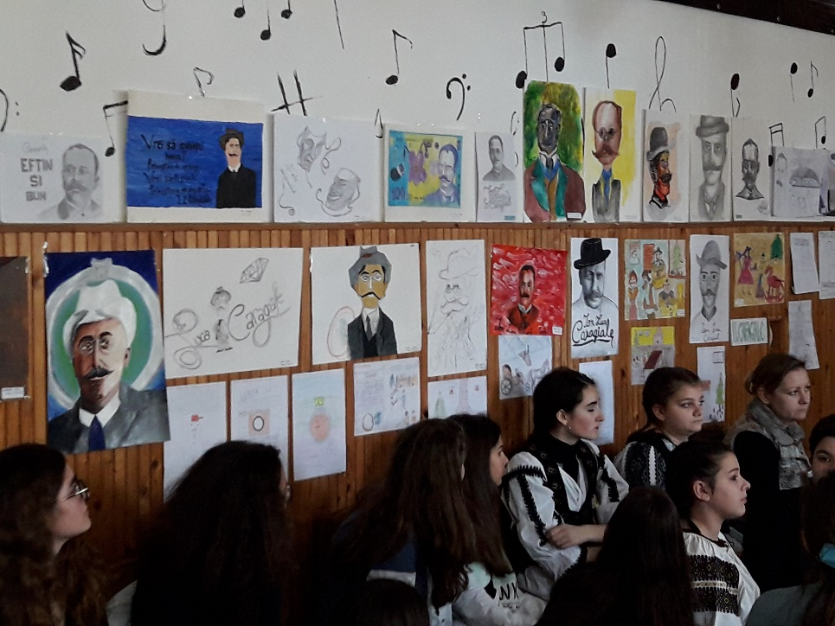
METHODOLOGY

Slide 7
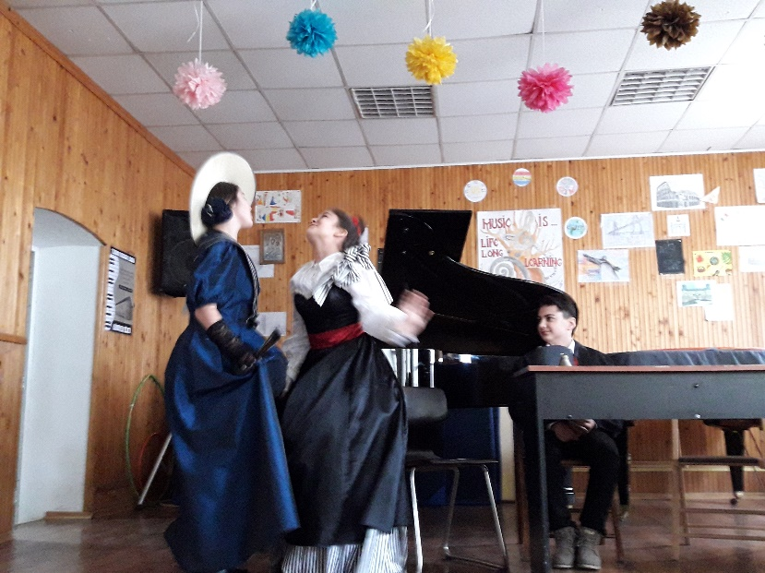
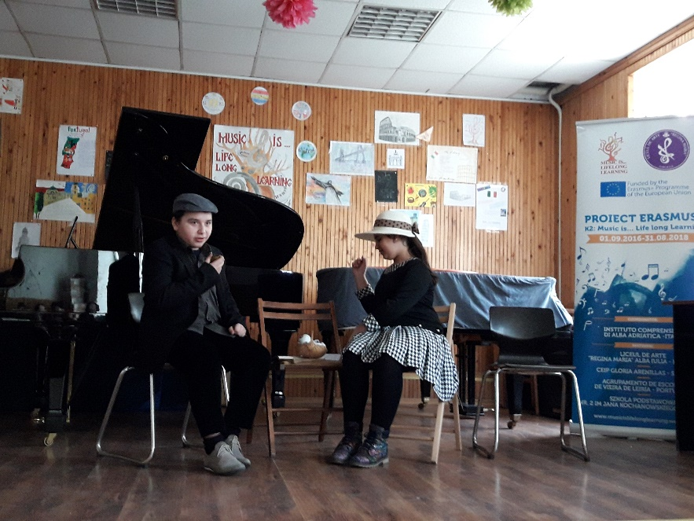
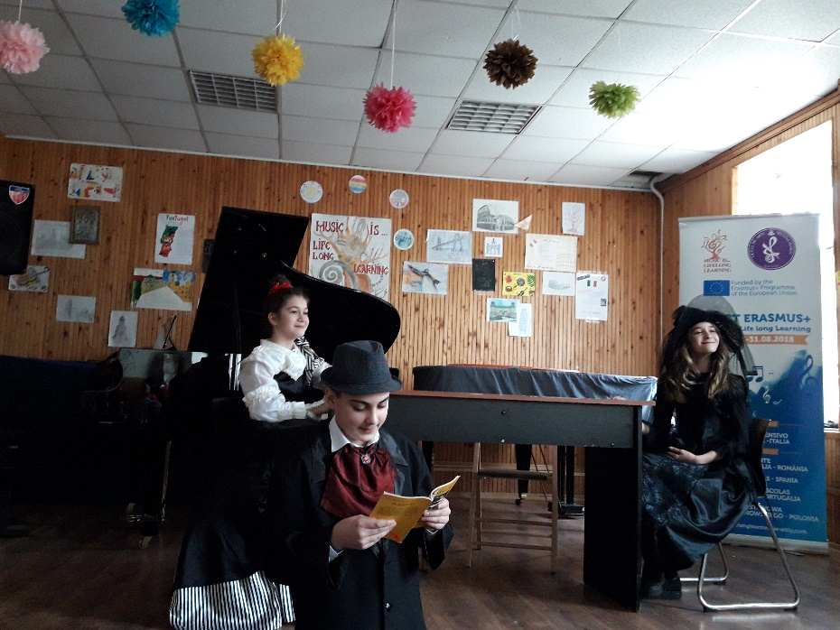
METHODOLOGY

Slide 8
ORGANISATION
RESOURCES
Different writings belonging to Caragiale
Critical views of Caragiale’s presentation of the Romanian habits, speech, behaviour
Musical instruments: piano, violin, cello
Posters, drawings, paintings, portraits
Traditional and classical musical pieces linked to Caragiale’s world
Individual
Pair work
Group work

Slide 9
EVALUATION of competences
Visual representation of Caragiale’s perspective of Romanian people in certain contexts through drawing, painting, portraits
Theatrical performance of different fragments/ plays by Caragiale
Traditional and classic musical pieces linked to Caragiale’s views of the world
Score obtained in the English contest based on the previous moments presented
Audience’s reaction to stage performance (theatrical, musical)
Exhibition of students’ art works

Slide 10
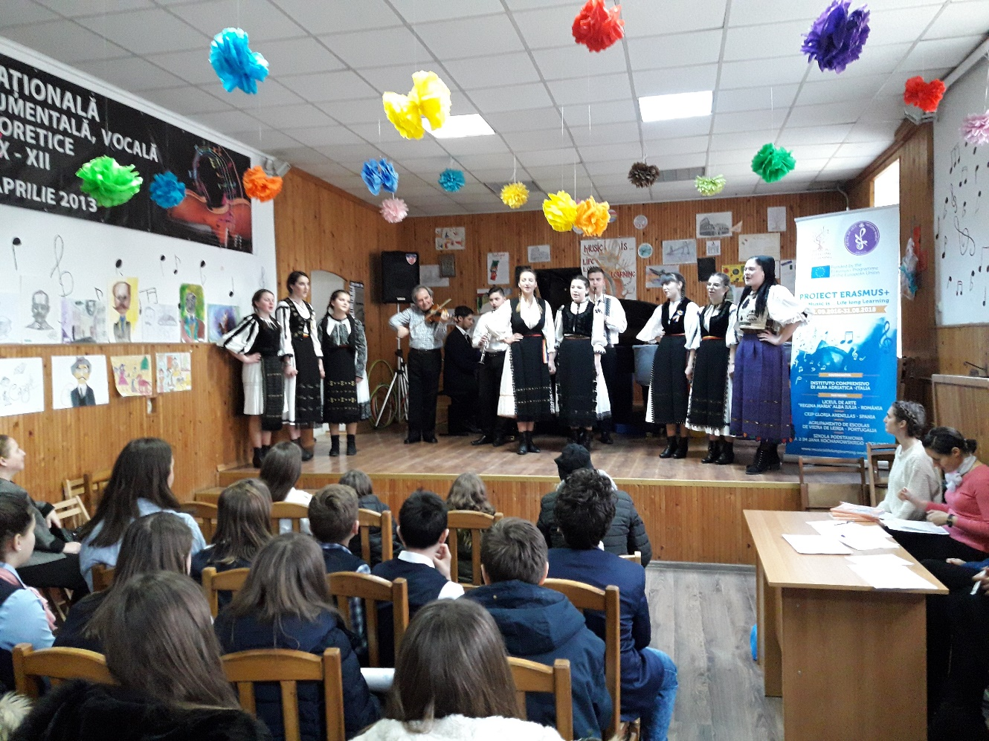
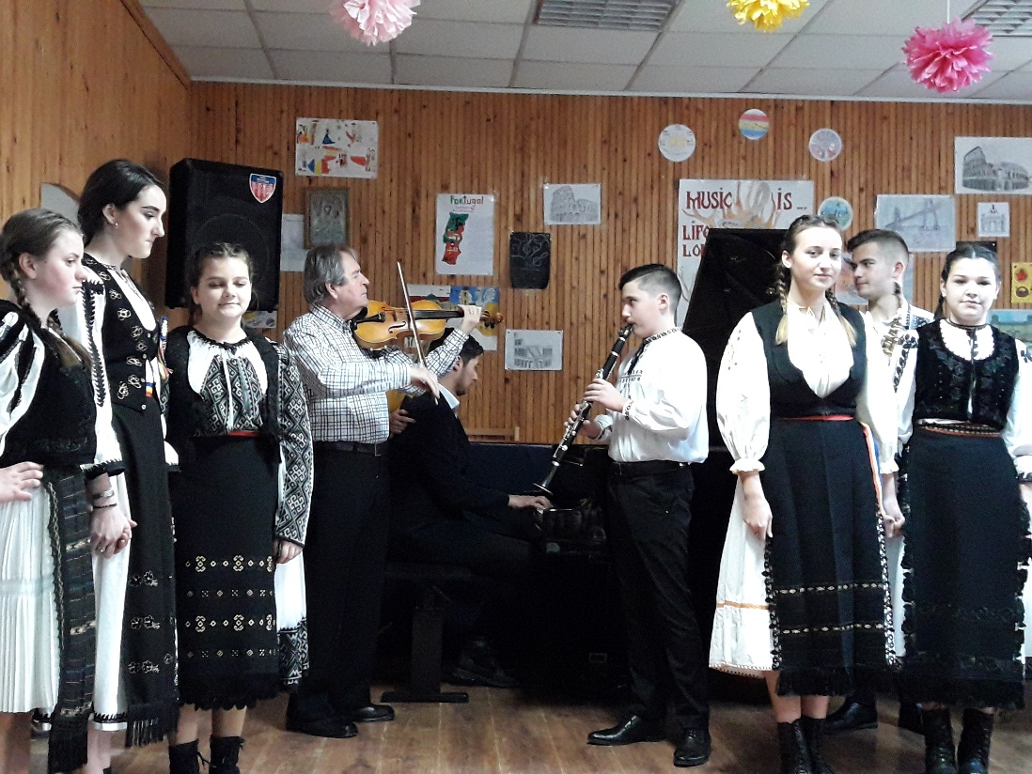

Slide 11
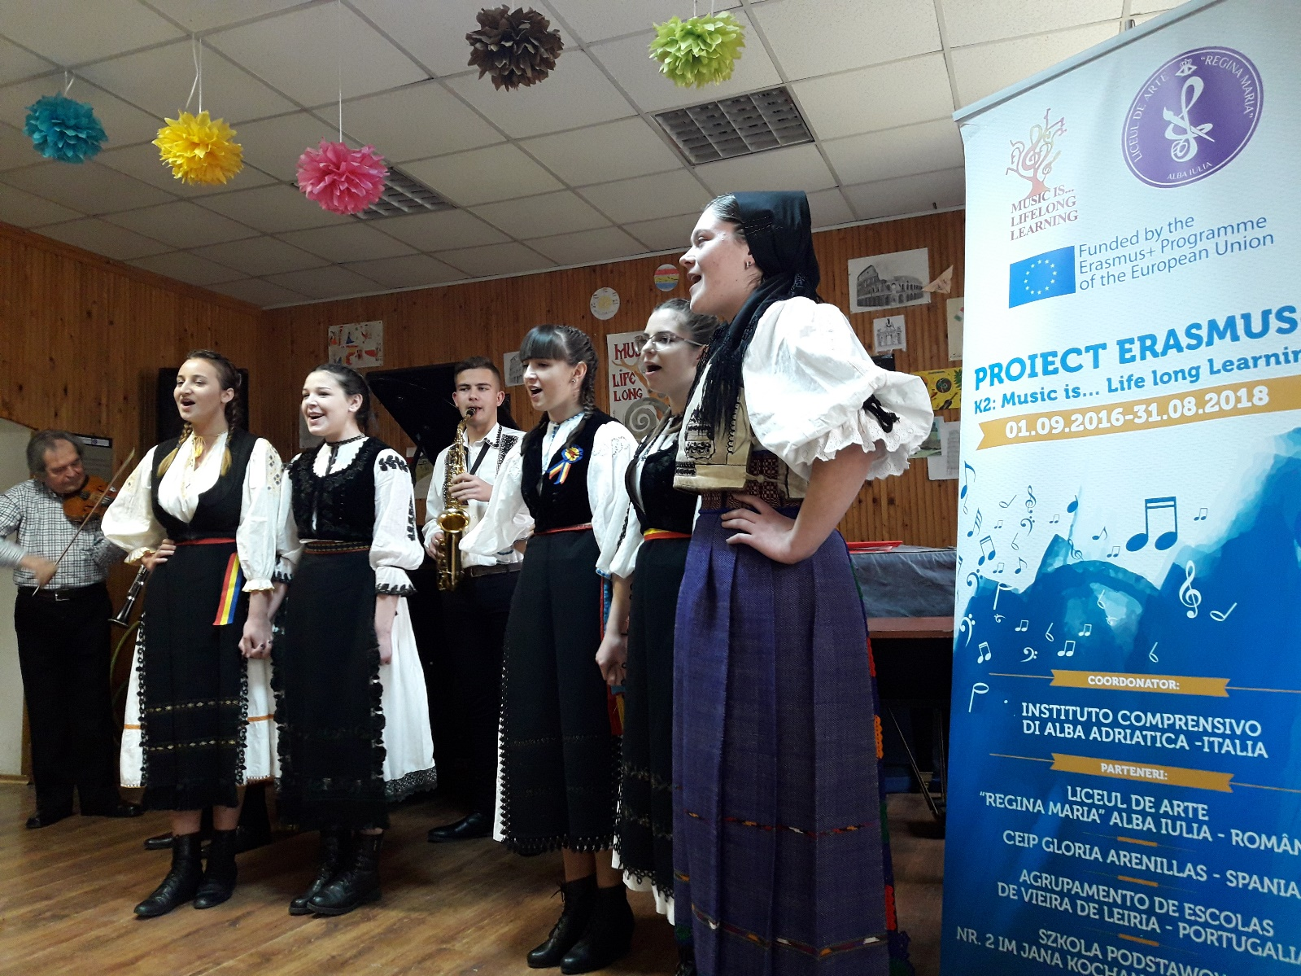

Slide 12
IMPACT EVALUATION

Slide 13
IMPACT EVALUATION

Slide 14
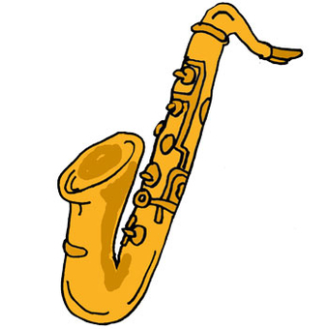
PRIMARY SCHOOL: 3rd grade
Theatre for Children. I want to play on stage
PERIOD: February 2018
Number of students: 29 (class 3A) + 8 (Inclusion Centre from Alba Iulia)
SUBJECT: learning by playing roles
LESSONS: learning to communicate and collaborate by interpreting roles on stage, singing and miming, playing games in English

Slide 15
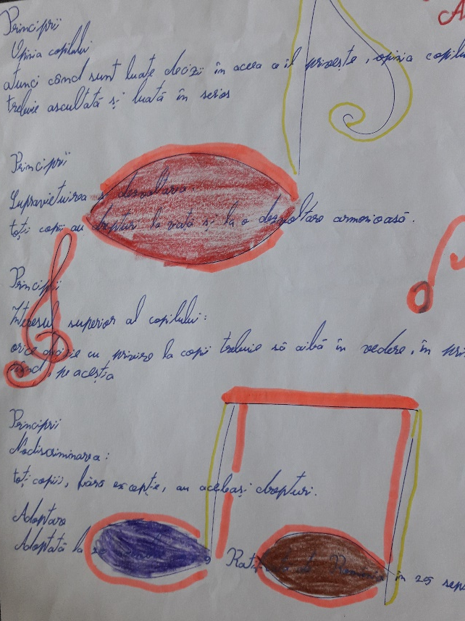
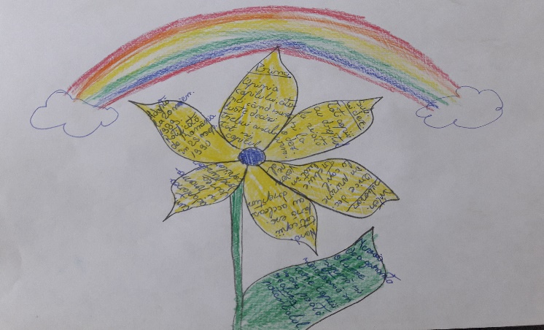
COMPETENCES
Work in groups in order to promote collaboration and self-confidence
Take initiative and show spontaneity in communication through musical performance

Slide 16
METHODOLOGY
Performance on stage of different plays – pupils identifying themselves with the characters they interpret
Involvement of parents in creating the costumes for the characters and the scenery
Combination of songs and movement in expressing the joy of working together
Collaboration in finding the most expressive mime or non-verbal communication to be used in the plays
Playing English games using specific dice, puppets, pictures
Switching roles (actors, spectators) according to the activity

Slide 17
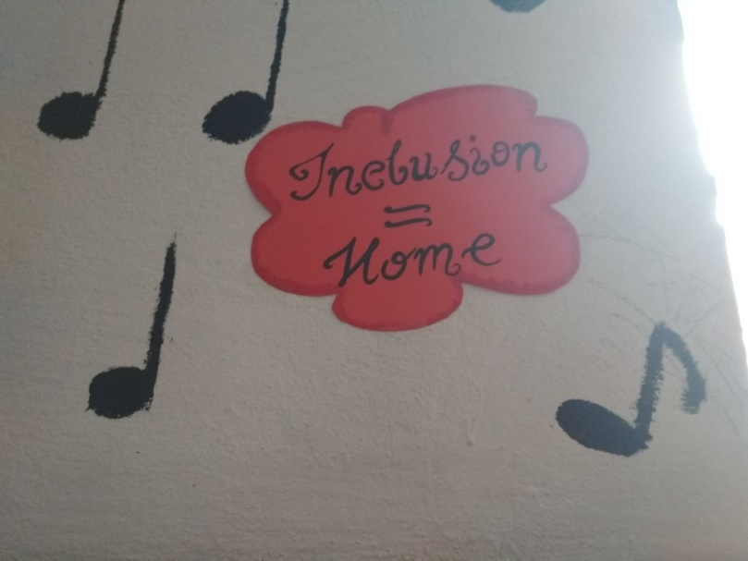
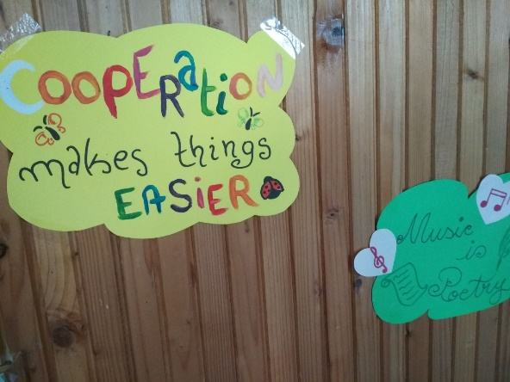
METHODOLOGY

Slide 18
ORGANISATION
RESOURCES
Pair work
Group work
Class interaction
Theatrical Play ( Math Class in the forest)
Musical instruments: piano, violin
Dice with different prepositions of place
Puppets, toy animals (fox, frog, puppy, rabbit etc.)
Songs involving circle movement and pair steps (in Romanian and English)
Pictures with toys placed in different parts of a room

Slide 19
EVALUATION of competences
Observation of pupils’ involvement in the activities
Interpretation of the theatrical play
Analysis of pupils’ role play, mime, song interpretation
Participation in the English games and songs according to the level of pair/ group cooperation
Creativity shown in play and song interpretation
Presentation of pupils’ handouts
Film Anca 2-3 min

Slide 20
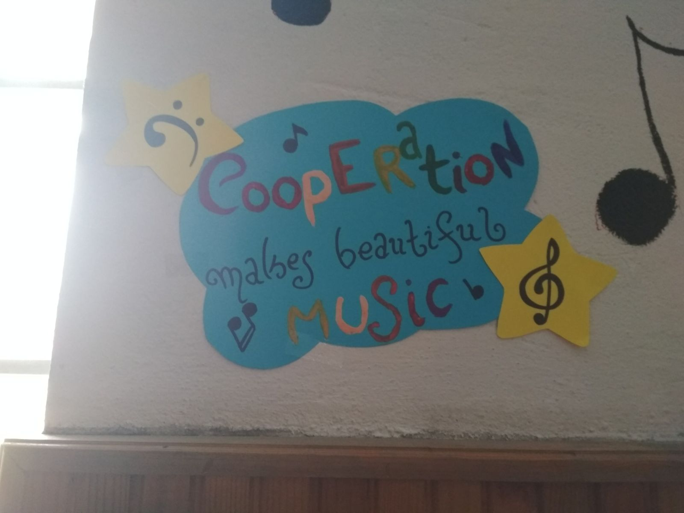
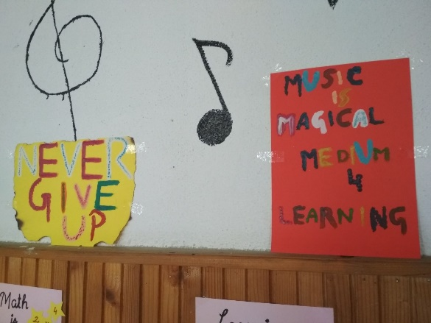
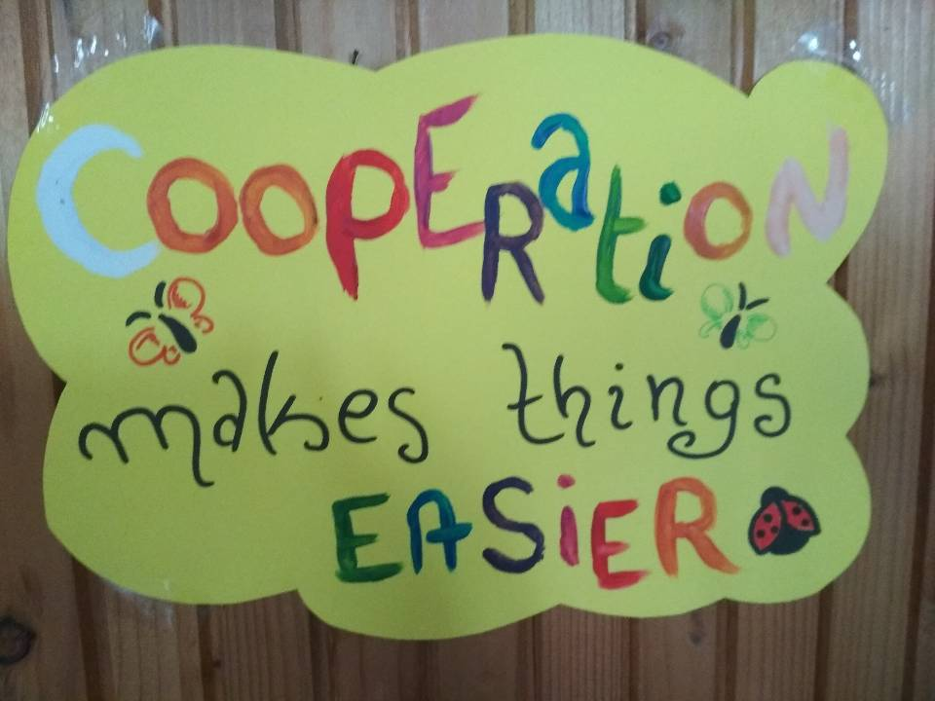
What do we evaluate…

Slide 21
IMPACT EVALUATION

Slide 22
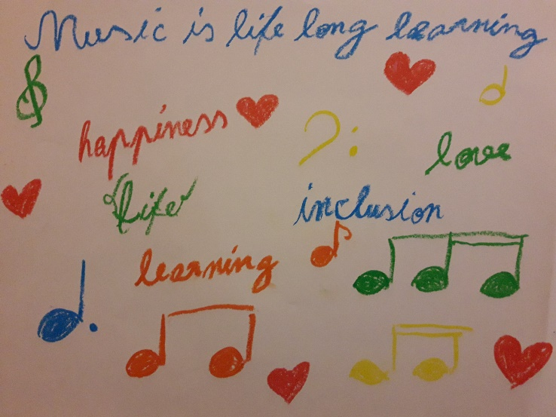
IMPACT EVALUATION

Slide 23
SECONDARY: 5th-6th grade
Traditions. Music. Movement
PERIOD: February 2018
Number of students: 3 (class 10A) + 14 (from Inclusion Centre of Alba Iulia)
SUBJECT: Romanian traditions and music
ACTIVITIES: learning about Romanian traditional costumes and folkloric music, about the parts of musical instruments, listening to grandma’s poem about the Romanian village, performing various steps on music

Slide 24
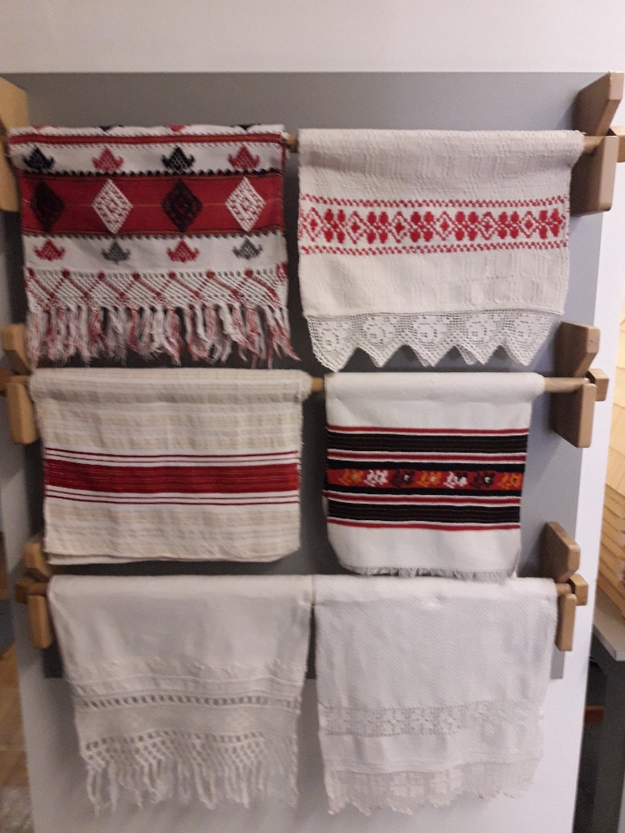
COMPETENCES
Encourage interaction on the topic of musical instruments and traditional Romanian songs/ costumes / values
Increase participation in musical activities through pre-taught steps

Slide 25
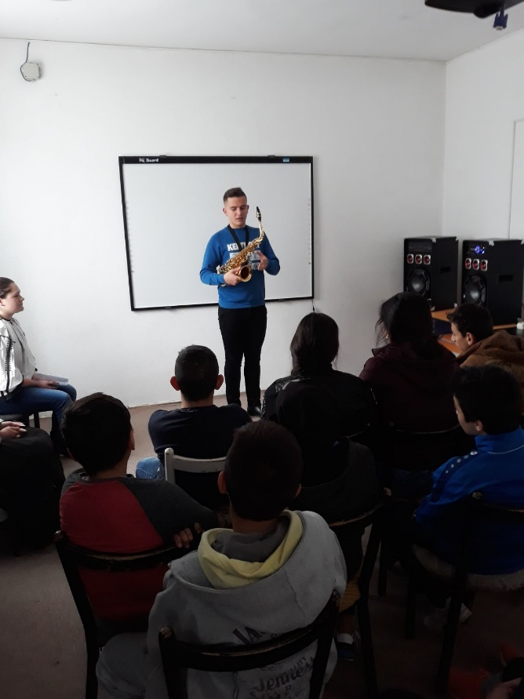
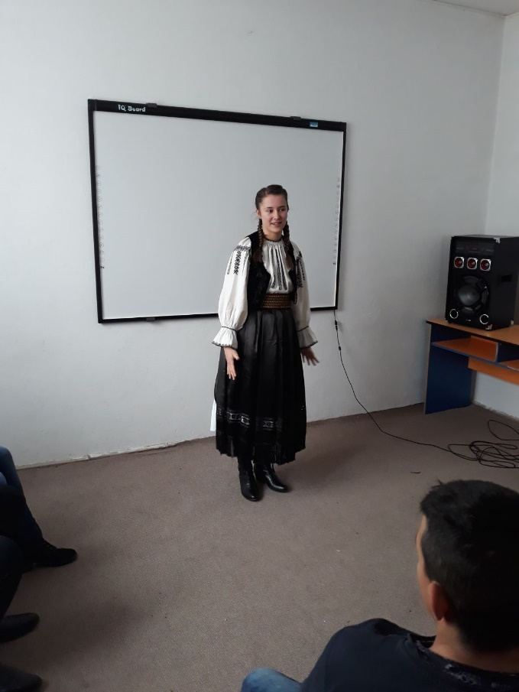
COMPETENCES: Music… gives courage and knowledge

Slide 26
METHODOLOGY
Presentation of musical instruments (the saxophone in particular) by students from “Regina Maria” Arts High School (parts, types of music to play – jazz, traditional Romanian music)
Discussion of different aspects regarding the saxophone
Presentation of Romanian traditional costume from Transylvanian region followed by questions and discussions
Performance of several Romanian traditional songs (accompanied by the saxophone) and a poem about the traditional village– guests and hosts’ involvement
Performance of dance steps, running, jumps, stretching exercises according to the pieces of music played

Slide 27
ORGANISATION
RESOURCES
Traditional Romanian costume
Musical instrument: saxophone
Various modern songs played on laptop
Poem about the traditional village
Traditional Romanian songs from the Romanian folklore
Dance steps and various sport exercises
Group work
Class interaction

Slide 28
EVALUATION of competences
Observation of pupils’ involvement in the activities
Discussion about the traditional Romanian costume, the poem about the traditional village, the traditional songs from the Romanian folklore
Analysis of pupils’ way of carrying out the dance steps and the sport exercises according to the music played
Degree of cooperation throughout the activity
Willingness to sing together (guests and hosts)

Slide 29
IMPACT EVALUATION

Slide 30
IMPACT EVALUATION

Slide 31
7th-9th grade
Music is … telling stories over centuries
PERIOD: February 2018
Number of students: 33 (classes 7A, 9A)
SUBJECT: ways of writing history through music
ACTIVITIES: listening to songs from different periods of time, analysing the lyrics in specific contexts, linking musical messages over time

Slide 32
COMPETENCES
(Re)discover the beauty and wonder of music by analyzing the story it tells
Raise awareness regarding the role played by music in people’s lives regardless of their education or social status

Slide 33
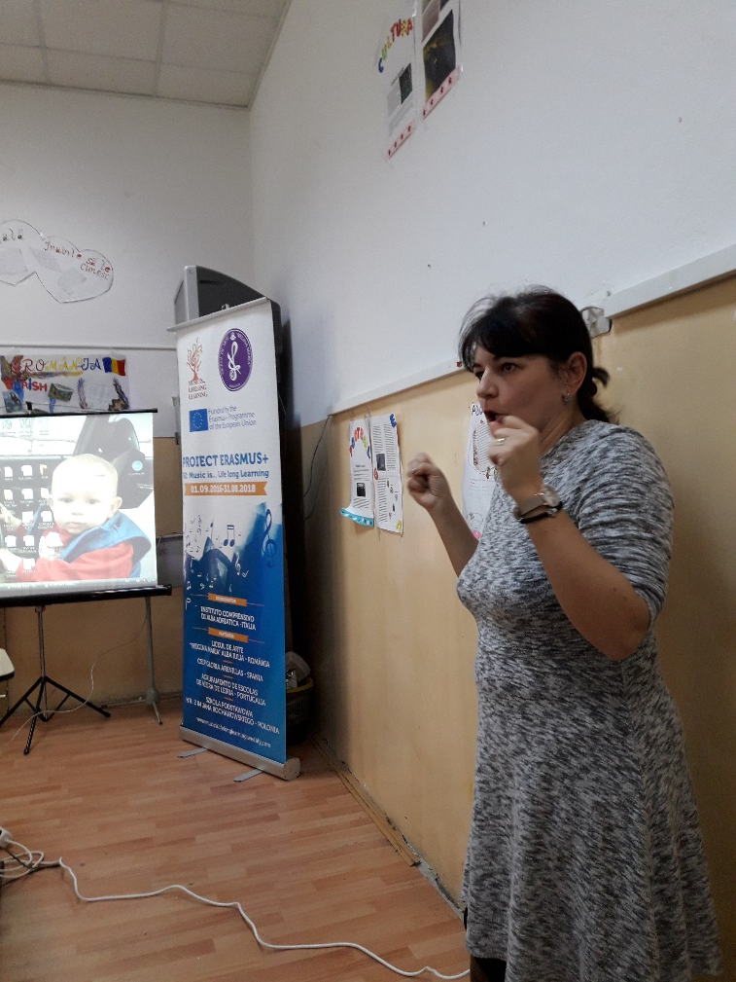
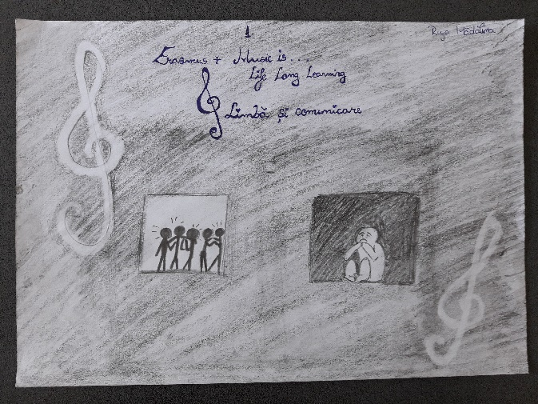
COMPETENCES

Slide 34
METHODOLOGY
Discussion regarding the role of music (more than a melodic line, music tells a story)
Finding links between three 20th century personalities – Lady Diana, Marilyn Monroe and Sir Elton John
Finding parallels between Lady Diana’s and Marilyn Monroe’s lives and realizing the key role played by music in shaping their life stories
Listening to and analyzing Candle in the Wind, by Elton John in order to help students realize that music may write history by remaining in people’s collective memory

Slide 35
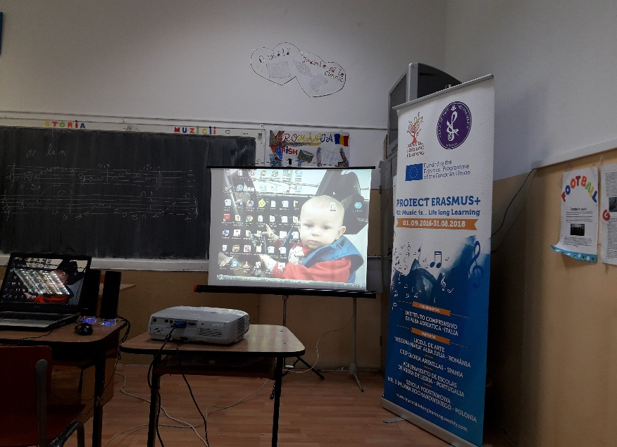
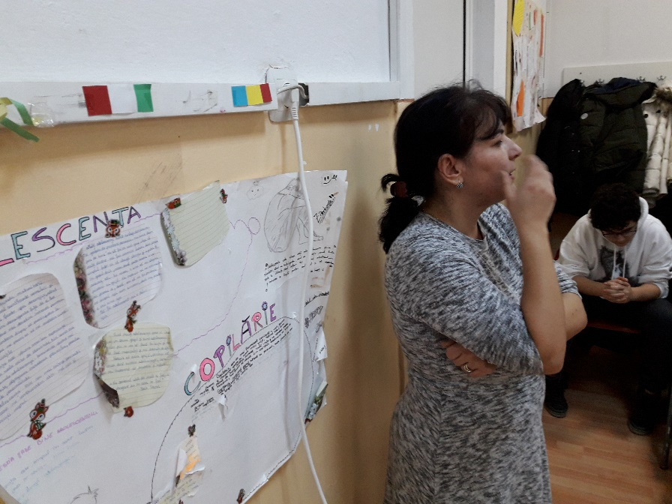
METHODOLOGY

Slide 36
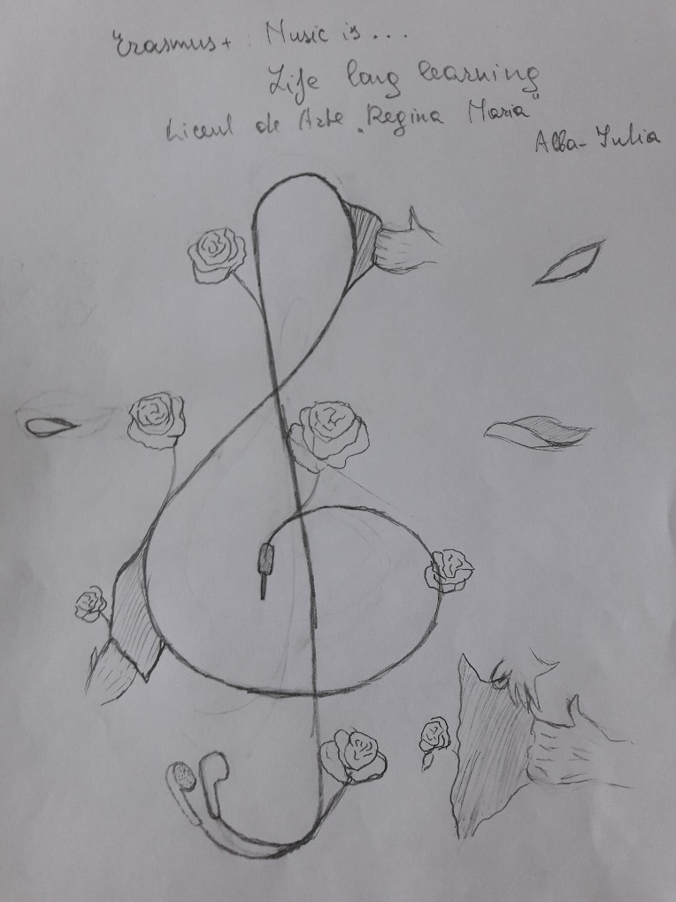
ORGANISATION
RESOURCES
Biography of Lady Diana
Texts presenting the lives of Lady Diana, Marilyn Monroe
Song: Candle in the Wind, by Elton John
Laptop, loudspeakers
Group work
Class interaction

Slide 37
EVALUATION of competences
Observation of pupils’ involvement in the activities
Discussion about the lives of the personalities chosen
The parallels found between the life stories of Lady Diana and Marilyn Monroe
Analysis of the role played by music in shaping history
Reflection on the stories told by music over centuries

Slide 38
IMPACT EVALUATION

Slide 39
IMPACT EVALUATION

Slide 40
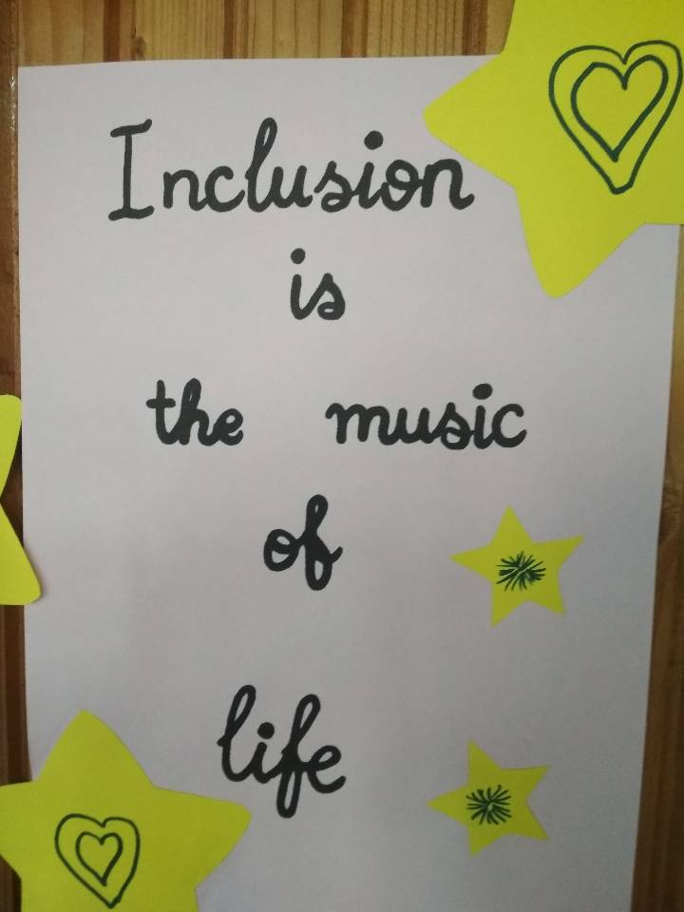
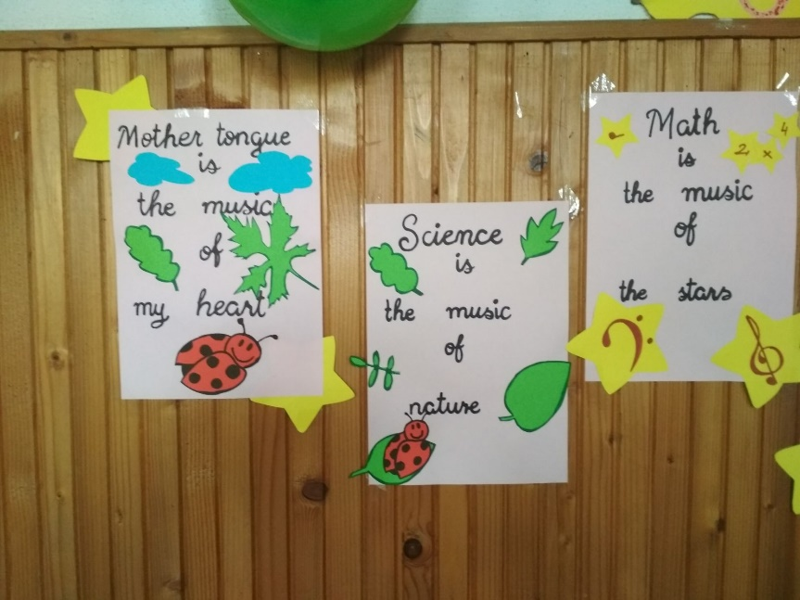
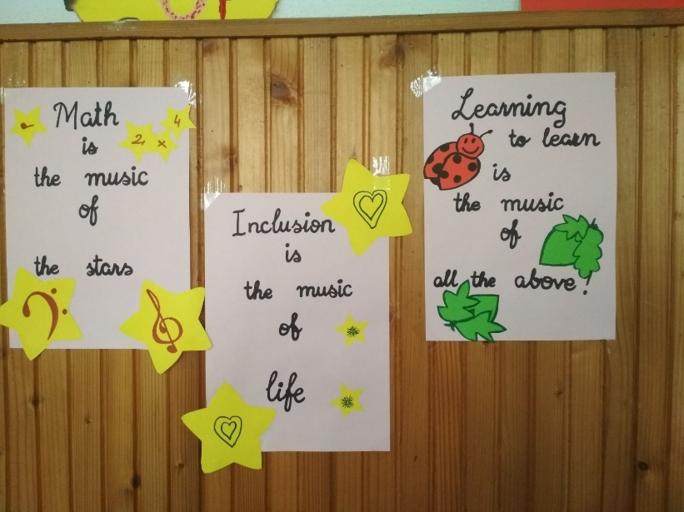
IMPACT

Slide 41
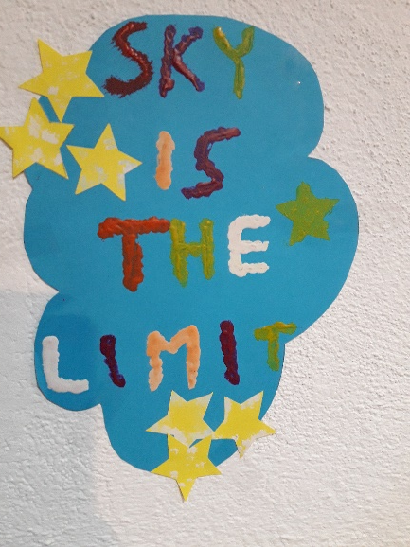
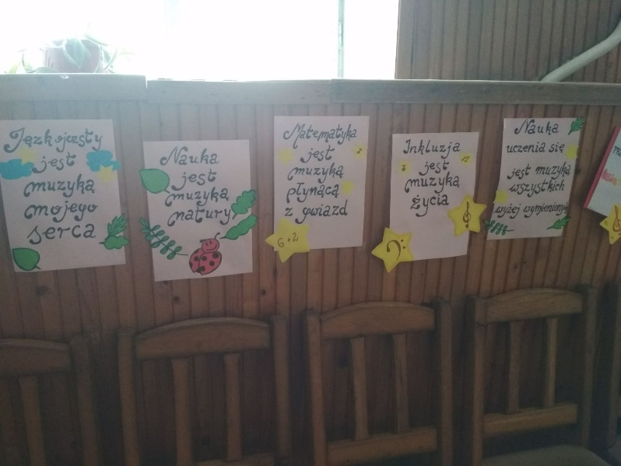
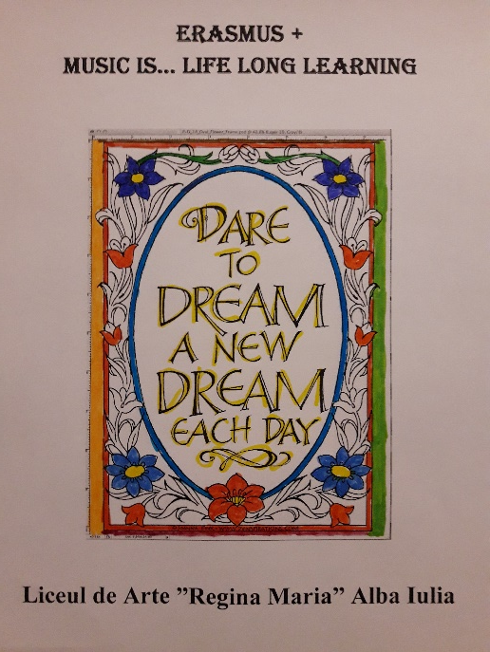
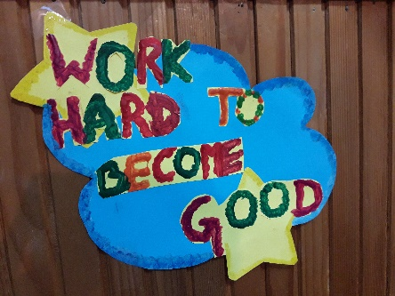
IMPACT
I talk to you… not about you.

