Slide 1
Music is… Life Long Learning
LEARNING TO LEAN THROUGH MUSIC 1
Liceul de Arte “Regina Maria” Alba Iulia
ITALY – 28th MAY - 1st JUNE, 2018

Slide 2
LEARNING TO LEAN THROUGH MUSIC
Was a joint effort of the entire school to create and apply activities with music. Students from primary, secondary and highschool took part in Erasmus+ and learned to learn…
Highschool students from architecture and fine arts created drawings according to their vision regarding the activities taking place at a particular period and space within the school…
Enjoy!
Film: Tanti Rita

Slide 3
PRIMARY – Preparatory grade
March Celebrations
PERIOD: 1st-10th March 2018
Number of students: 25
Number of parents: 25
SUBJECT: celebration of the arrival of spring and mother’s day
ACTIVITIES: creating special cards for mother’s day, handicrafts in musical settings, performing various songs

Slide 4
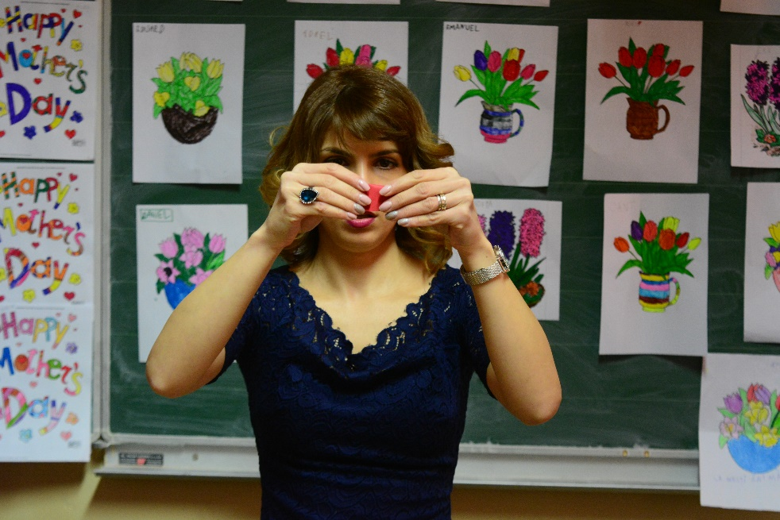
COMPETENCES
Improving practical skills while working with different materials and applying accessible techniques in musical settings
Performing various songs and poems according to the chosen theme

Slide 5
METHODOLOGY
Film: Dream of You
Presentation of different materials to be used in creating special cards for mother’s day
Card design is carried out by pupil and mother together
Listening to background music (piano, violin, quitar) while working at the card
Having students from high school as guests who perform various songs using different musical instruments
Song and poetry performance on selected themes

Slide 6
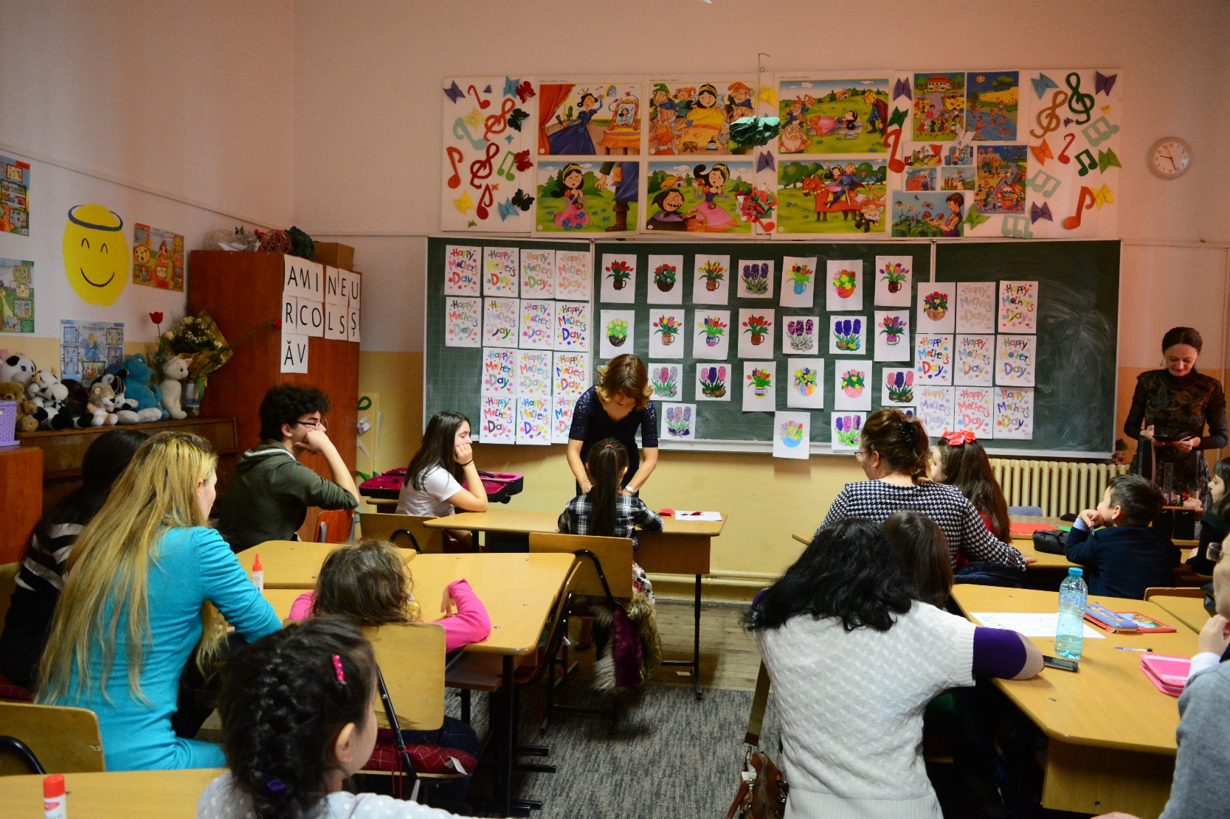

Slide 7
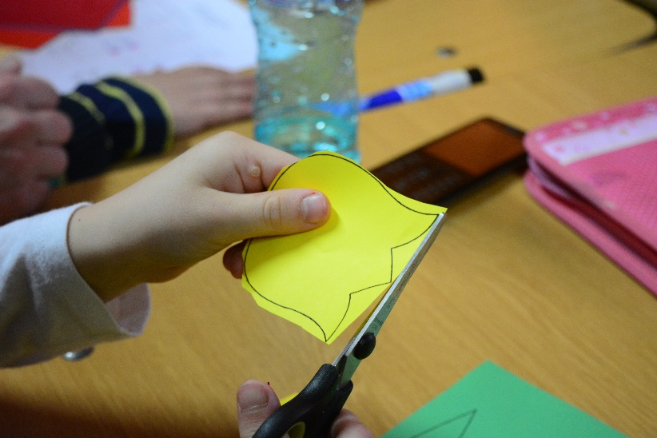
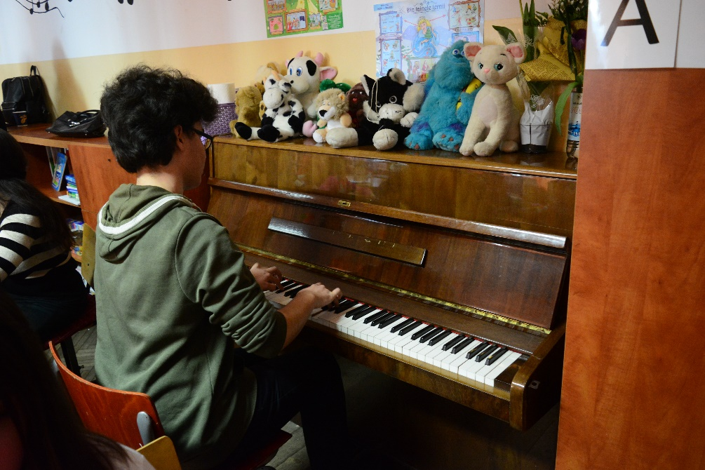
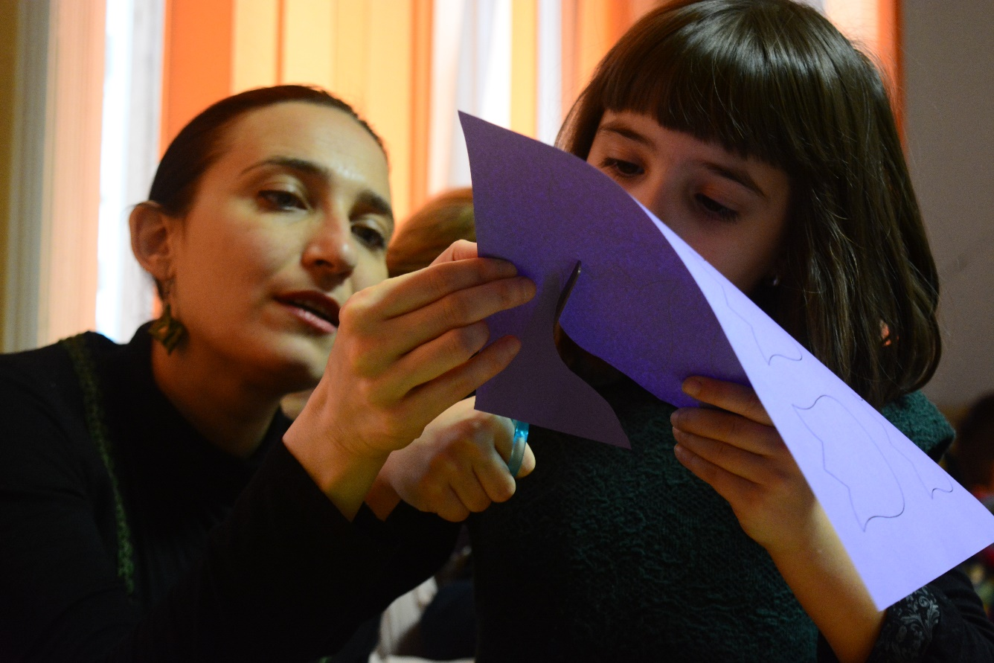

Slide 8
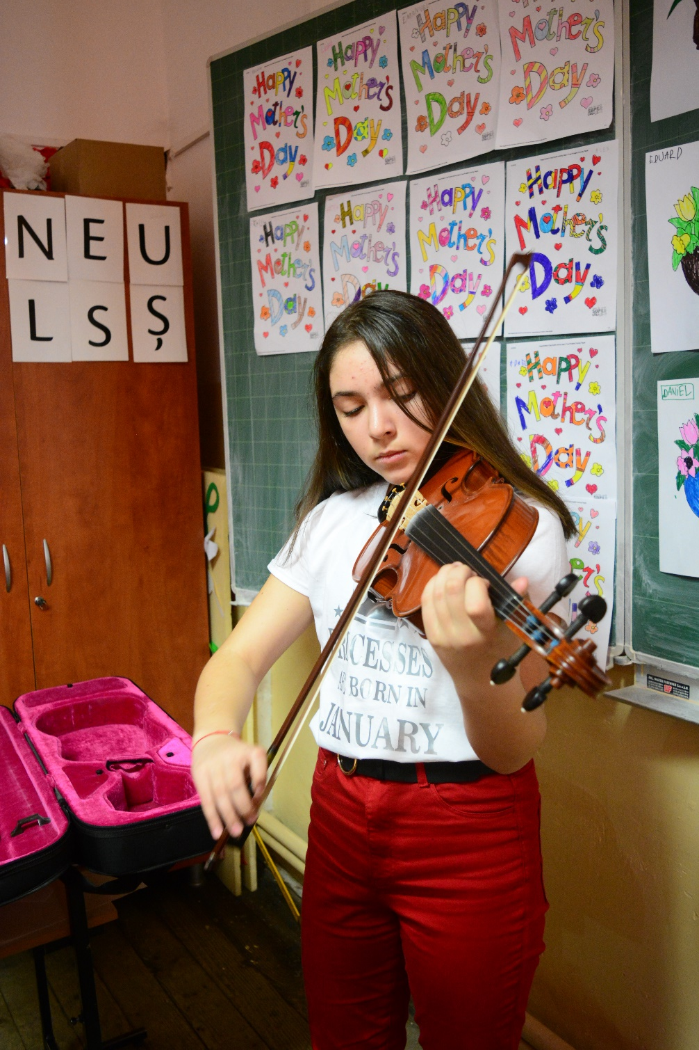
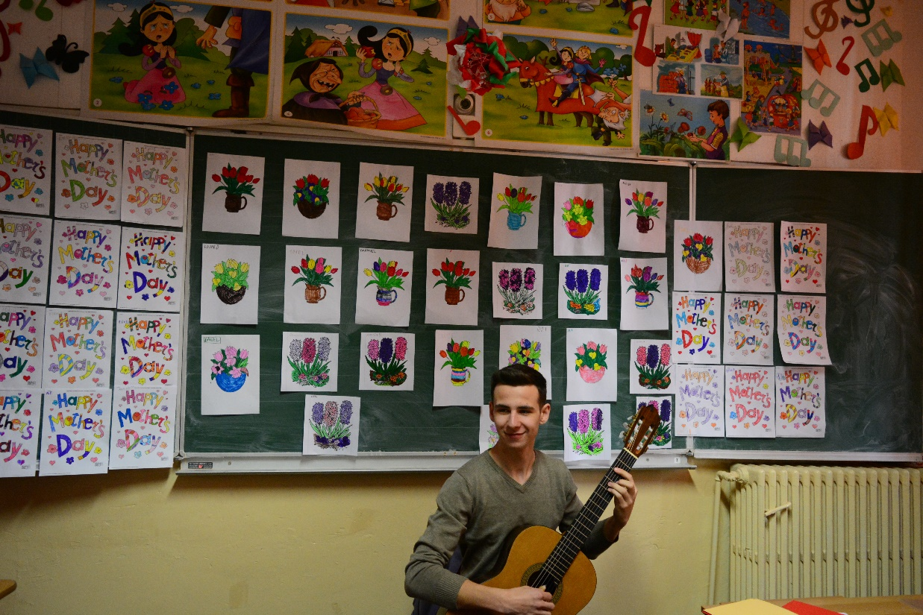
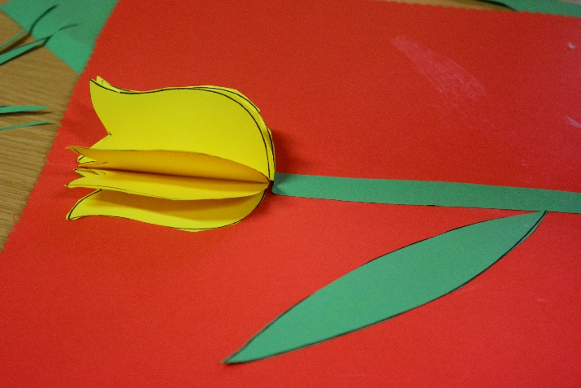

Slide 9
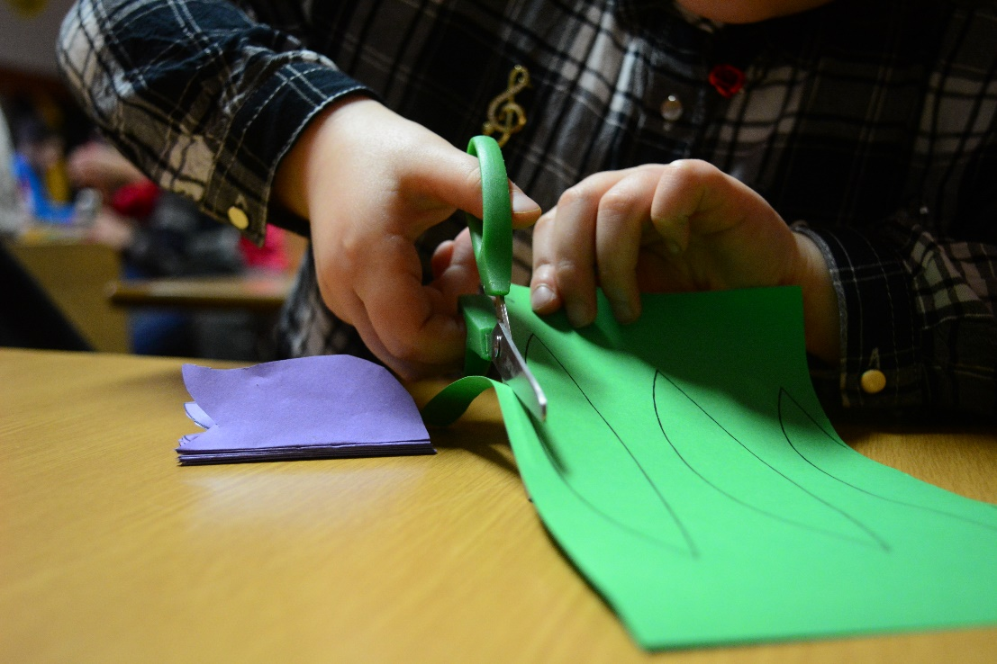
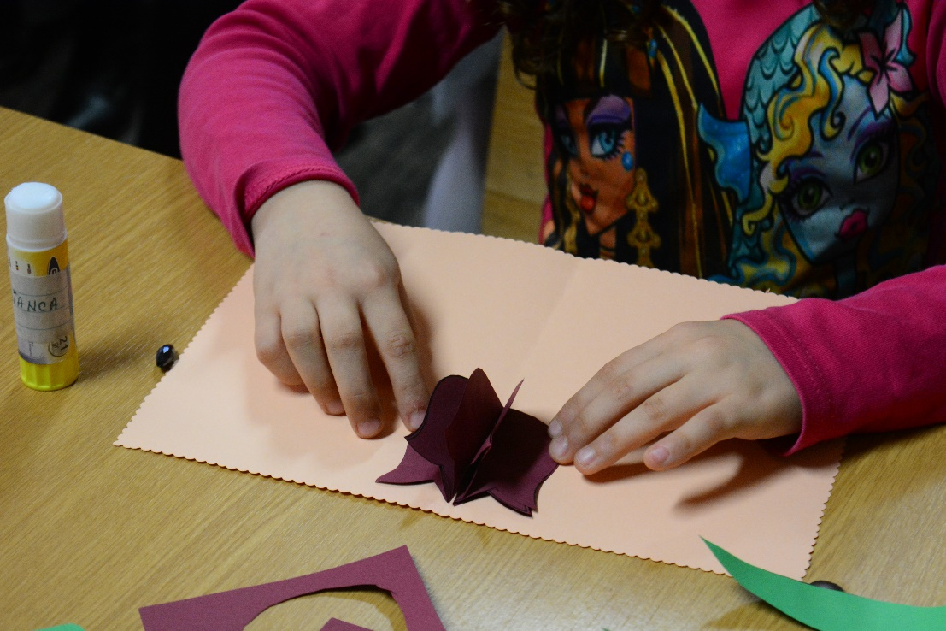
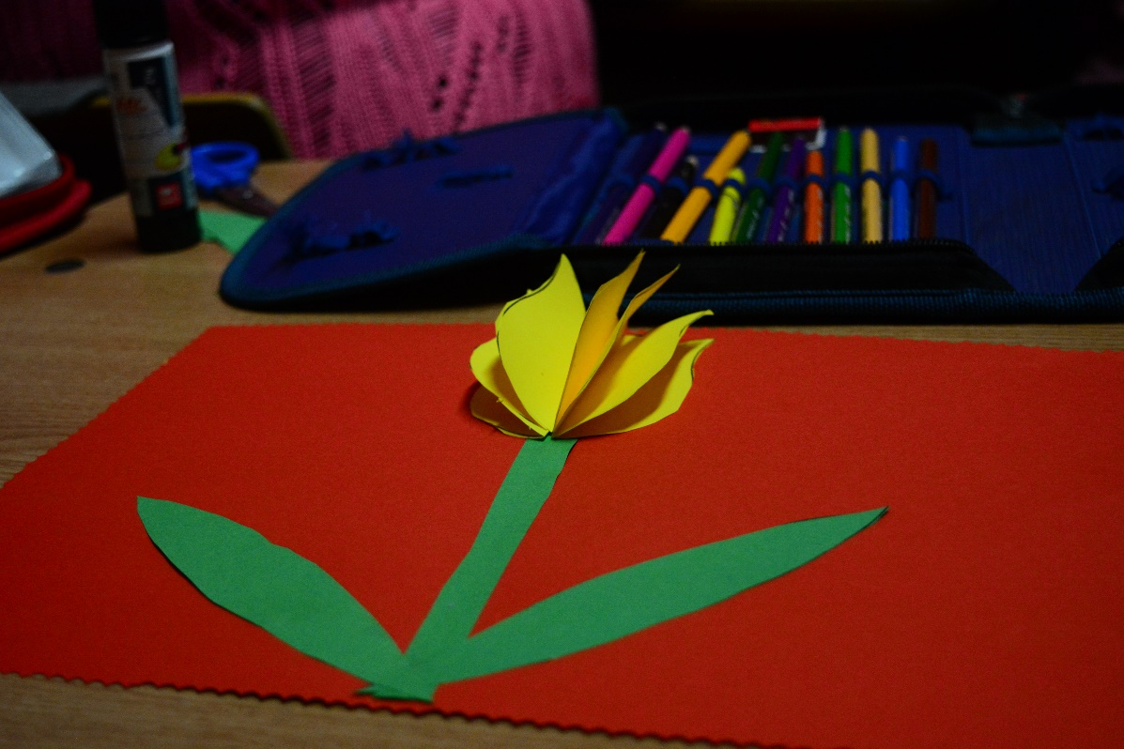

Slide 10
ORGANISATION
RESOURCES
Musical instruments: piano, violin, guitar
Coloured paper, scissors, glue,
Songs in different languages and having different themes
Songs: Mother’s Day, Spring, The Snowdrop
Poems about family relations, the arrival of spring, joy and flowers
Techniques for handicrafts
Film buli-buli
Individual, Pair work: parent-student, Class interaction

Slide 11
EVALUATION of competences
Observation of pupils
Cards for mother’s day – design, arrangement, message
Steps followed in designing the card having musical background
Song interpretation according to the themes discussed
Poetry performance in musical settings
Exhibition of pupils’ works

Slide 12
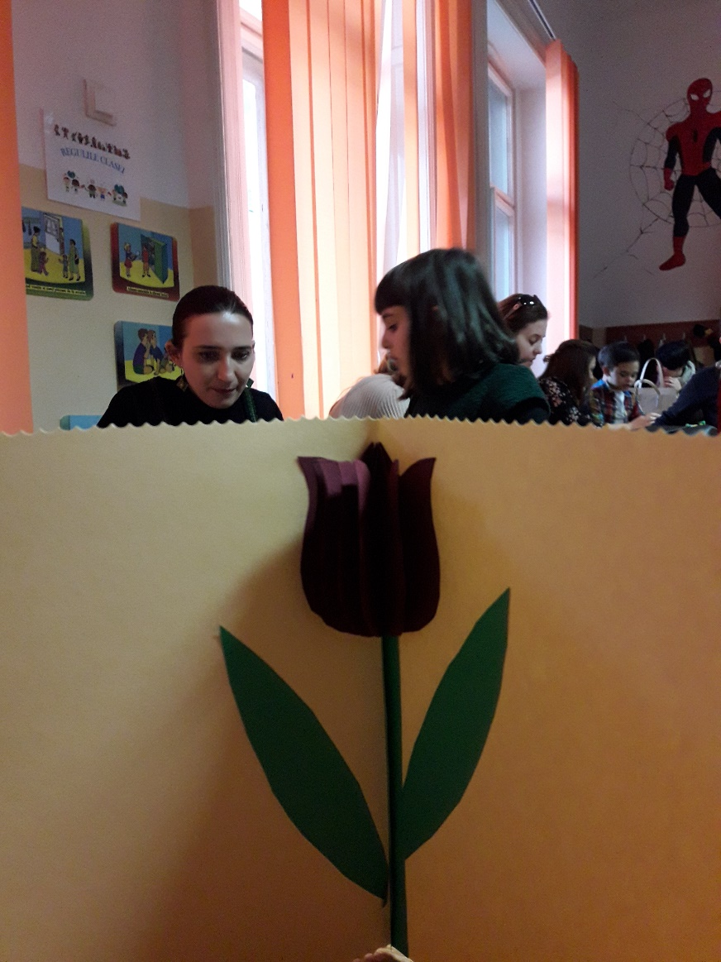
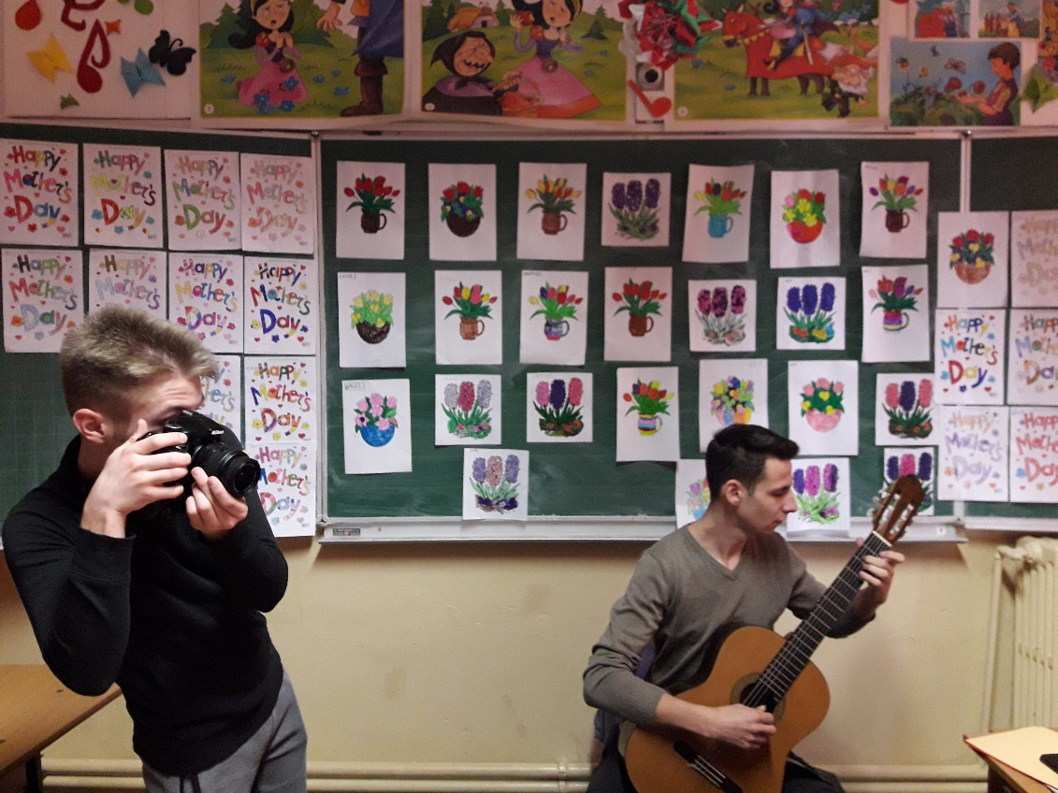

Slide 13
PRIMARY – 2nd grade, +ART: architecture students (drawings)
Music and Poetry
PERIOD: 12-24 March 2018
Number of pupils: 30
SUBJECT: learning about spring through poetry and music
ACTIVITIES: reading and discussing selected poetry in musical settings, finding the messages of different poems/songs, learning poems through musical pieces, interpreting poems using familiar musical fragments

Slide 14
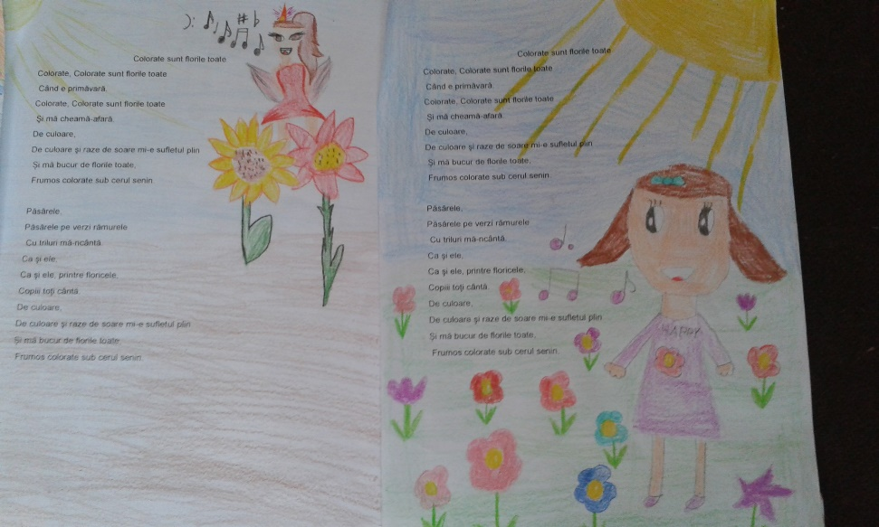
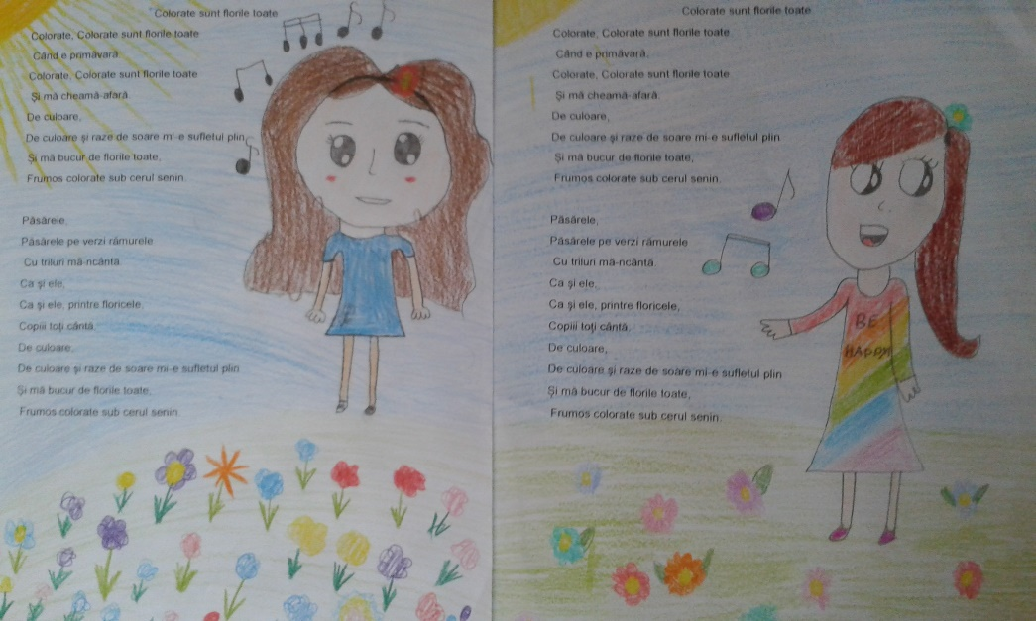
COMPETENCES
Development of reading, memorizing, understanding and learning capacities related to poetry
Association of familiar musical fragments with poetic verses in order to broaden pupils’ knowledge on certain topics

Slide 15
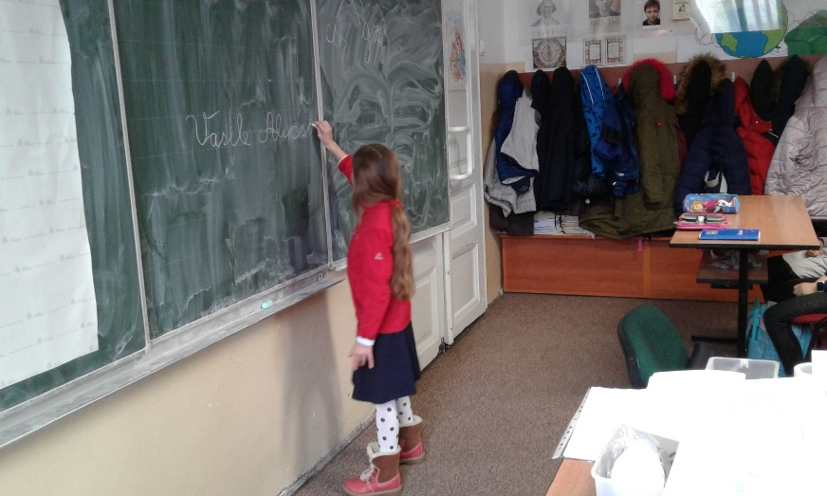
METHODOLOGY
Reading poems on different topics, asking and answering questions in order to reach the message of the poems
Interpreting various existent songs for the selected poems
Offering guidelines for learning certain poems

Slide 16
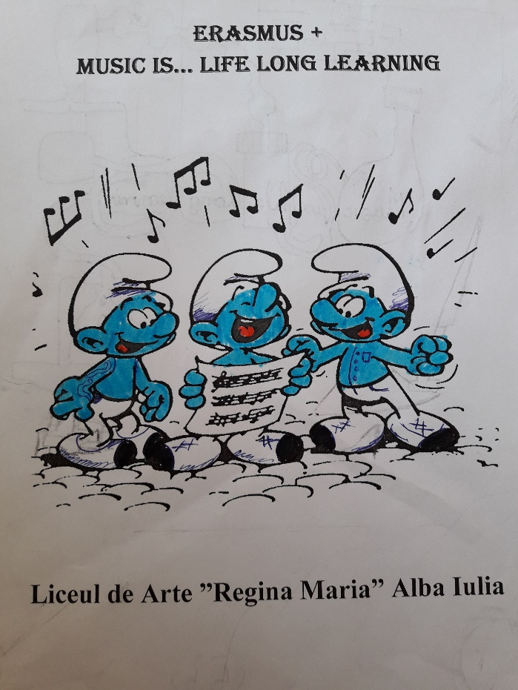
METHODOLOGY
Musical interpretation of several missing words from poems using different musical instruments (one pupil performs the musical piece, the other pupils try to guess the missing word having on a handout the verses of the poem discussed)
Word games in musical settings and selection of familiar musical fragments to play the verses of poems
Exhibition: students’ works presented within musical frames

Slide 17
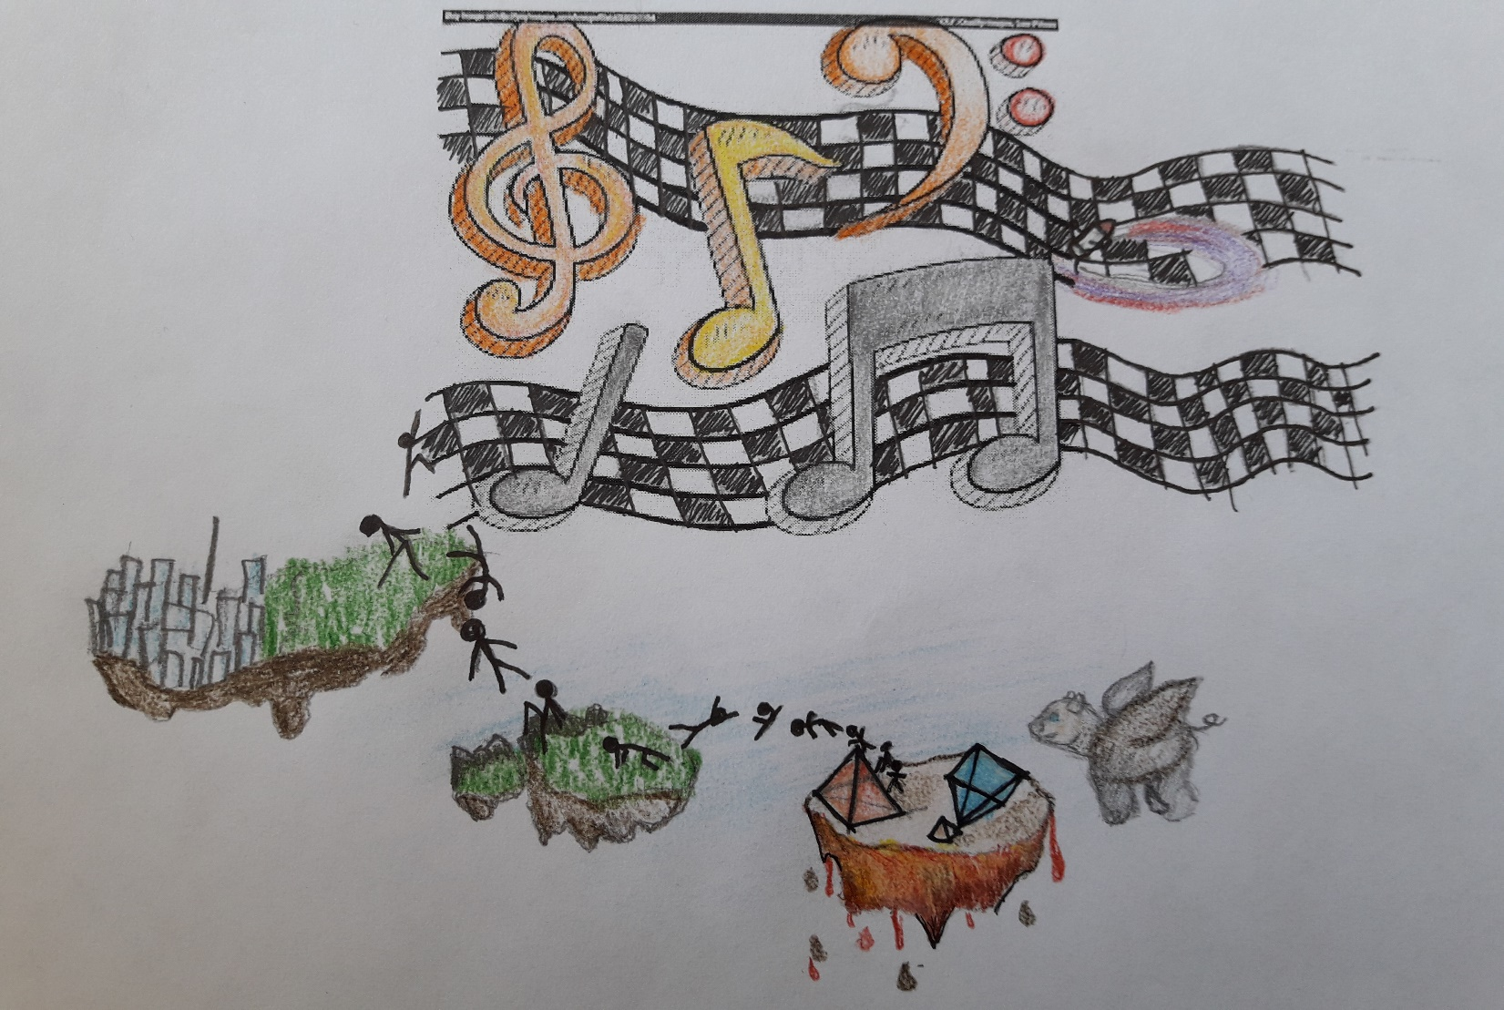

Slide 18
ORGANISATION
RESOURCES
Musical instruments: piano, violin, xylophone
Coloured paper, posters, board
Handouts with the verses of poems/ songs
Various songs about spring and nature (The gardens are blooming)
Poems about spring and nature
Drawings (vocabulary, poems, songs)
Familiar musical fragments known by pupils
Individual
Pair/Group work
Class interaction

Slide 19
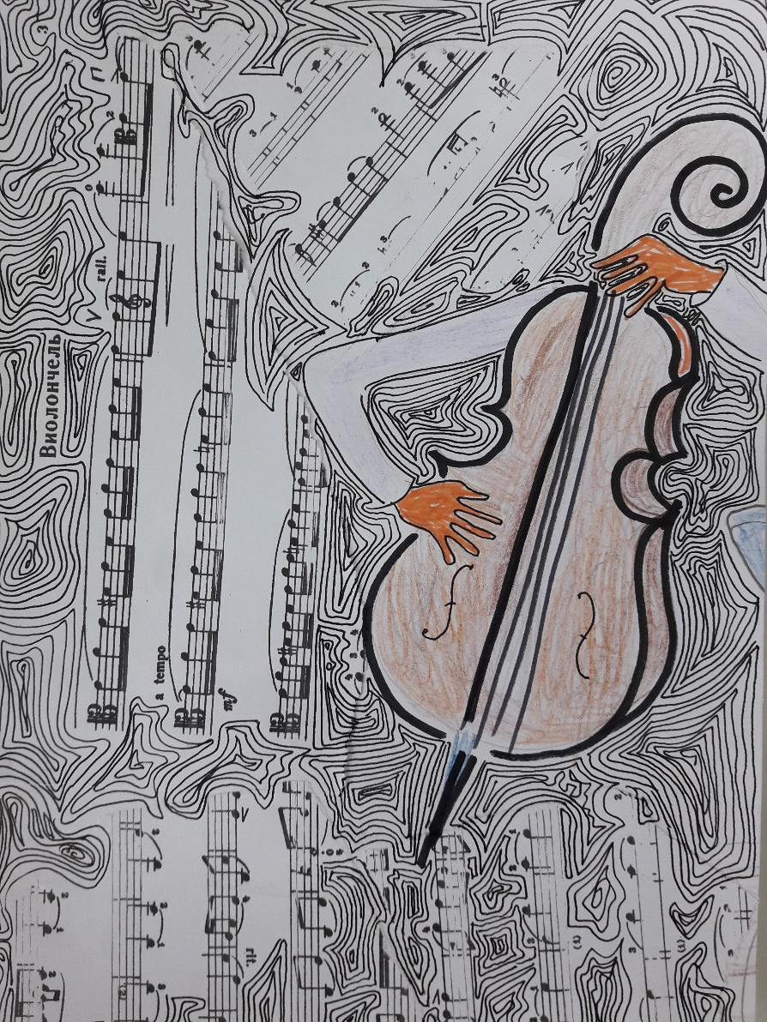
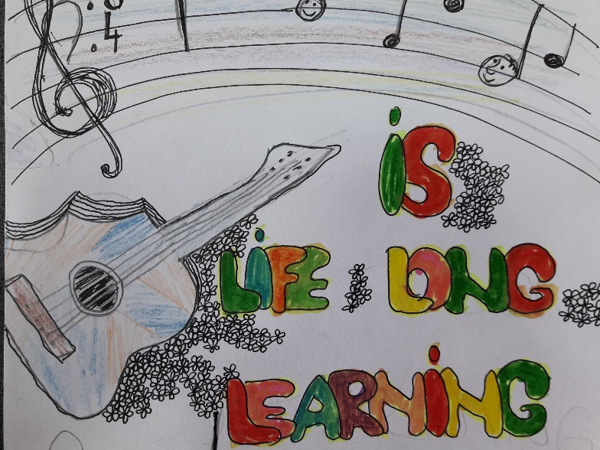

Slide 20
EVALUATION of competences
Observation of pupils
Pronunciation of verses while reading poems
Answers given to questions related to the images and the message of the poems
Association of words with musical fragments played on the piano, violin, xylophone (creativity, sense of rhythm/ word pronunciation)
Musical interpretation of poems using familiar musical fragments
Exhibition of pupils’ works (texts of songs, poems accompanied by drawings)

Slide 21
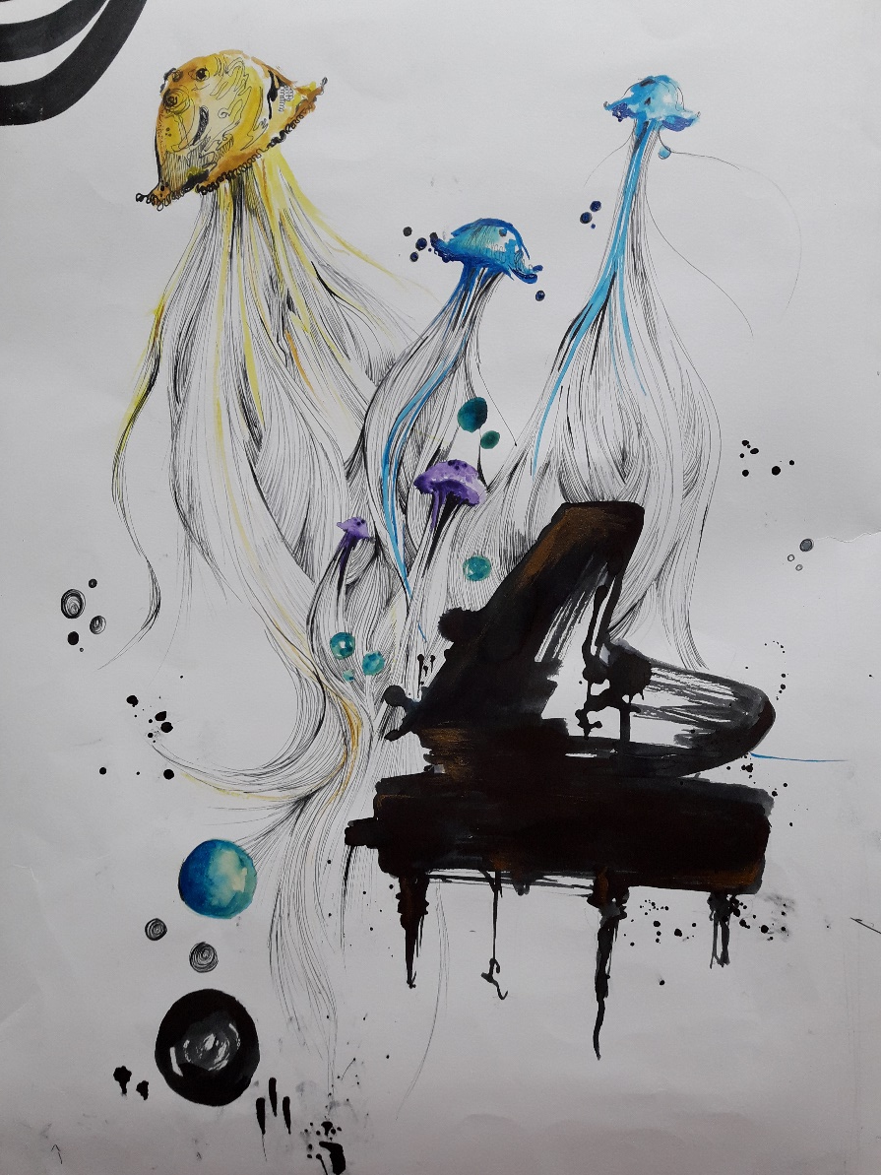
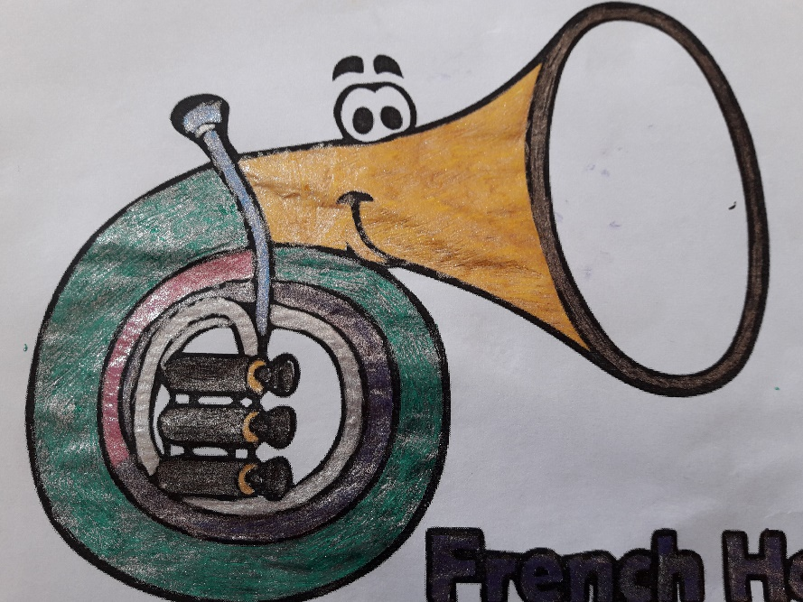

Slide 22
PRIMARY – 3rd grade, + ART: architecture students (drawings)
Theatre and Music Advertisement
PERIOD: 19th -30th March 2018
Number of pupils: 29
SUBJECT: Literary contexts
ACTIVITIES: identification of real and unusual characters from literary texts having musical backgrounds, character description and song interpretation, role play with music, designing an advertisement for the play in musical settings

Slide 23
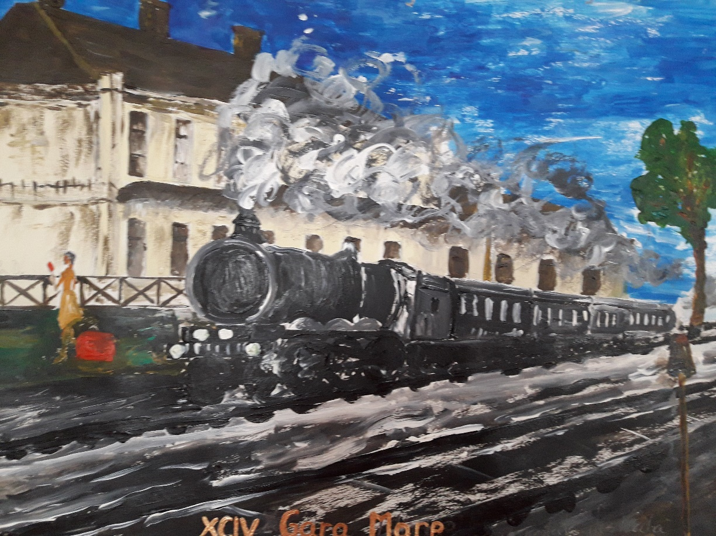
COMPETENCES
Detail identification, character description and role play in literary contexts
Production of functional text including visual and verbal language

Slide 24
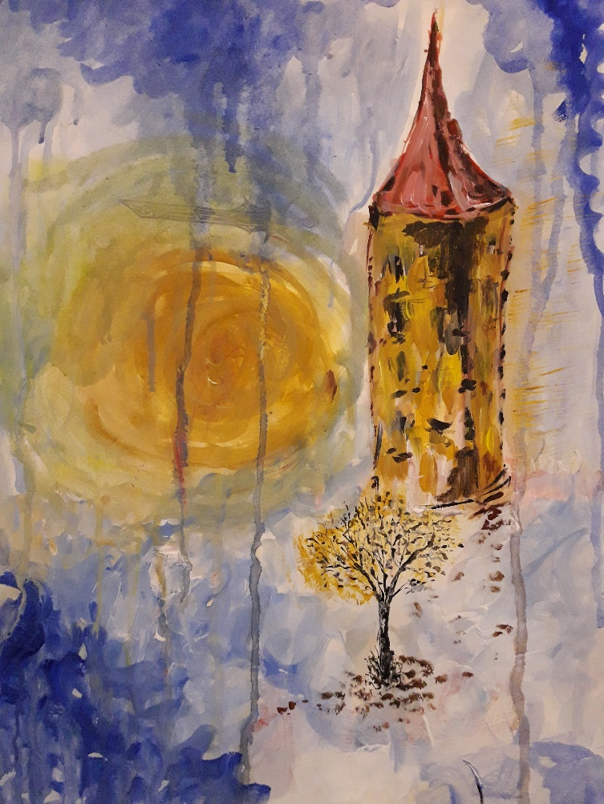
METHODOLOGY
Identification of various details in a literary text (real, unusual characters) having musical pieces played on the piano by pupils
Character description with guidance in finding positive and negative features accompanied by joyful/ sad songs according to the features identified

Slide 25
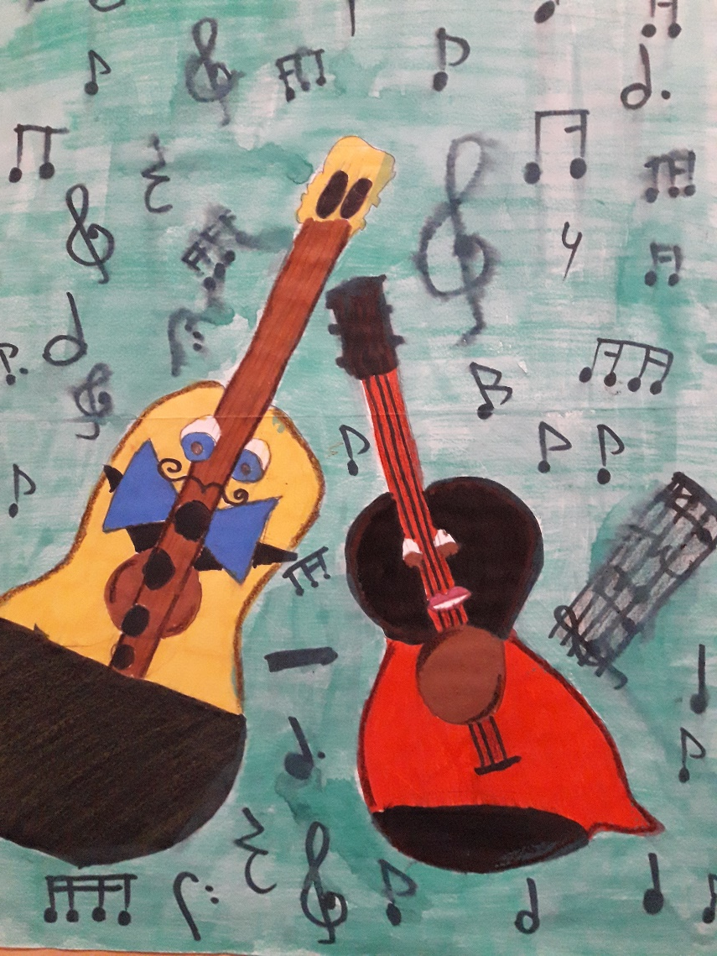
METHODOLOGY
Role play starting from the literary text (pupils read their roles having in the background Moonlight Sonata, by Beethoven – piano performance)
Designing an advertisement starting from the information given about a show including theatre play and music (in the background Mozart, Eine kleine nacht muzik)
Exhibition: pupils’ works presented on the Class Creative Panel

Slide 26
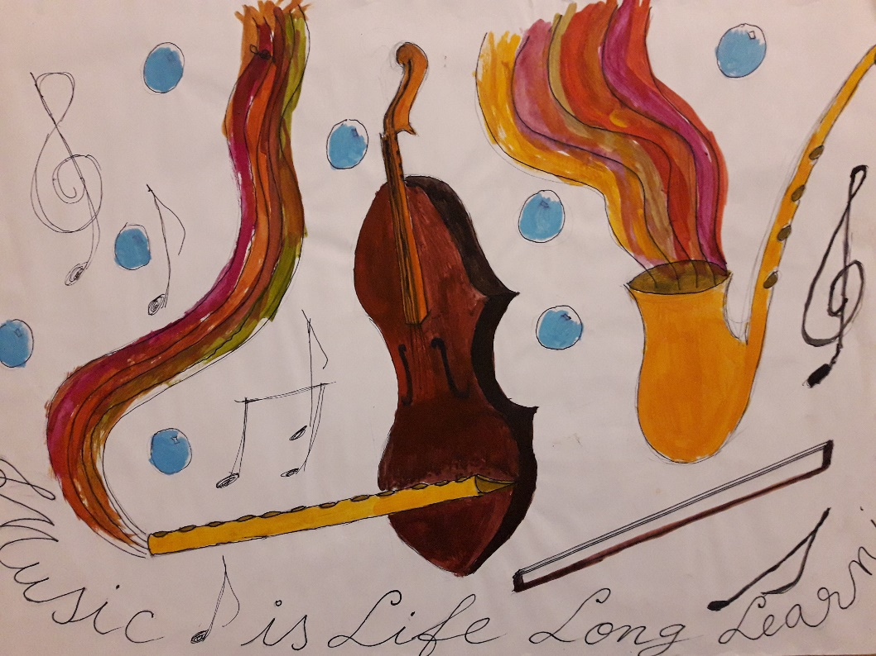
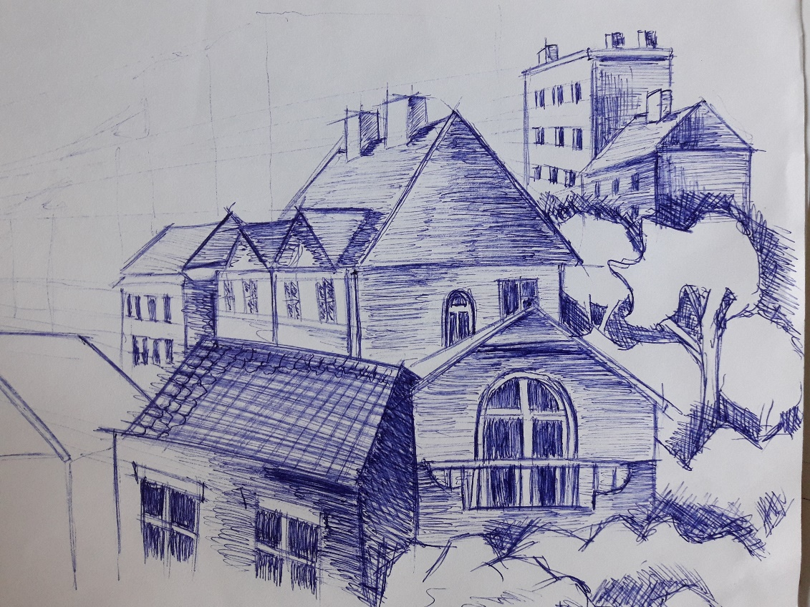

Slide 27
ORGANISATION
RESOURCES
Musical instrument: piano
Literary texts from school library (The girl who took ‘NO’ in her arms)
Classical music: J.S.Bach, Cantatas, Beethoven, Moonlight Sonata, Mozart, Eine kleine nacht muzik
Songs: Oh, poor little cuckoo offspring (sadness), Competition Song (joyful)
Posters representing key words, white paper, crayons, watercolours, glue, scissors, collage
Individual
Pair/Group work
Class interaction

Slide 28
EVALUATION of competences
Observation of pupils
Classification of characters (real, unusual)
Identification of positive and negative features of characters
Association of songs (joyful, sad) with the characteristics of the characters (positive, negative)
Selection of details from literary texts according to the tasks given
Role play in musical settings (pronunciation, understanding of lines)
Design of Theatre and Music Advertisement and exhibition of pupils’ work

Slide 29
