Slide 1
Music is… Life Long Learning
LEARNING TO LEAN THROUGH MUSIC 3
Liceul de Arte “Regina Maria” Alba Iulia
ITALY – 28th MAY - 1st JUNE, 2018

Slide 2
SECONDARY – 7th grade (activity), + ART: fine arts (drawings)
Movement dynamics through Music
PERIOD: May 2018
Number of pupils: 45
SUBJECT: Physical education
ACTIVITIES: transporting a sport mattress, ‘don’t get caught’ game, playing volleyball with an aerobic ball, balloons in a line in musical settings

Slide 3
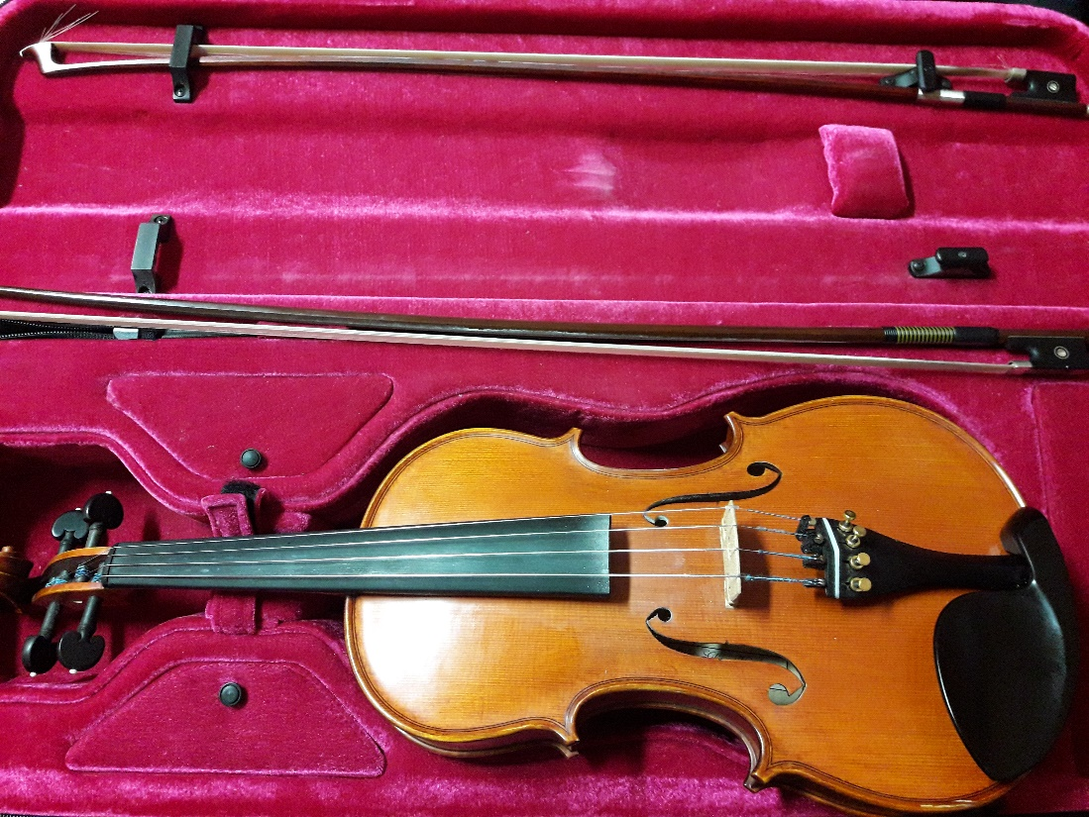
COMPETENCES
Harmonious physical development and acquisition of basic motor skills
Improving competition efficiency and teamwork

Slide 4
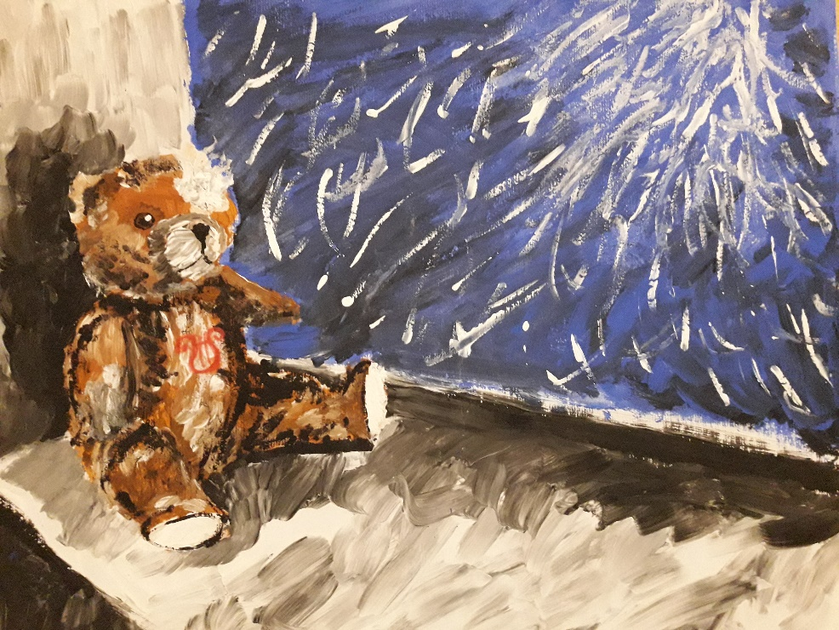
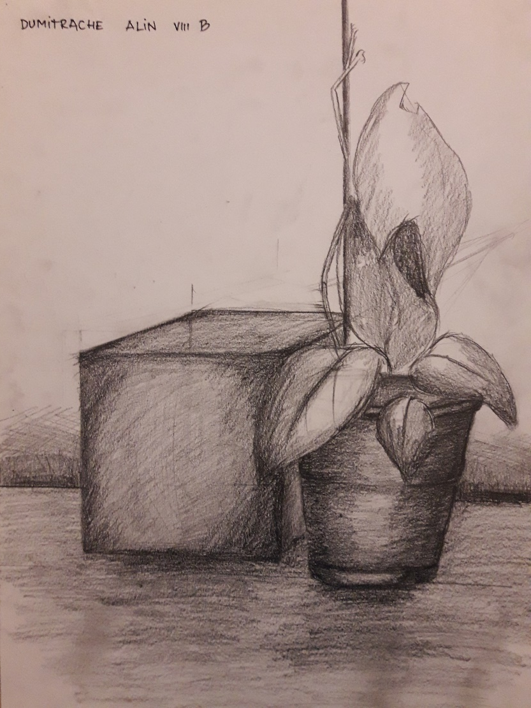

Slide 5
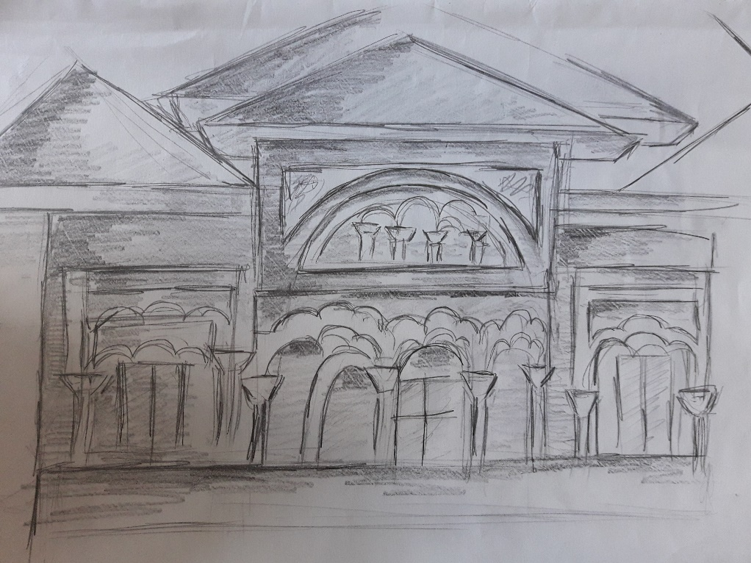
METHODOLOGY
Film: Salteaua - coordonare
“Transporting a sport mattress” – students (divided into 2 teams) have to carry a sport mattress on their heads without falling. On their path they have to create a rhythm of moving so that they don not lose balance and they also have to overcome some obstacles.

Slide 6
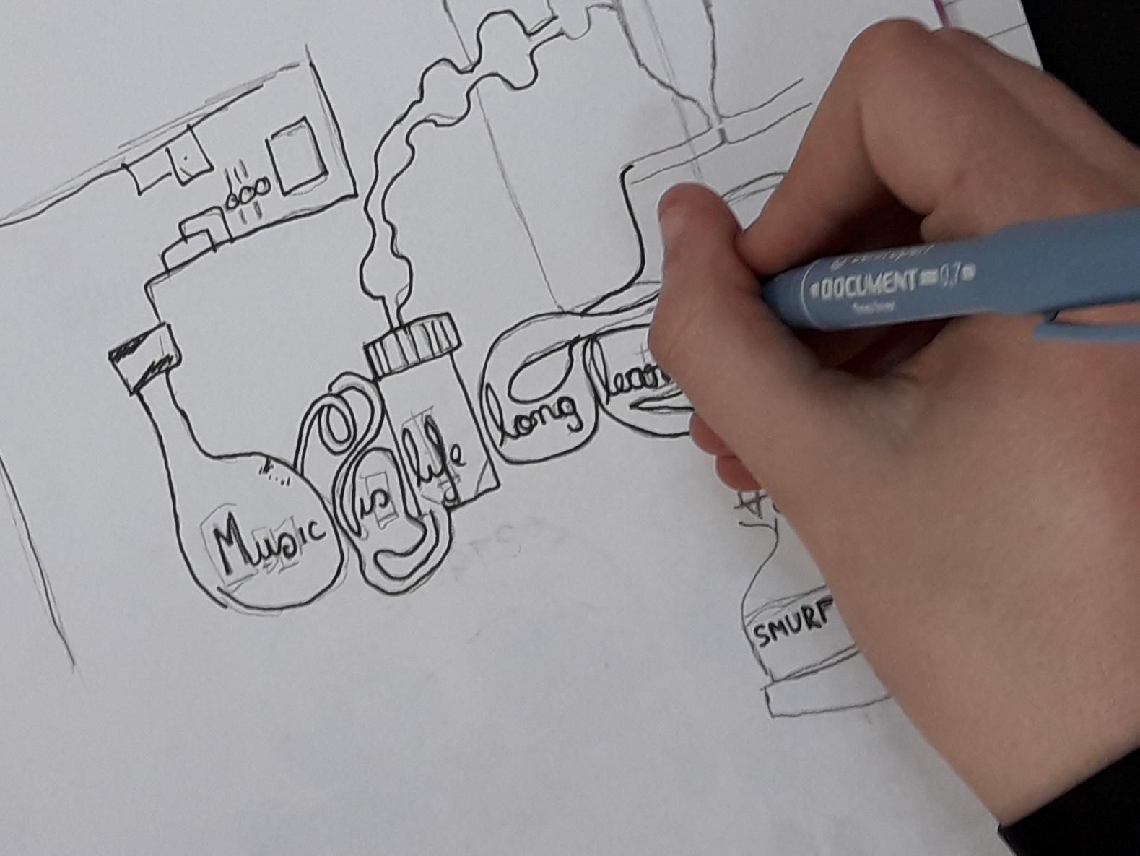

Slide 7
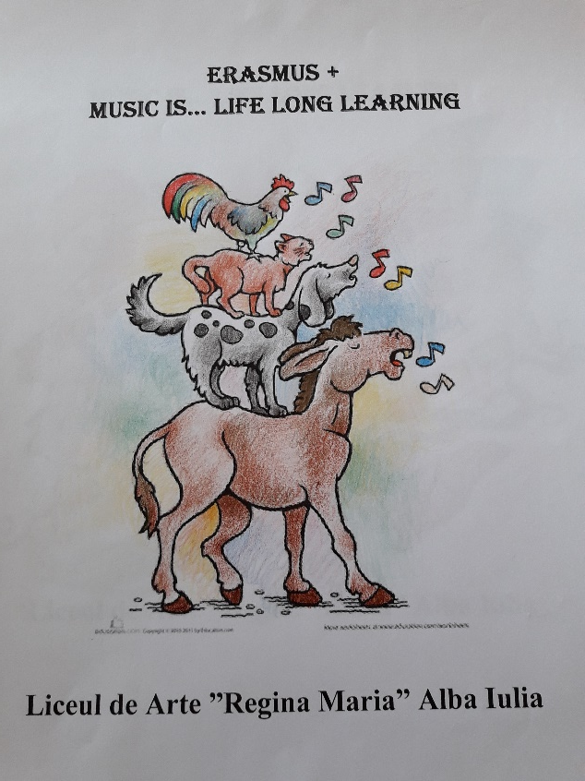
METHODOLOGY
Film: Alergare – Nu te lasa prins
“Don’t get caught” – students are divided on the sport field that has been marked and they have to move according to the limits drawn. They walk, run, jump from one line to another and if they are caught they are eliminated

Slide 8
METHODOLOGY
Film: Volei cu mingea de gimnastica
“Volleyball with an aerobic ball” – students are divided into 2 teams of 6 players each. They have to play volleyball using an aerobic ball according to the rules while music is played in the background.

Slide 9
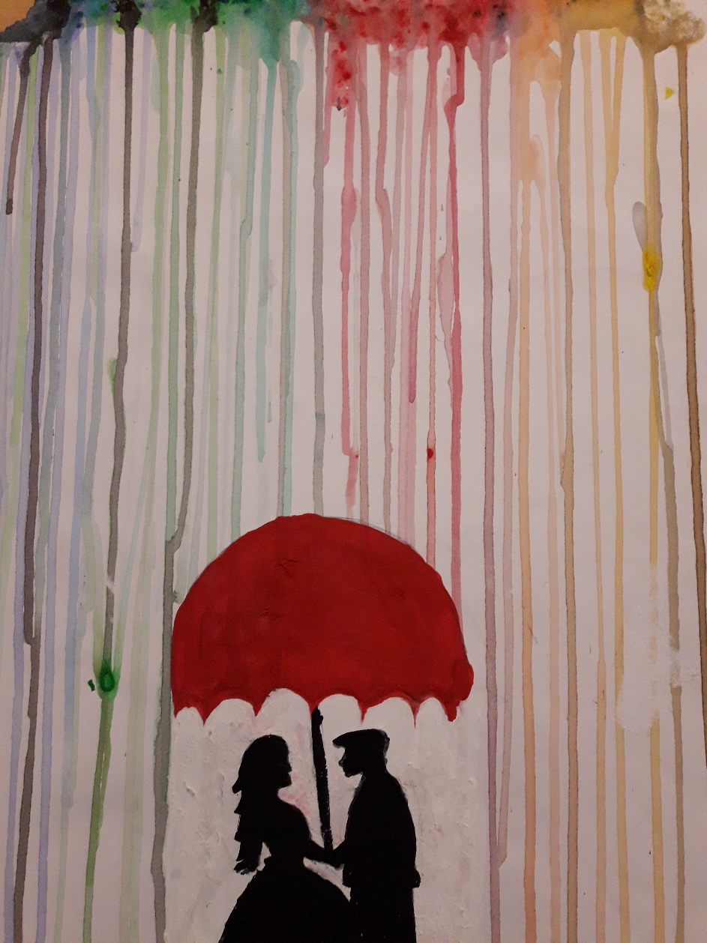
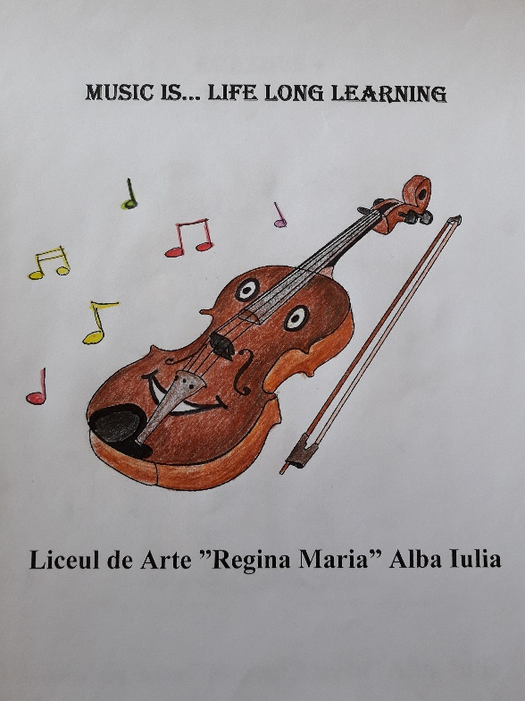

Slide 10
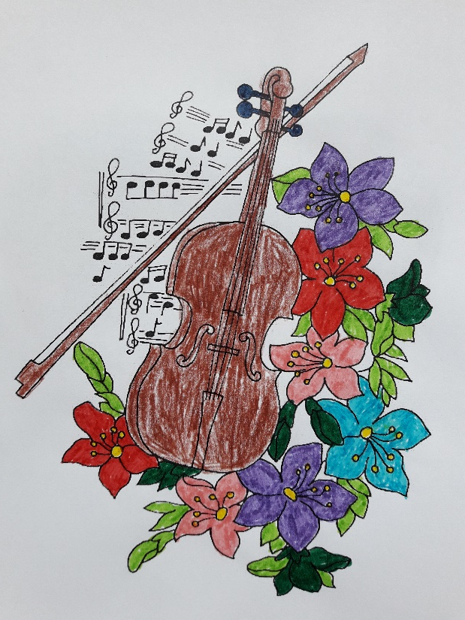
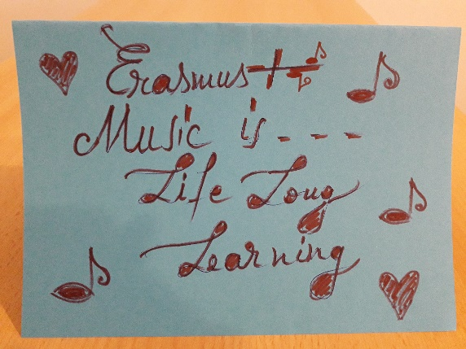
METHODOLOGY
Film: Baloanele
“Balloons in a line” – students are divided into 2 teams. They have to move from A to B (marked by the teacher) holding the balloons with their bodies (use of hands is forbidden) while music is played in the background.

Slide 11
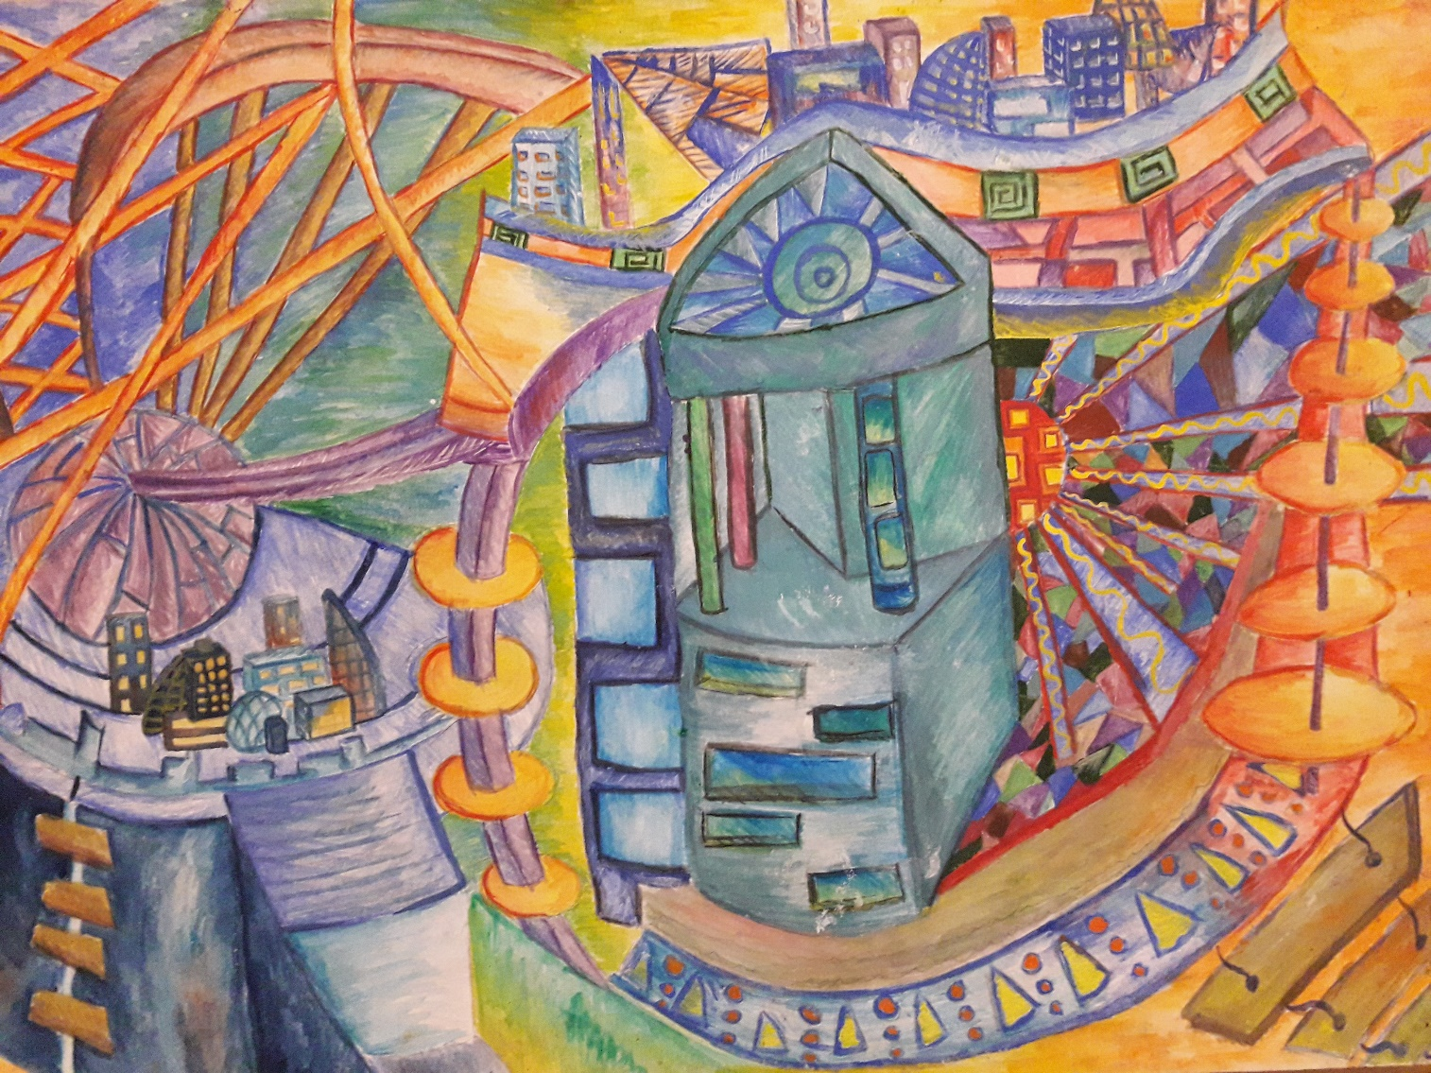
What a balloon sees while travelling above the city

Slide 12
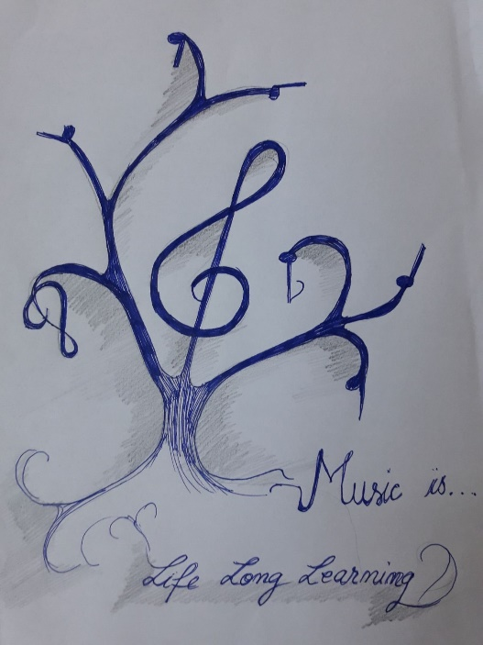
ORGANISATION
RESOURCES
Rhythms created by students so that they are able to mode at the same pace
Laptop. loudspeakers
Musical pieces with various rhythms
Selection of movements
Aerobic ball, sport mattress, balloons
Articles on the dynamics of movements and influence of music on carrying out different exercises
Pair work
Teamwork

Slide 13
EVALUATION of competences
Coordination of body movement with (musical) rhythms
Performance of movements according to the musical rhythms
Respecting the rules of the games
The degree of achievement of the goals set for each game
Coordination of team members in order to achieve their goal
Degree of involvement in competitive activities

Slide 14
SECONDARY – 8th grade (activity), 10th grade (drawings)
Shakespeare Revisited
PERIOD: April - May 2018
Number of students: 30
SUBJECT: With Shakespeare through life
ACTIVITIES: interpreting various Shakespearian quotations through visual arts in musical settings, gaining life experience from Shakespearean texts through musical performance

Slide 15
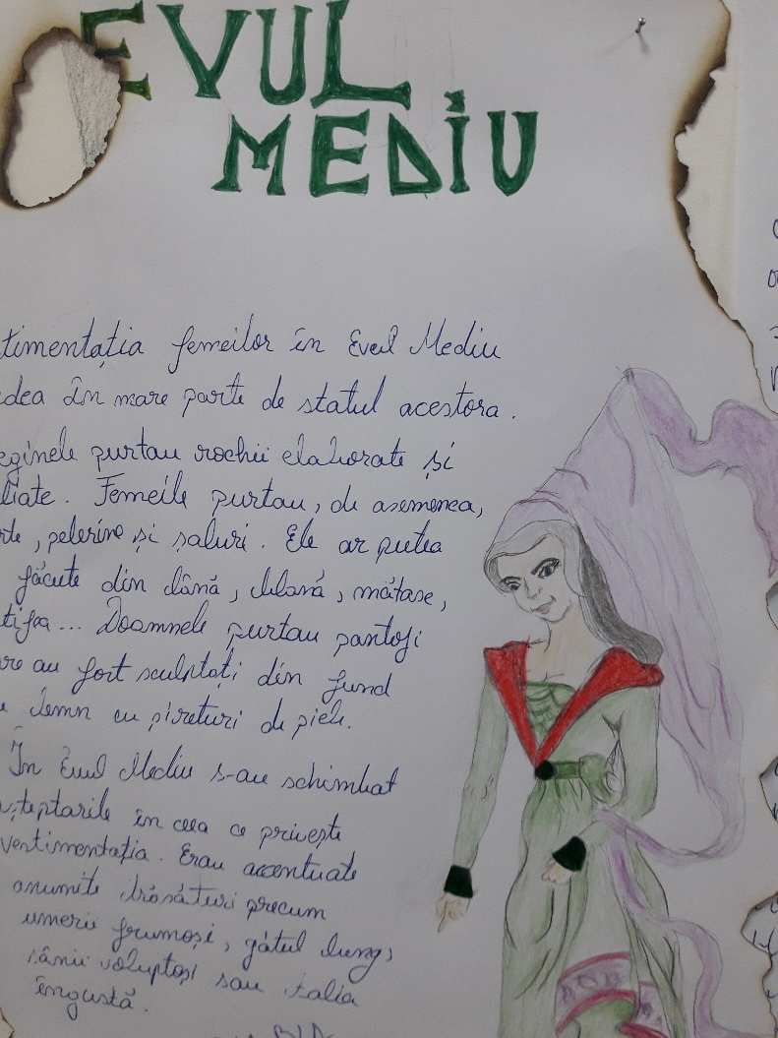
COMPETENCES
Development of critical thinking skills in relation to Shakespearean plays and sonnets through music and visual arts
Drawing parallels between Shakespearean thought and contemporary frameworks

Slide 16
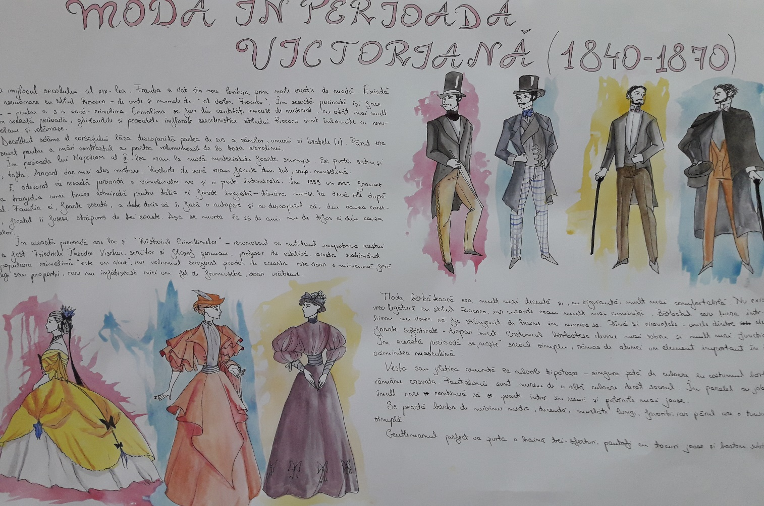
Students from 10th grade created drawings with the evolution of fashion from Shakespearean times until present days

Slide 17
METHODOLOGY
Film Nico
Selection of thematic Shakespearean quotations to be rendered through visual arts (drawings, paintings)
Setting a peaceful environment for students to create the artistic works (at the library) and providing musical background (another student playing the guitar)
Combining basic rhythm with body percussion and the verses of Sonnet 94
Performing a musical song for the sonnet respecting the rhythm of the words

Slide 18
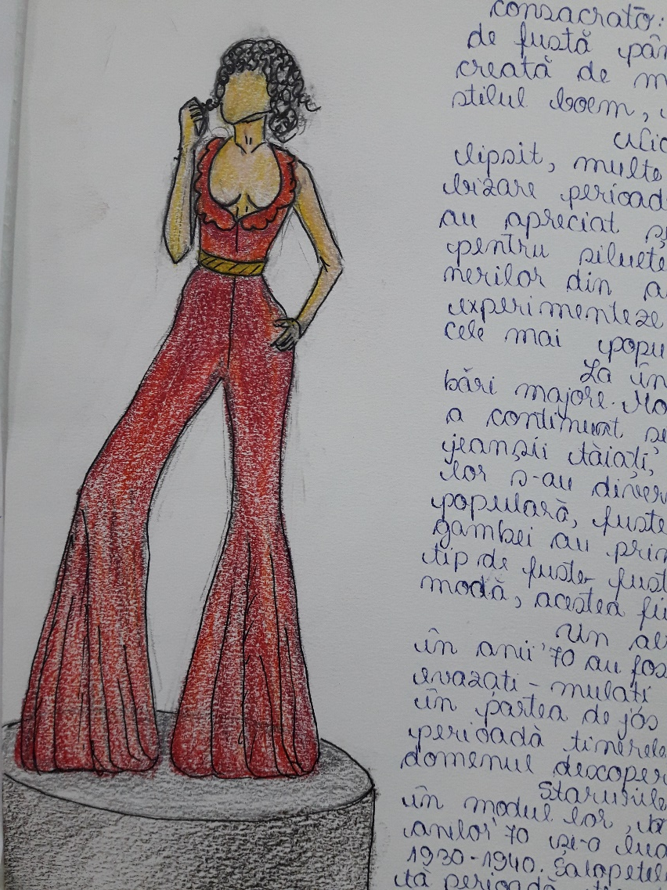
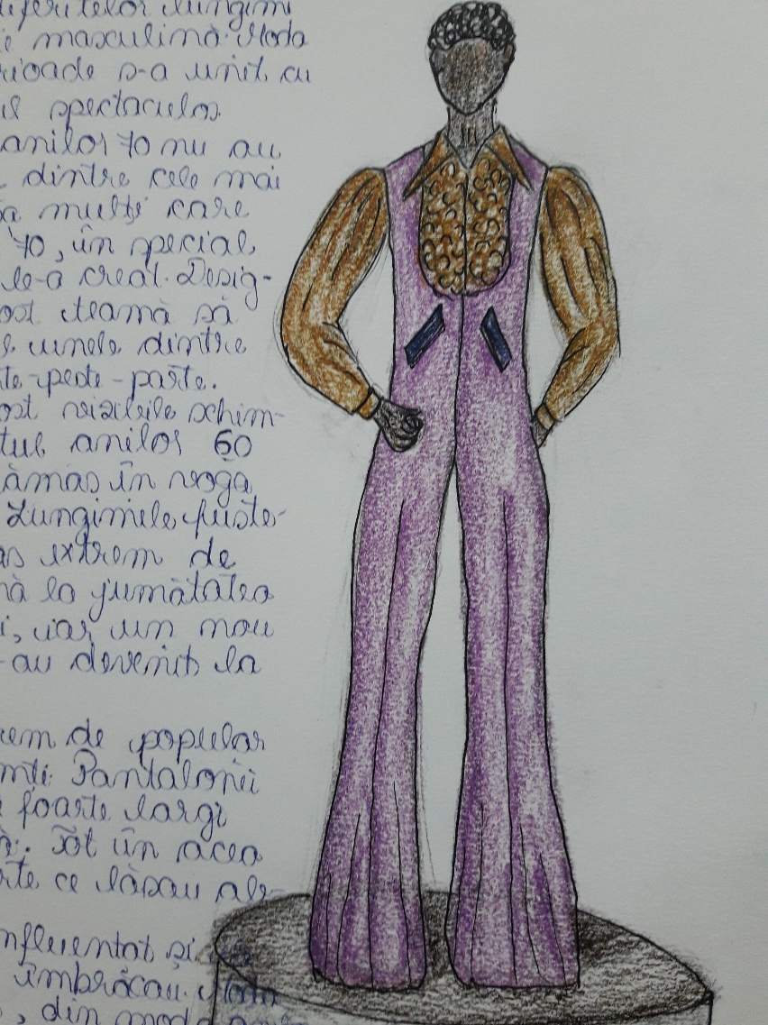

Slide 19
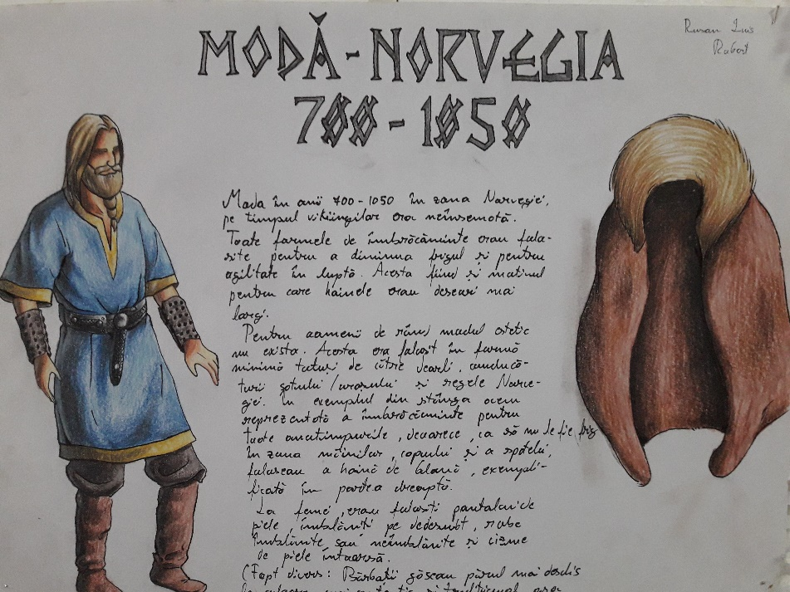
METHODOLOGY
Discussing the ideas from the sonnet in connection to daily life
Making associations between the ideas expressed in the sonnet and students’ life experience moving beyond the verses
Draw comparisons between Shakespearean thought and students’ own perspective thus emphasizing the way in which we can enrich our life experience through literature

Slide 20
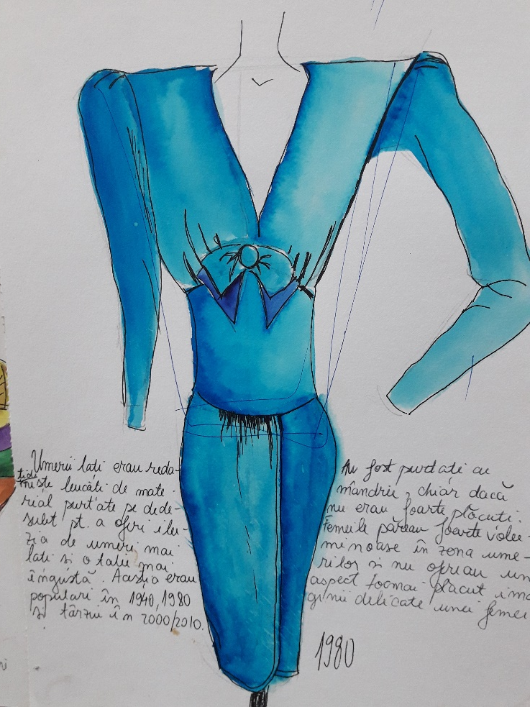
ORGANISATION
Individual
Class interaction
RESOURCES
Musical instruments: piano, guitar
Interdisciplinary approach: music teachers, English teacher, philosophy and psychology teacher, drawing teacher, librarians
Art albums, Shakespeare’s plays and sonnets
Rhythmic structures
Handouts with verses and vocabulary
Materials: paper, watercolours, crayons, pencils, glue

Slide 21
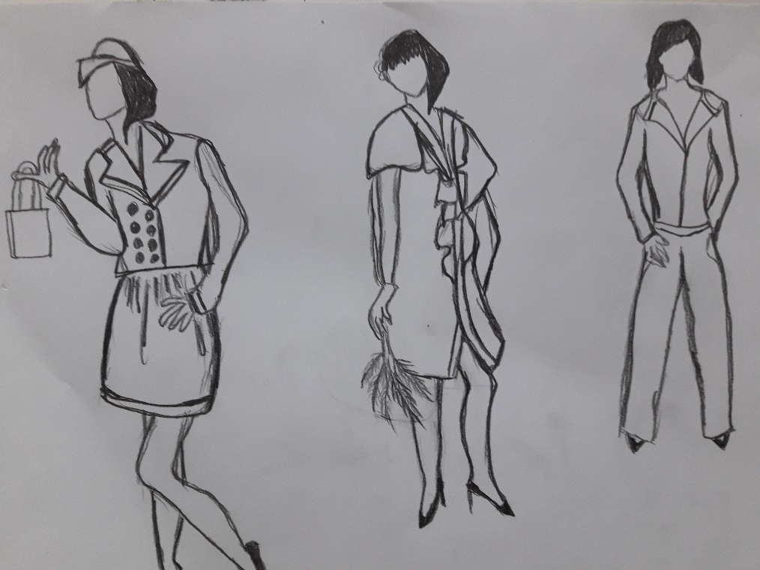
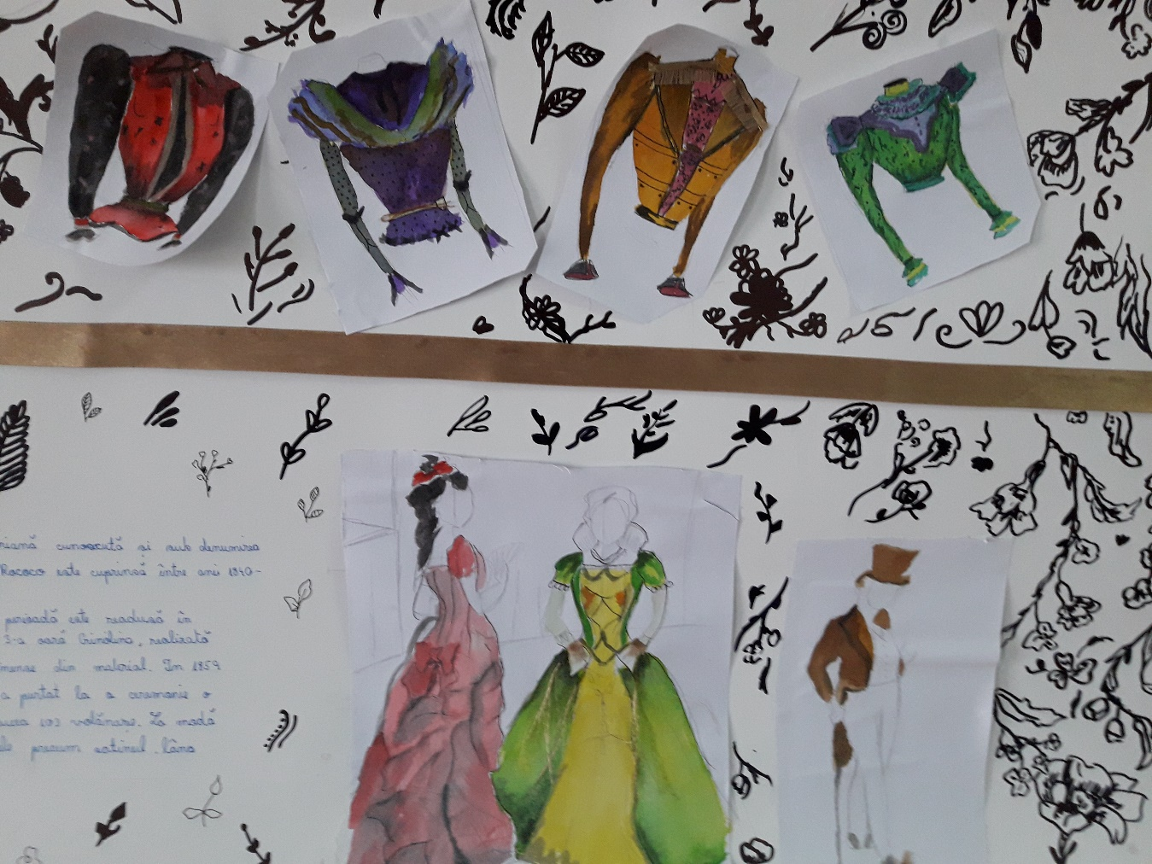

Slide 22
EVALUATION of competences
Song interpretation of Sonnet 94 (voice and piano)
Associations of rhythmic structures with the words forming the verses of the sonnet
Coordination body percussion with musical tune and word pronunciation
Comparisons between the ideas expressed in the sonnet and students’ life experience
Exhibition of drawings, paintings reflecting Shakespearean thoughts
Involvement in the discussions related to Shakespearean views reflected in contemporary contexts

Slide 23
HIGH SCHOOL – 10th grade
Preparation and Presentation of Self-Created Products
PERIOD: April - May 2018
Number of students: 59
SUBJECT: Entrepreneurship Education
ACTIVITIES: organisation of students’ own learning (time and information management individually and in groups), gathering necessary data, and presentation of products

Slide 24
COMPETENCES
Organisation of individual learning and assimilation and analysis of data and skills
Use of prior knowledge and life experience in presenting the products

Slide 25
METHODOLOGY
Film: Florin saxofon
Presentation of working habits related to time and information management individually and in teams
Combination of non-formal learning (unplanned and spontaneous) with team organisation
Presentation accompanied by musical fragments played on the piano, clarinet, violin, pan pipes
Film: Doriana flaut

Slide 26
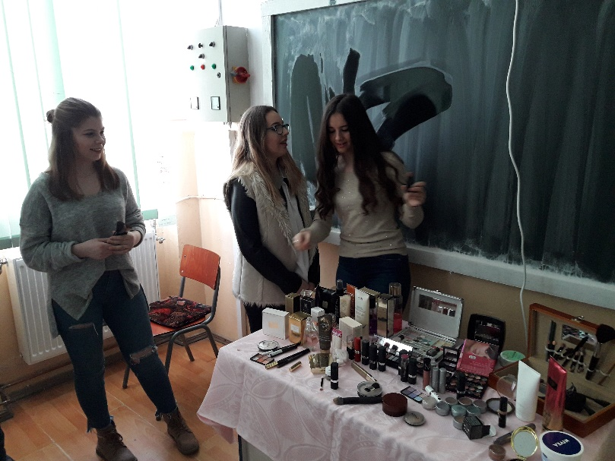
METHODOLOGY
Learning through discovery the process of data assimilation and analysis
Association of different products with specific musical pieces
Presentation and Exhibition of students’ products in musical settings

Slide 27
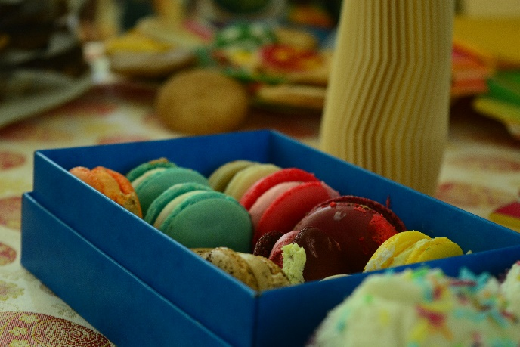
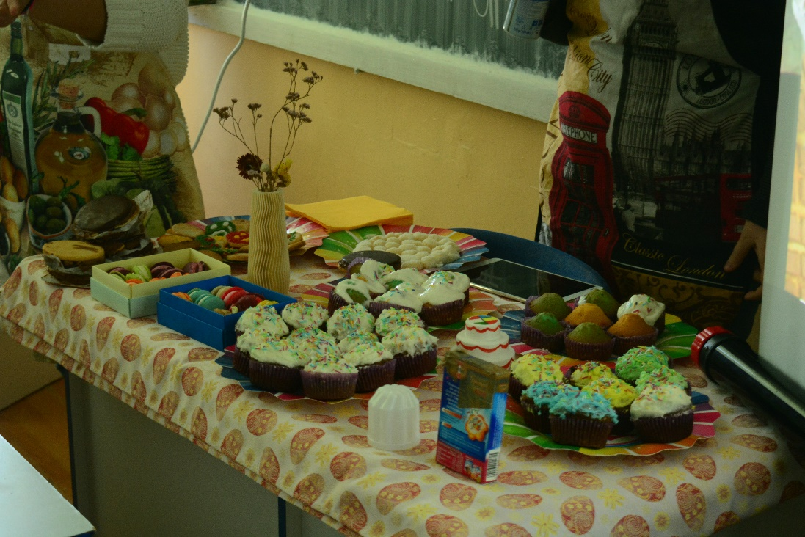

Slide 28
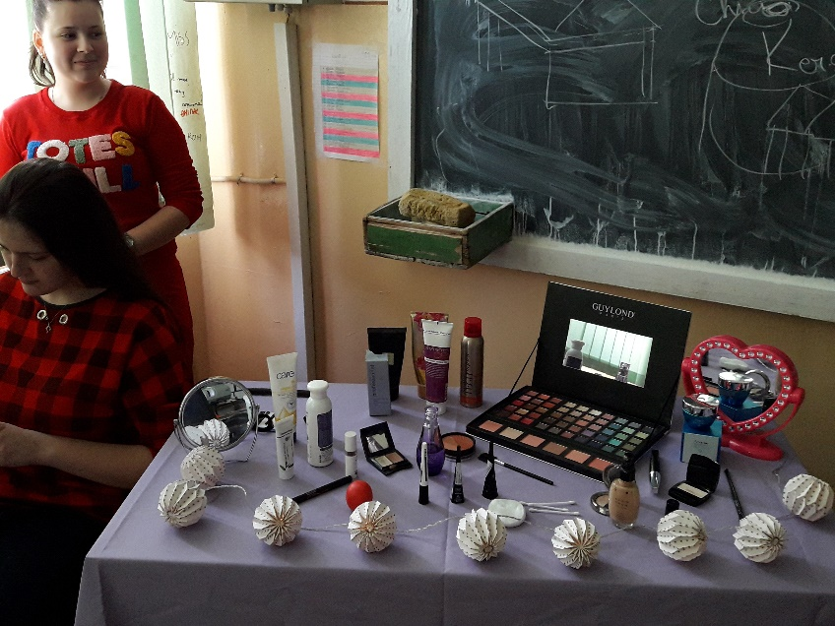
ORGANISATION
RESOURCES
Cakes, jewels, building models, toys, clothing items, laptop, loudspeakers, tablecloth
Musical instruments: piano, violin, clarinet, pan pipes
Music scores, fabrics, food
Musical fragments adapted to the products presented
Student-centred teaching methods
Posters on different topics
Individual
Team / Group work

Slide 29
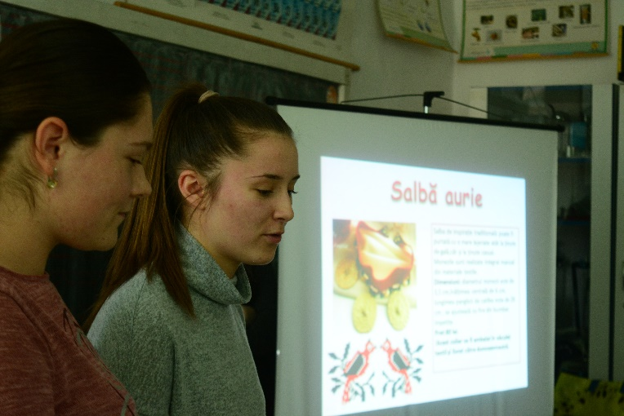
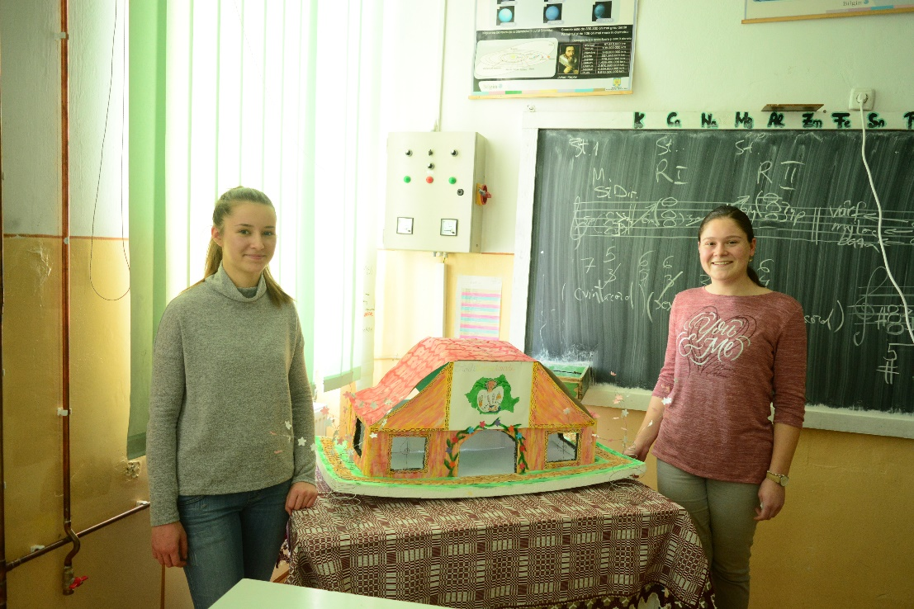

Slide 30
EVALUATION
Combination of working habits in teamwork
Association of musical fragments with the products presented
Comparison of different ways of data assimilation and analysis
Presentation of products according to the stages of improved individual learning organisation
Exhibition of students’ products in musical contexts, including uses of prior knowledge as well as personal life experience

Slide 31
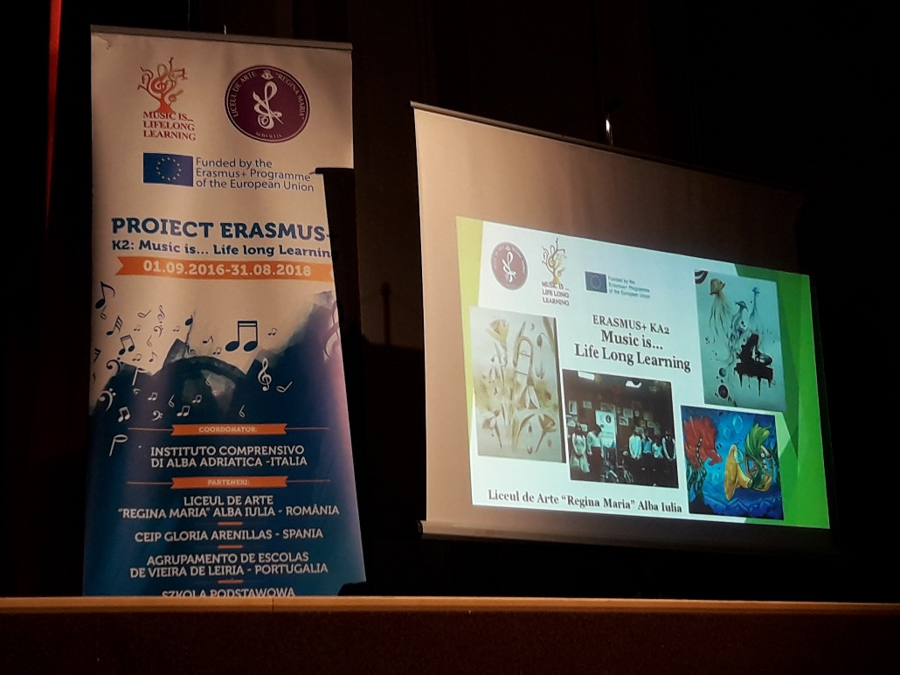
END OF YEAR ANNIVERSARY DISSEMINATION CONCERT

Slide 32
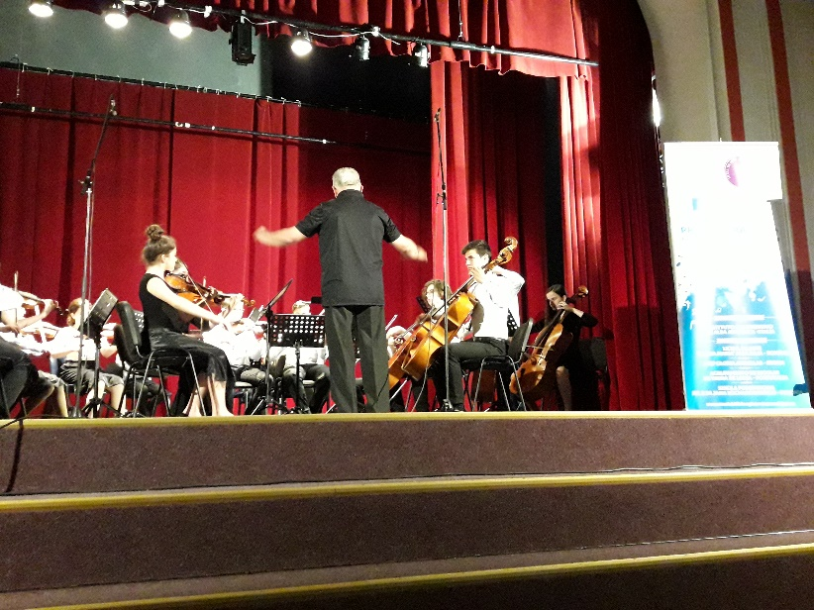
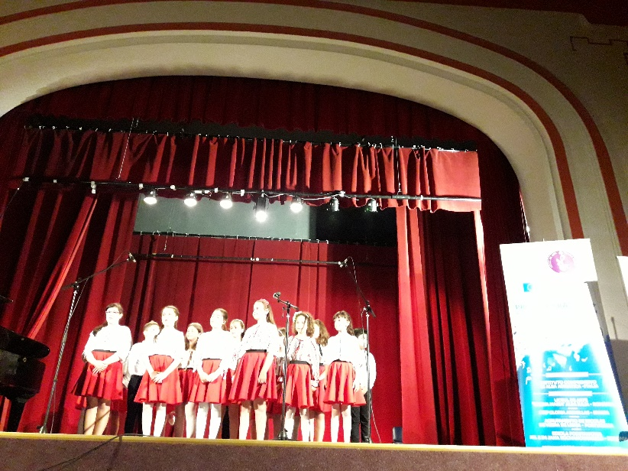
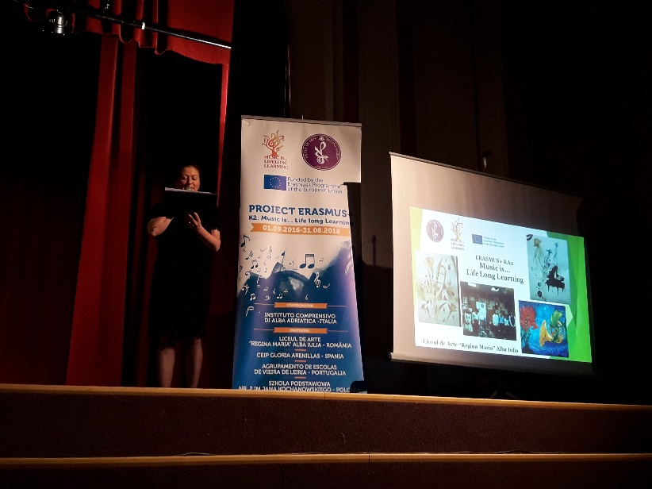

Slide 33
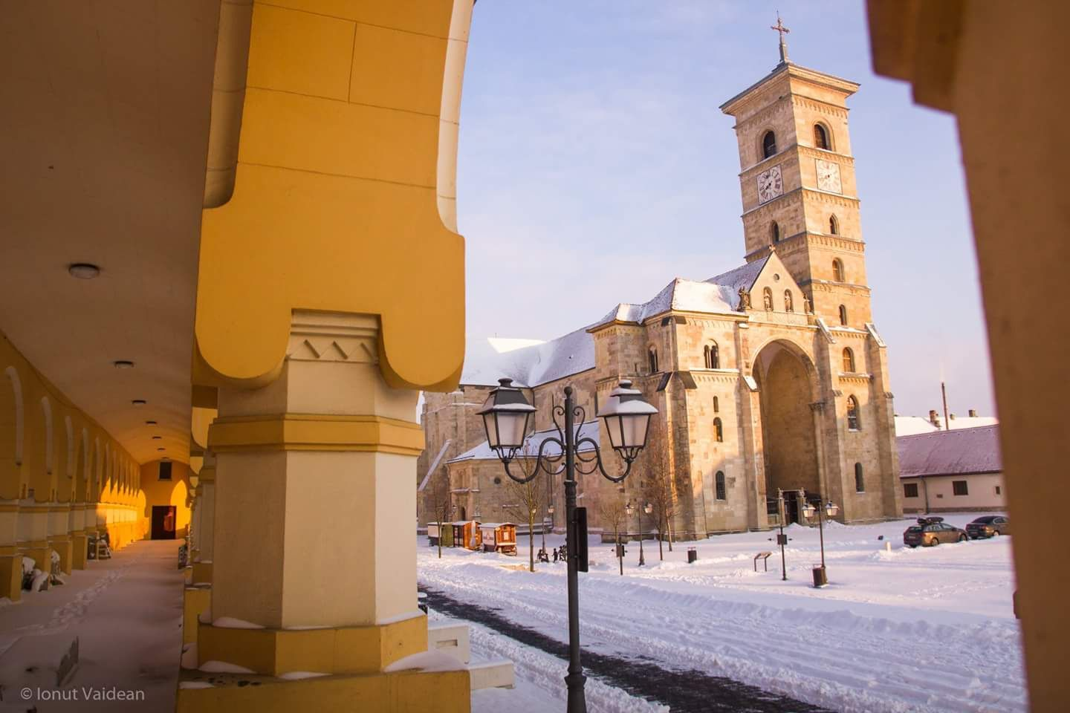
ALBA IULIA, LICEUL DE ARTE ”REGINA MARIA”, AND THE ERASMUS+ TEAM… IS MUSIC…

Slide 34
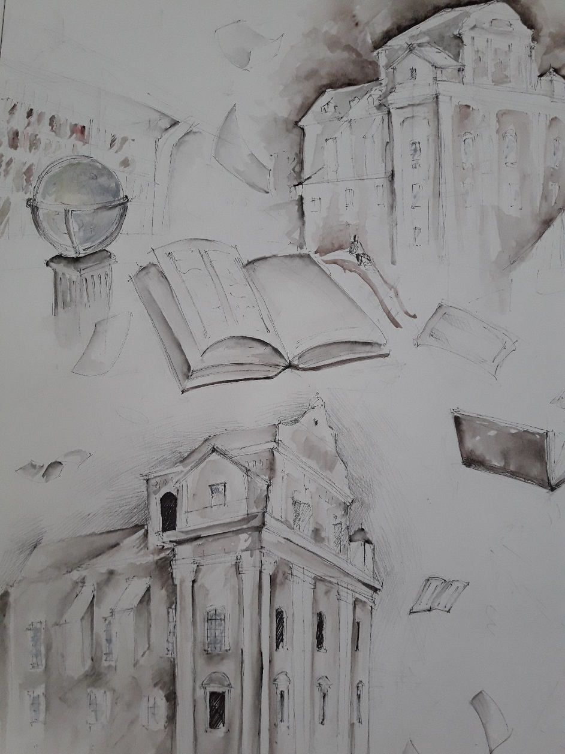
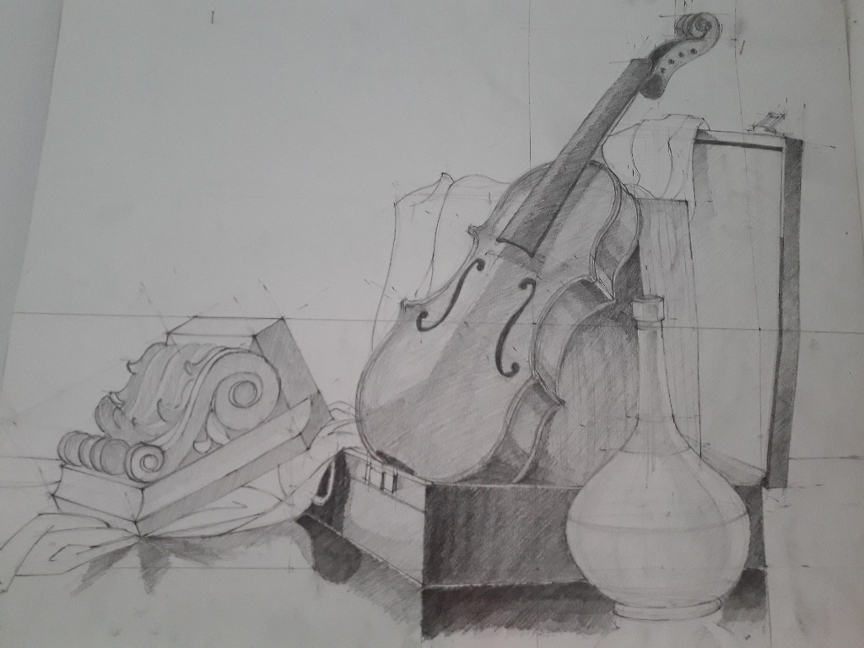
Our school…
Is MUSIC
Our life…

