Slide 1



Music is… Life Long Learning
SCIENCE AND MUSIC
ROMANIA – 29th May – 2nd June, 2017

Slide 2
PRIMARY SCHOOL: 1st grade
EXPLORING THE ENVIRONMENT
PERIOD: 8 – 19 May 2017
Number of students: 30
SUBJECT: Natural Sciences
LEARNING UNIT: Observe, Research, Discover
LESSONS: teaching, and learning about forms of energy, electricity, the wind, the sun through music

Slide 3
COMPETENCES IN SCIENCES
Identification of certain phenomena, consequences of actions and simple processes
Accomplishment of functional and/ or aesthetic creations using diverse materials and basic techniques
Finding simple explanations through the use of logical elements
Problem solving starting from the observation of some common natural features
Expression of oral messages using a few scientific terms
Exploration of the abilities of relating to the others

Slide 4
OBJECTIVES / AIMS OF THE LESSONS:
Identification of the consequences of some actions, phenomena, simple processes
Exploring the abilities of interacting with the others
Performing songs in groups adding movement
Recalling the natural/ artificial sources of light, as well as the forms of energy learned
Expressing the results of some observations using a few scientific terms

Slide 5
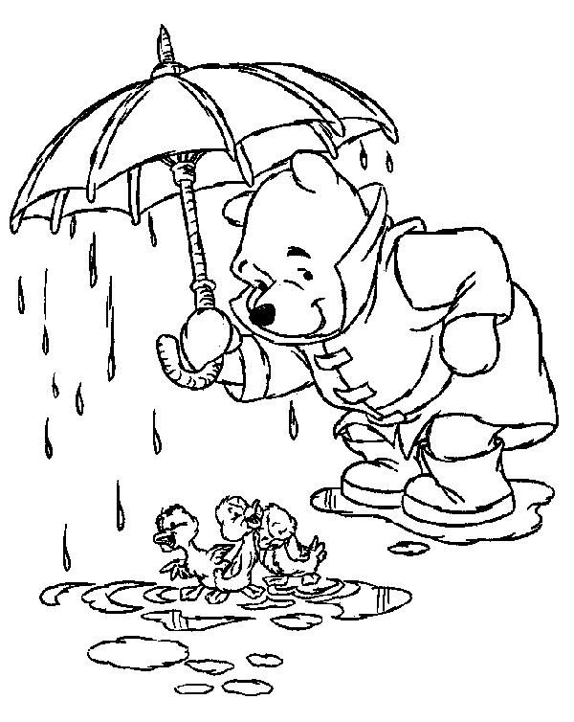
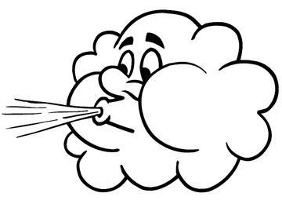

Which phenomenon is this?

Slide 6
ORGANISATION
RESOURCES
Handouts with the lyrics of songs: The wind puts the leaves of the trees in motion, The wind blows the windmill, All the flowers are coloured, Shine little star
Handouts with numbers, questions about sources of energy, topic related images/ posters
A castle where summer is a prisoner, windows to be opened to free summer
Pictures illustrating the sun, the castle, the windows, the pinwheel, flowers
Musical instruments: piano, violin, pipe
National Syllabus, Textbooks, Science books, colouring handouts, Pedagogical Books
Individual
Group performance
Whole class interaction

Slide 7
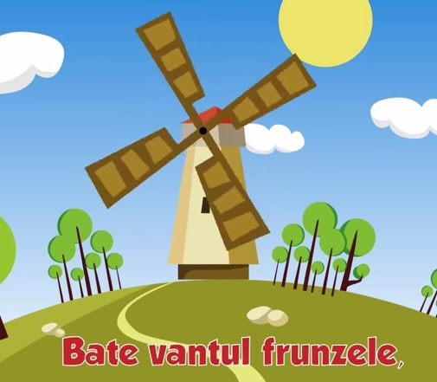
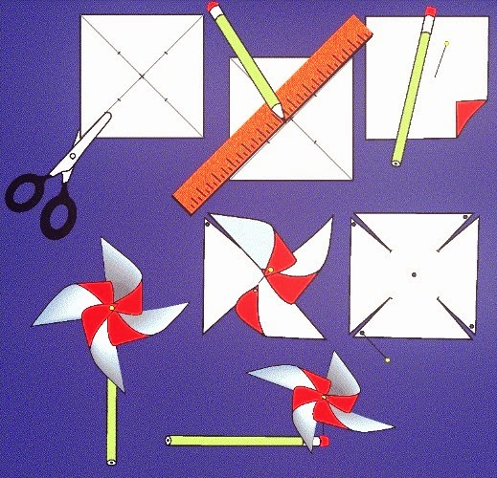
The wind blows the windmill

Slide 8
METHODS
Using explanation on musical rhythms to facilitate understanding processes, phenomena
Practice a wide range of rhitmical exercises in order to revise and consolidate specific scientific knowledge
Development of simple musical conversation including scientific elements
Problem-solving tasks starting from the themes discussed and one musical line per theme
Team work, using music creatively while performing songs
Working independently in order to assimilate the scientific elements through music

Slide 9


Slide 10
EVALUATION
Systematic observation of pupils
Song interpretations
Recognition of sources of energy
Identification of similarities and differences between sources of energy
Managing to open the windows that allow ‘summer’ to escape from the castle
Completion of evaluation worksheets while listening to certain pieces of music
Responses given during students’ interactions on the margin of the wind, the light, warmth, electricity, the sun etc.

Slide 11
IMPACT EVALUATION: BEFORE AND AFTER

Slide 12

Never forget this important thing:
…life long learning

Slide 13
PRIMARY SCHOOL: 4th grade
DISSOLUTION OF SOLIDS AND LIQUIDS. CAPILLARITY OF PARTICLES
PERIOD: 8 – 19 May 2017
Number of students: 26
SUBJECT: Natural Sciences
LEARNING UNIT: Liquids and Solids
LESSONS: teaching, and learning about the features of liquids and solids through music

Slide 14
COMPETENCES IN SCIENCES
Observation of various natural processes and phenomena through experiments
Making associations between different stages of development in scientific processes
Dealing with a range of criteria regarding the characteristics of particles
Selection of particles according to the purposes chosen

Slide 15
OBJECTIVES / AIMS OF THE LESSONS
Conducting experiments in order to observe processes and phenomena having classical music in the background
Guided observation of patterns with the aim of pointing out the relations between particles
Identification of the criteria of ordering the characteristics of particles
Highlighting some charcateristics of water and other liquids

Slide 16
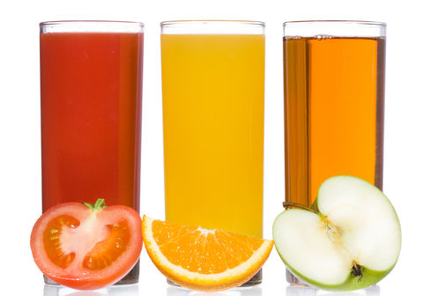
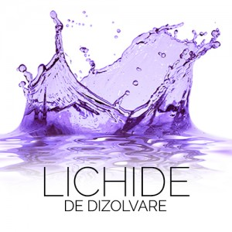
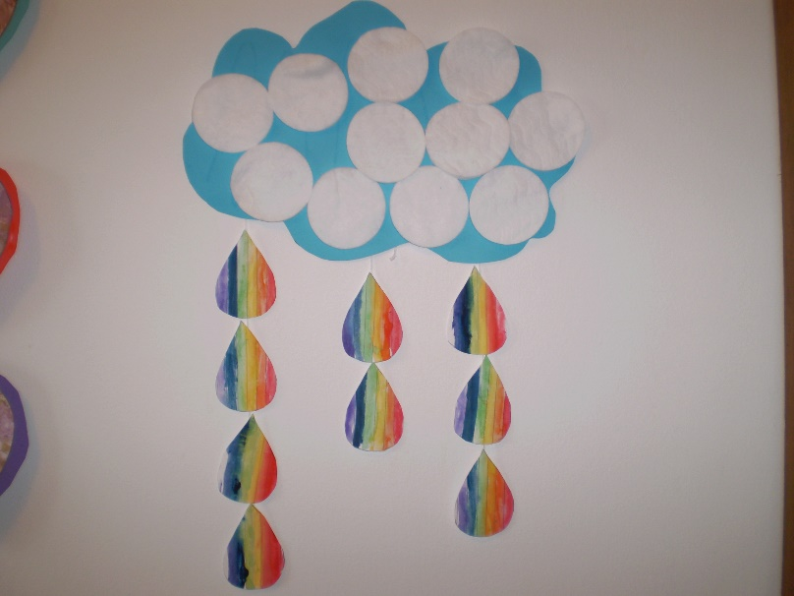
Disolvation
Yummy liquids
Rainbow drops

Slide 17
ORGANISATION
RESOURCES
Pieces of classical music (Bach, H.Bertini, Mendelssohn etc.)
Musical instruments: piano, flute, cello, violin
Materials: salt, sugar, sand, glasses of water, oil, ink, colour additive (blue and red), toilet paper, corrugated paper rolls etc.
Handouts with various theme related tasks
Process presentation in small steps, on musical rhythms
Individual
Pair work
Whole class interaction

Slide 18
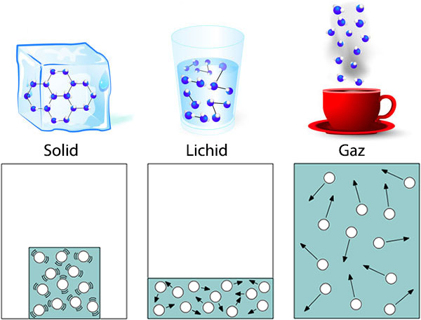
Something we all know…

Slide 19
METHODS
Performance of different classical pieces according to the topic of the activity (dissolution of solids into liquids, dissolution of liquids into liquids, dissolution of liquids used for food into other liquids, capillarity of particles etc.) and using musical instruments (piano, violin, flute, cello)
Carrying out a wide range of experiments having classical music in the background (Bach, Bertini, Mendelssohn etc.)
Revising the previous knowledge by resorting to music and the information it awakens in students’ minds: memory anchorage with music
Asking and answering questions in a musical setting
Preparation of materials required on certain musical rhythms
Paying attention to the sounds involved in the experiments carried out and connecting them to the music listened to: memory anchorage sound-experiment-phenomenon

Slide 20

Film Andreea

Slide 21
EVALUATION
Systematic observation of pupils
Interpretations of pieces of classical music in accordance to the experiments carried out
Identification of similarities and differences between liquids, solids and other particles
Answering questions about the dissolution of liquids, solids, the role of colour additives and the capillarity of particles
Completion of experiments while listening to certain pieces of music

Slide 22
IMPACT EVALUATION: BEFORE AND AFTER

Slide 23

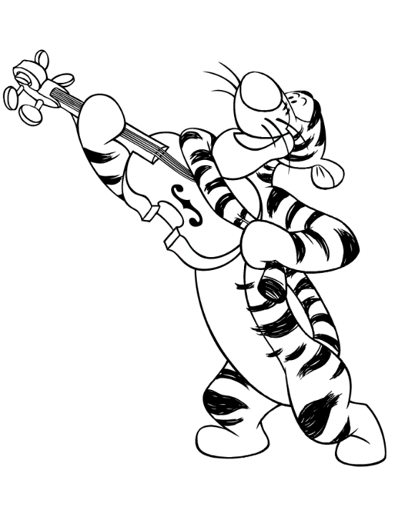
I can explain dissolution of liquids to my cat now!
I will tell her that I can practice my everyday violin exercises underwater…

Slide 24
PRIMARY SCHOOL: 3rd grade
CHARACTERISTICS AND TRANFORMATIONS OF LIFELESS PARTICLES
PERIOD: 8 – 19 May 2017
Number of students: 27
SUBJECT: Natural Sciences
LEARNING UNIT: Lifeless Particles
LESSONS: revising knowledge regarding seasons through music

Slide 25
COMPETENCES IN SCIENCES
Exploration of the characteristics of particles, phenomena and processes
Investigation of the environment using specific tools and procedures
Solving daily life problems

Slide 26
OBJECTIVES / AIMS OF THE LESSONS
Observation of seasons and identification of their characteristics
Recognition of the features of the seasons presented
Asking questions leading to the necessity of investigation in order to find out the answers

Slide 27
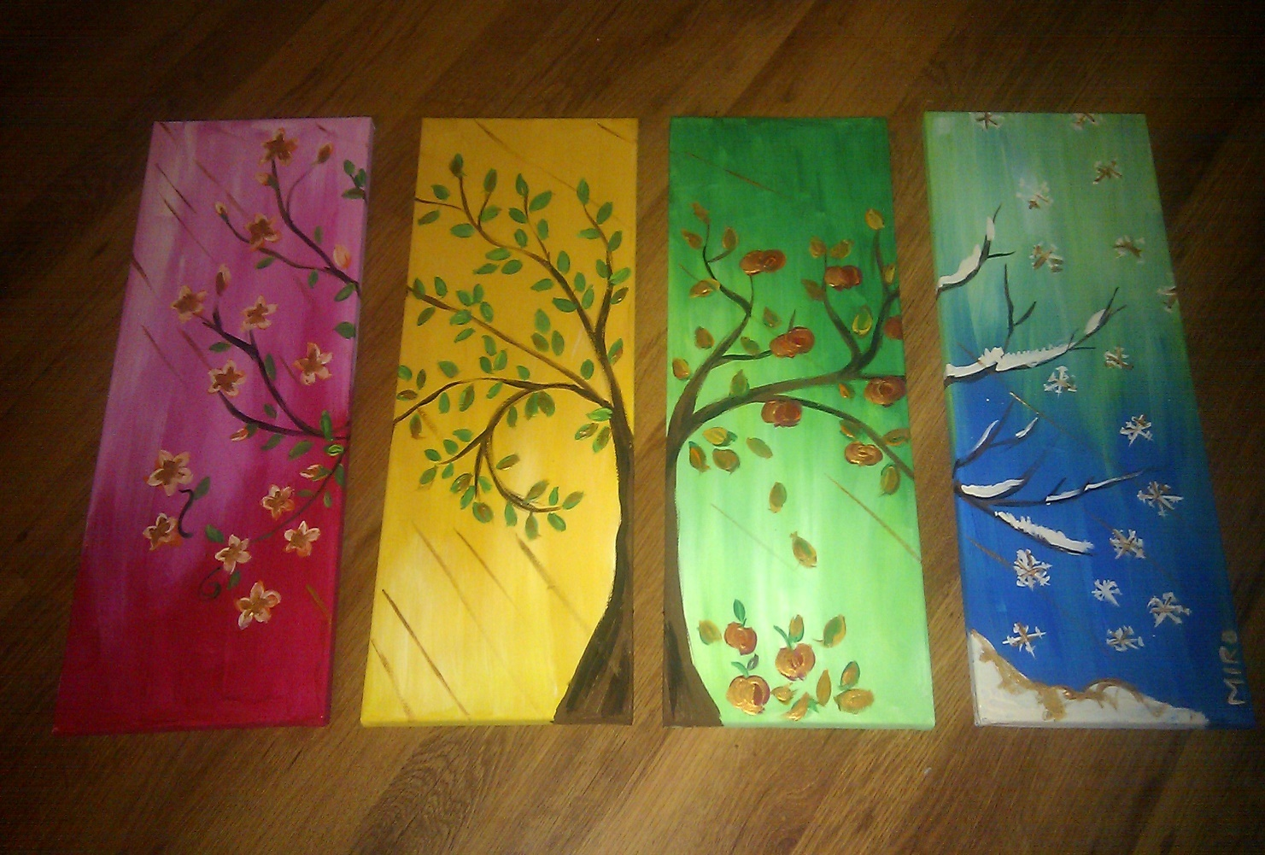
Seasons in Art: painting

Slide 28
ORGANISATION
RESOURCES
Handouts with the lyrics of songs about the seasons
Handouts with drawings of a tree changing according to the season
Pictures illustrating specific elements for the four seasons
A. Vivaldi (fragments from the four seasons)
The surprise basket containing cards with seasons and musical scores as small presents
Individual
Team work
Whole class interaction

Slide 29

The Tree of Seasons
What happens?

Slide 30
METHODS
Listening to different songs related to the seasons
Selecting specific information from songs and then synthesizing it in drawings
Making associations between the pieces of music and the seasons
Performing small pieces of music according to each season
Using the specific terms on the theme of seasons in various contexts and with different goals
Working in groups in order to achieve the expected result
Encouragement of artistic expression of feelings and emotions through music and drawing
Adopting proper body posture during the activities

Slide 31

4 Tissues
Happiness handouts

Slide 32
EVALUATION
Observation of pupils
Performance of pieces of music and interpretation of music through drawing
Associations of music with the specific notions used in connection to seasons
Degree of cooperation in the process of reaching a result
Using the specific notions in other contexts
Completion of evaluation worksheets while listening to certain pieces of music
Acknowledgement of the main features of each season through musical expression

Slide 33
IMPACT EVALUATION: BEFORE AND AFTER

Slide 34
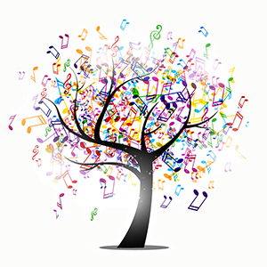
IMPACT EVALUATION: Seasons ARE Music!

Slide 35
SECONDARY SCHOOL: 6TH grade
PHYSICS – MAGNETIC PHENOMENA
PERIOD: 8 – 19 May 2017
Number of students: 50 (27 A and 23 B)
SUBJECT: Physics
LEARNING UNIT: Magnetic Phenomena
LESSONS: teaching, and learning how to build an electromagnet in a musical setting

Slide 36
COMPETENCES IN SCIENCES
Structured scientific investigation through experiments
Scientific explanation of some simple phenomena in Physics and some technical applications
Interpretation of data and information obtained through experiments regarding simple phenomena in Physics
Solving problems / situations through methods specific to Physics

Slide 37
OBJECTIVES / AIMS OF THE LESSONS
Gaining knowledge about the characteristics of magnets
Acquiring practical skills in the field of making magnets and using them
Becoming aware of the role played by each element in building an electromagnet

Slide 38
ORGANISATION
RESOURCES
Presentation of magnets – definition and properties
School magnet kit
Pieces of music reflecting the world of magnets (flute, guitar), Jean Michel Jarre, Magnetic Field
Materials: screw or iron nail, wire, battery, paper clips
The National Syllabus for Physics
Individual
Whole class interaction

Slide 39
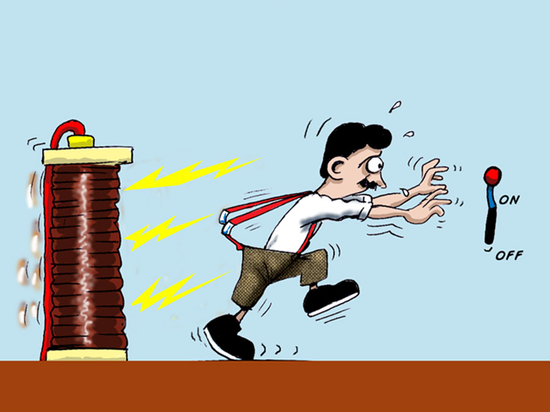
Electromagnetism is funny!

Slide 40
METHODS
Starting the lessons with a piece of music played at a musical instrument (flute, piano)
Presentations of the topic of the lessons emphasizing definitions and characteristics
Bringing practical materials in class, such as the school magnet kit
Building experiments in Physics in relation to music in different ways according to the content of the lesson, to the knowledge to be acquired, students’ attitudes and approaches of the process or the laws governing the issues taught
Drawing students’ attention to an increased focus on building a magnet with the help of music
Facilitating students’ understanding of various phenomena in Physics by using music as a link between the laws governing Physics and the way they work in the world

Slide 41

Film clasa a 6 a – magneți

Slide 42
EVALUATION
Systematic observation of pupils
Associations of musical pieces and the issue explored from Physics in order to remember better the scientific notions and stages
Students’ involvement in the accomplishment of the task (e.g. building an electromagnet)
Achievement of the final product (e.g. electromagnet) and testing it for proper working (checking whether the electromagnet attracts the paper clips or not)

Slide 43
6A IMPACT EVALUATION: BEFORE AND AFTER

Slide 44
6A IMPACT EVALUATION: BEFORE AND AFTER

Slide 45
6A IMPACT EVALUATION: BEFORE AND AFTER

Slide 46
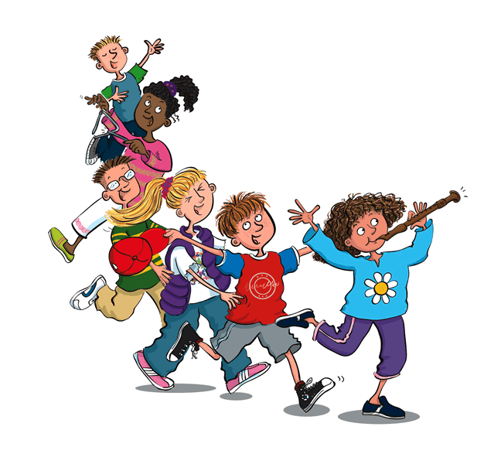
From now on, this is how we go to Physics class

Slide 47
6B IMPACT EVALUATION: BEFORE AND AFTER

Slide 48
6B IMPACT EVALUATION: BEFORE AND AFTER

Slide 49
6B IMPACT EVALUATION: BEFORE AND AFTER

Slide 50
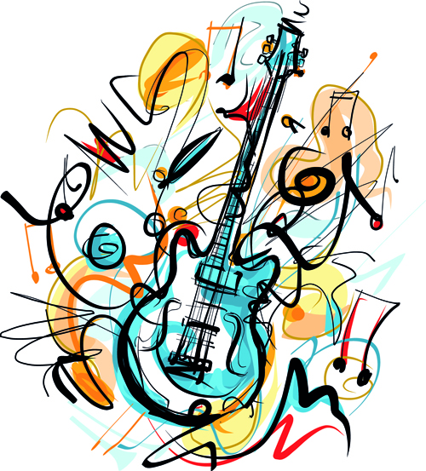

Like this… I love science classes! Physics rocks!

Slide 51
SECONDARY SCHOOL: 7th grade
How to Make Your Own Slime?
AND
Chemical Volcano
PERIOD: 8 – 19 May 2017
Number of students: 39 (7A 19 and 7B 20)
SUBJECT: Chemistry
LEARNING UNITS: Substance. Mixture. Chemical Reactions
LESSONS: teaching, and learning about mixtures and chemical reactions through music

Slide 52
COMPETENCES IN SCIENCES
Exploration of phenomena and properties of substances encountered in daily activity
Interpretation of data and information obtained during the process of investigation
Solving problems in concrete situations using algorithms and tools specific to Chemistry
Evaluation of the consequences of processes and effects of chemical substances on the individual and the environment

Slide 53
OBJECTIVES / AIMS OF THE LESSONS:
Gaining knowledge about the characteristics of chemical mixtures
Acquiring practical skills related to mixtures in chemistry
Becoming aware of the differences between mixture and combination
Development of practical abilities in working with chemical substances

Slide 54
ORGANISATION
RESOURCES
Materials slime: glue, colour additive, shaving foam, liquid washing powder, glitter
Materials volcano: modeling clay (colour additive, water, vegetable oil, flour, salt), jars, bowls, spoons, baking soda, vinegar
Presentation of chemical processes
Musical instruments: piano, flute
Song: I’m the amateur chemist
National Syllabus for Chemistry
Individual
Whole class interaction

Slide 55

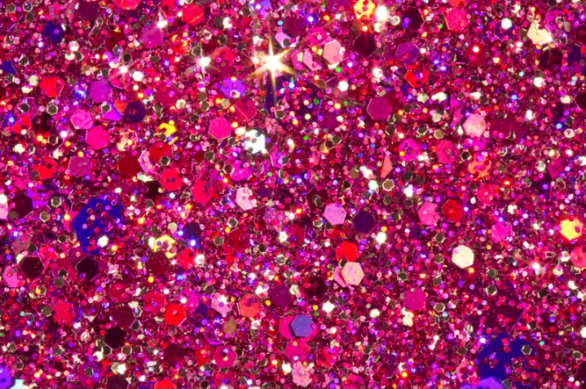
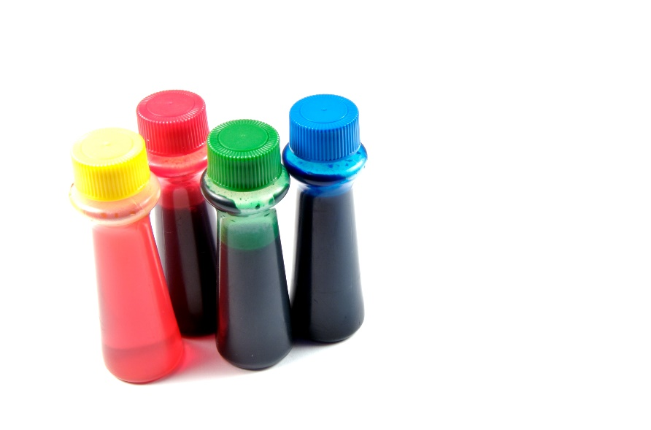
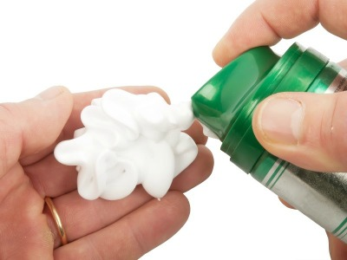
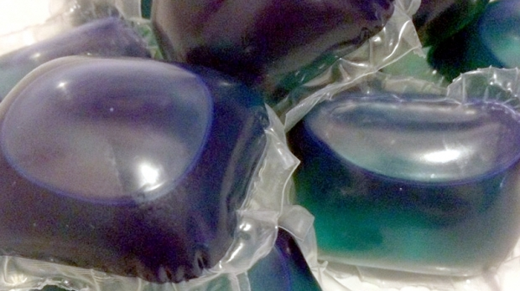
RESOURCES
Glue
Shaving foam
Food colouring
Liquid detergent
Glitter

Slide 56
METHODS
Presentation of the chemical process that students have to carry out as an experiment similar to You Tube videos of How to ….? (combining the ingredients in order to obtain the chemical mixture for the slime, combining the ingredients in order to obtain the molding clay used for building the volcano, combining the ingredients that render the chemical reaction similar to the eruption of a volcano etc.) having classical music in the background
Creating a musical atmosphere in which the experiments to take place so that students associate the peacefulness of the pieces of music chosen with working with chemical mixtures

Slide 57

Film clasa a 7 a - slime

Slide 58
METHODS
Offering assistance to students in the development of the chemical experiments carried out by each one of them through simple suggestions or observations and encouragement in working with substances
Gradual movement from one stage to another so that students notice the changes produced by the chemical reactions, movement facilitated by the music played (piano, flute etc.)

Slide 59
Film clasa a 7 a- chemical volcano

Slide 60
EVALUATION
Systematic observation of the gradual movement from one chemical phase to another and students’ responses across the process
Preparation of the chemical mixtures and the substances obtained (slime, molding clay)
Achievement of the chemical reactions required (e.g. eruption of the volcano)
Pursuit of the chemical phases presented leading to the accomplishment of the chemical experiment

Slide 61
7A IMPACT EVALUATION: BEFORE AND AFTER

Slide 62
7A IMPACT EVALUATION: BEFORE AND AFTER

Slide 63
7A IMPACT EVALUATION: BEFORE AND AFTER

Slide 64

7A IMPACT EVALUATION: This is How We Feel!

Slide 65
7B IMPACT EVALUATION: BEFORE AND AFTER

Slide 66
7B IMPACT EVALUATION: BEFORE AND AFTER

Slide 67
7B IMPACT EVALUATION: BEFORE AND AFTER

Slide 68
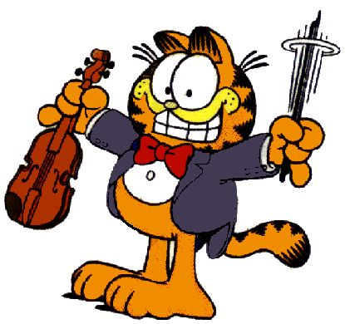
7B IMPACT EVALUATION: This is How We Feel!

Slide 69
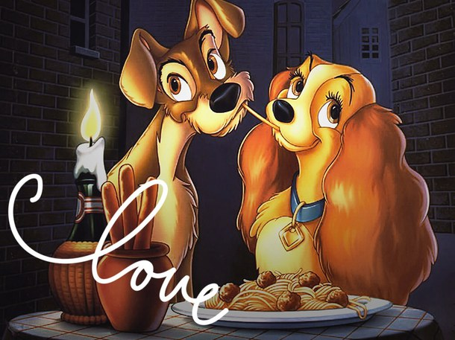
SCIENCE
MUSIC

Slide 70

Music is life…
Science just makes it more interesting…
Thank you!

