Slide 1
Music is… Life Long Learning
LEARNING TO LEAN THROUGH MUSIC 2
Liceul de Arte “Regina Maria” Alba Iulia
ITALY – 28th MAY - 1st JUNE, 2018

Slide 2
PRIMARY – 3rd grade, + ART: fine arts students (drawings)
AT THE MARKET:
Development and Growth of Plants
PERIOD: 11th -20th April 2018
Number of pupils: 29
SUBJECT: Natural sciences: Plants
ACTIVITIES: exploration of the characteristics of plants while performing songs about plants, observation/description of plants’ development stages/conditions through music, analysis of seeds in musical settings, role play at the market

Slide 3
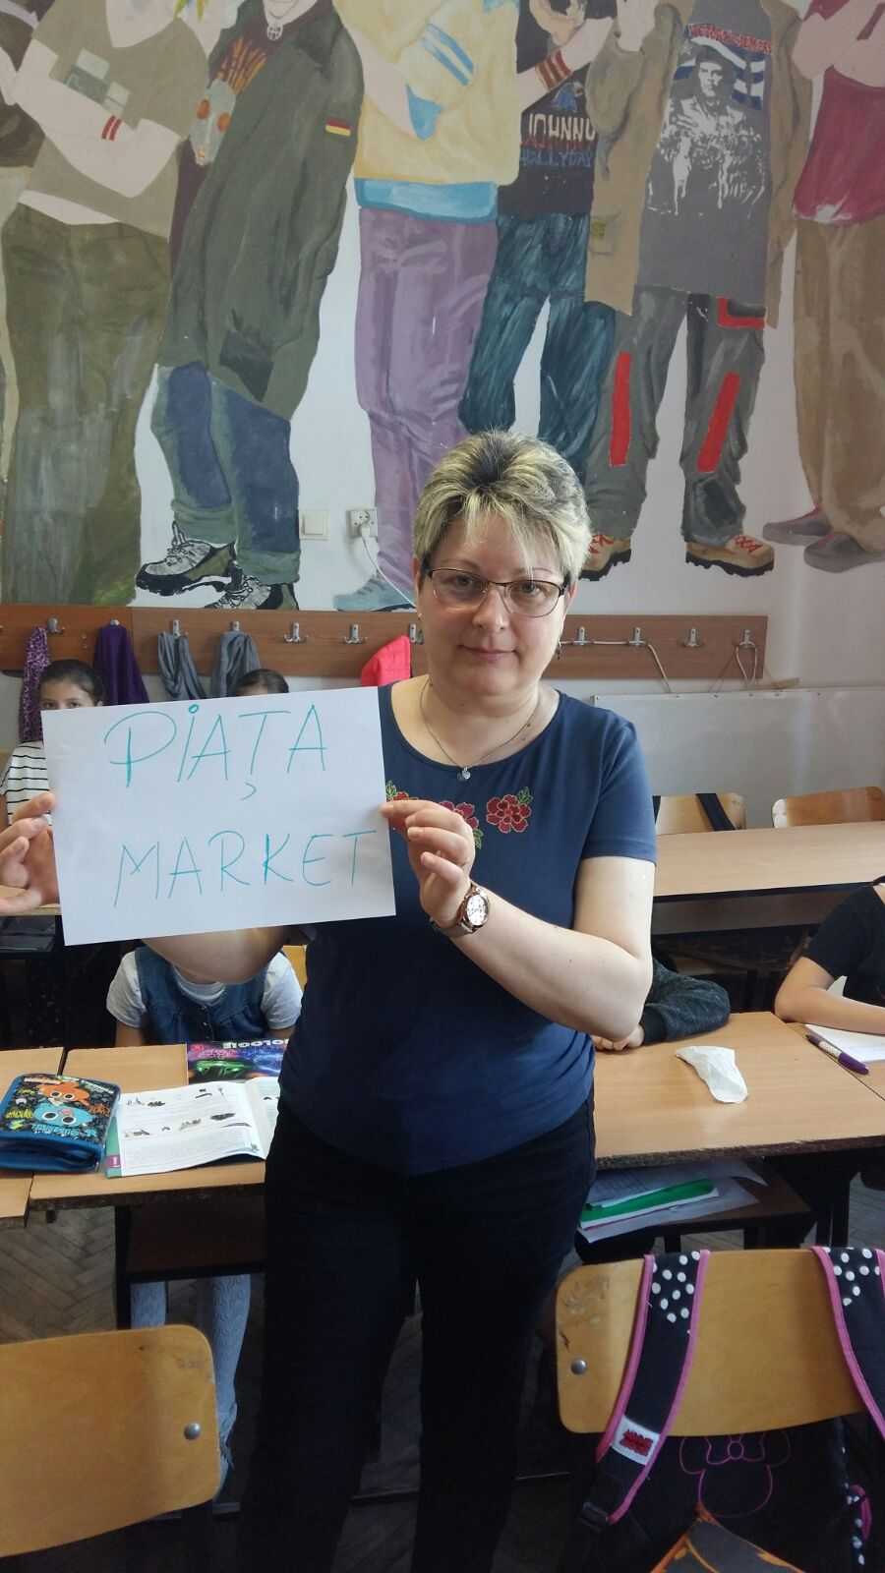
COMPETENCES
Exploration of characteristics, stages identification, comparison criteria in relation to elements from nature
Presentation of conclusions regarding the investigations carried out and the use of acquired knowledge in daily life

Slide 4
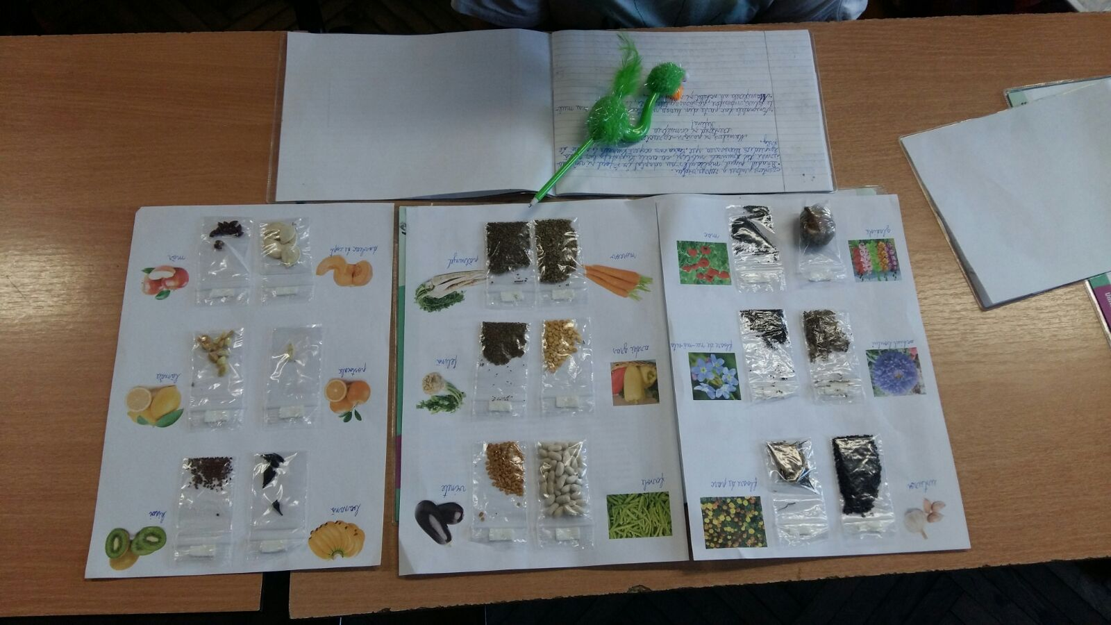
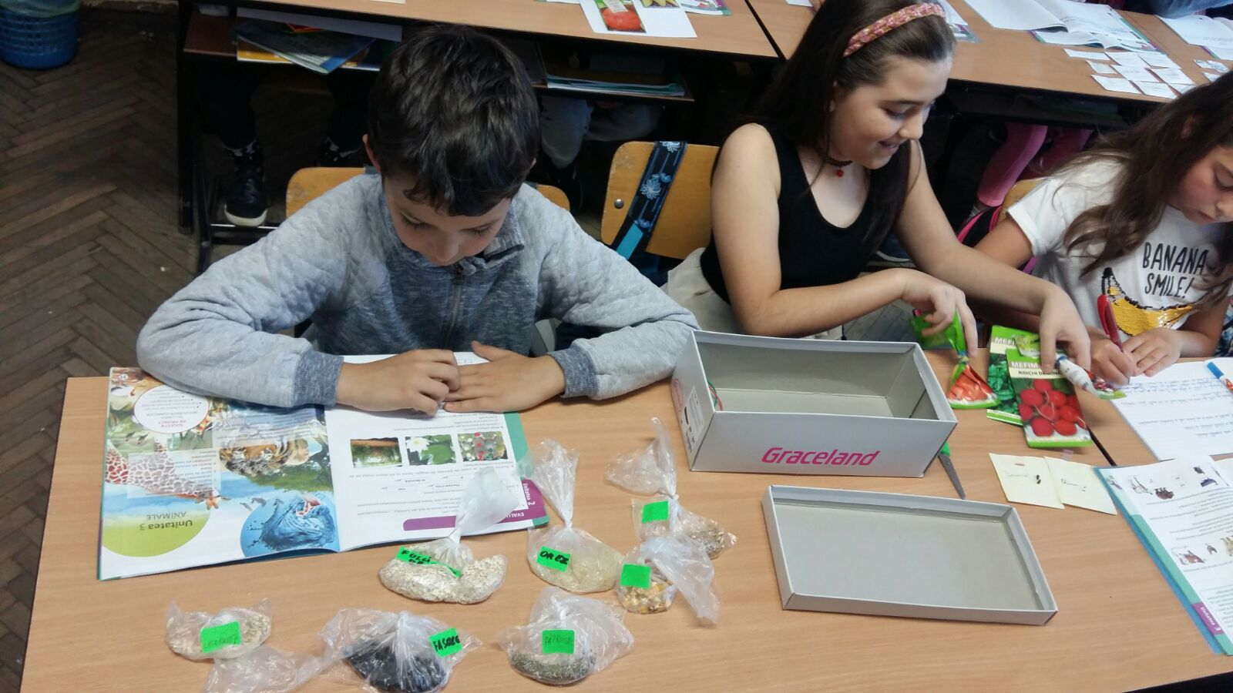

Slide 5
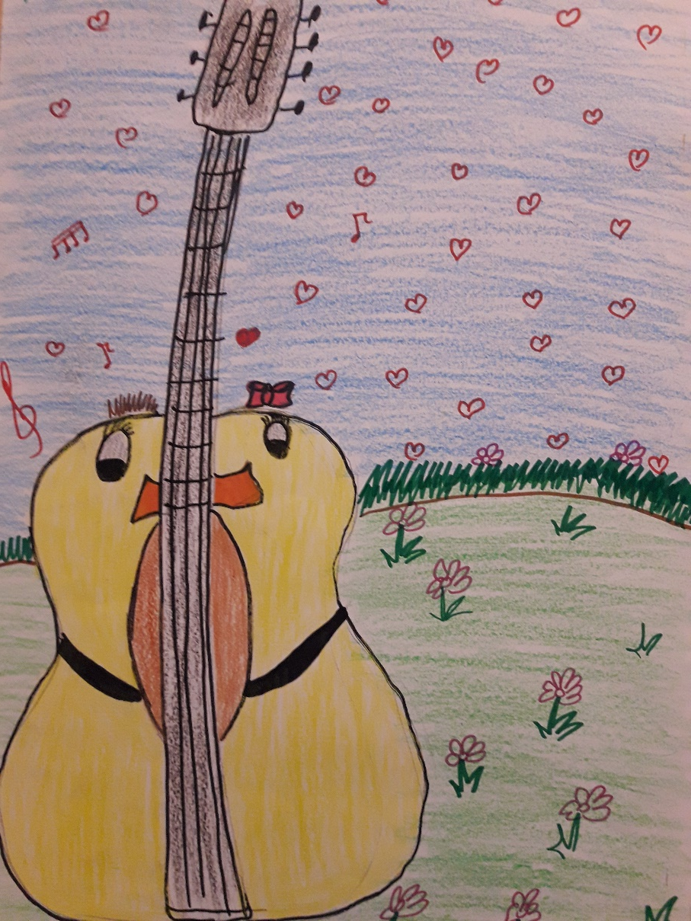
METHODOLOGY
Exploration of the parts of plants using posters (vegetables, flowers, trees, medical plants)
Observation of plant germination (wheat, corn, beans)
Song interpretation: The Rose, The Snowdrop, The Fir Tree, Edelweiss, traditional Romanian folk songs

Slide 6
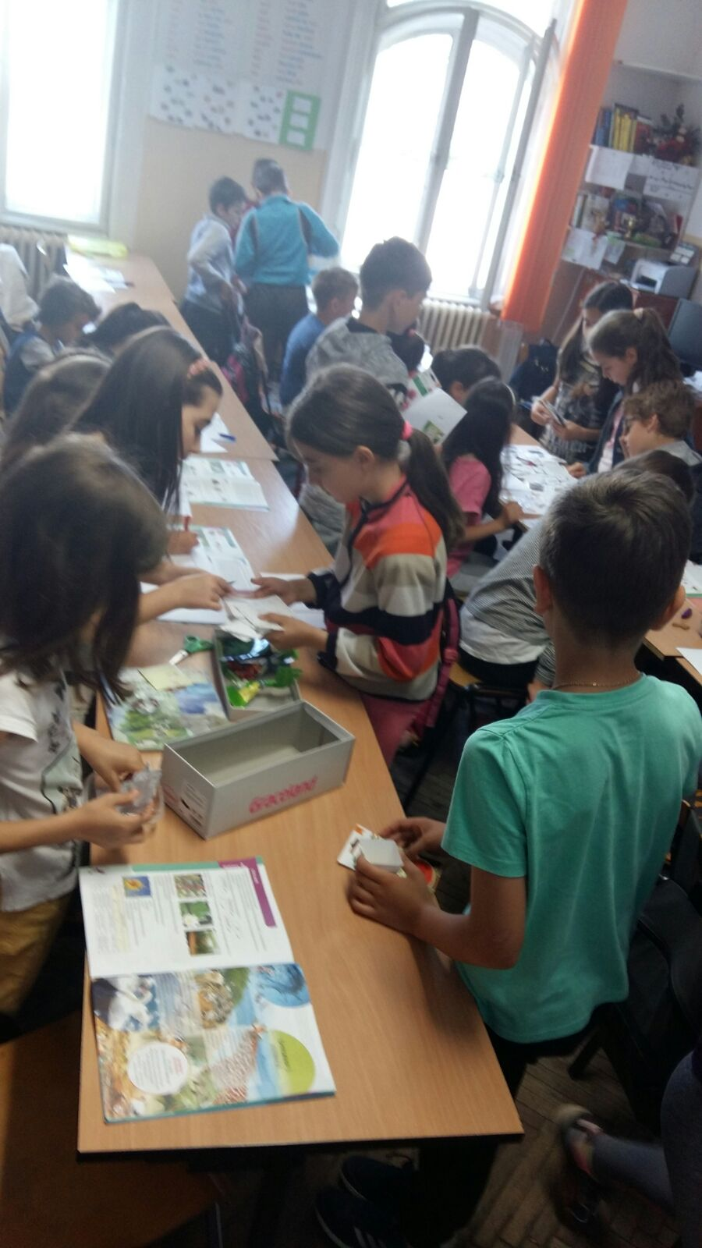
METHODOLOGY
Description of plants’ basic needs (water, air, light, temperature, soil) and the stage of their development including environmental conditions
Comparison of various seeds brought by pupils writing down observations
Role play: at the market (agriculturists, farmers, buyers) where pupils exchange/ buy seeds to improve their agricultural crops

Slide 7
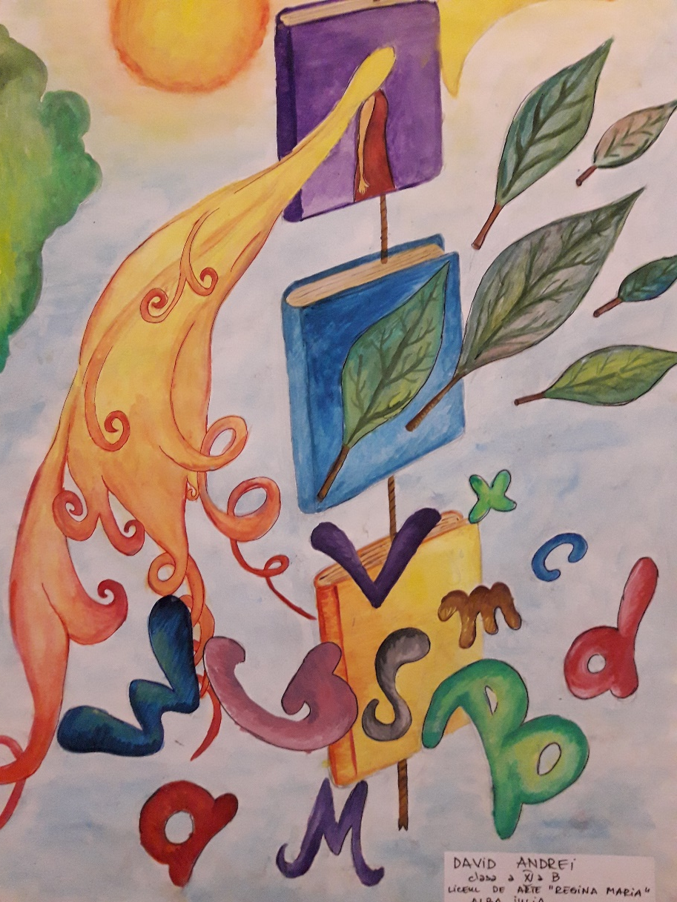
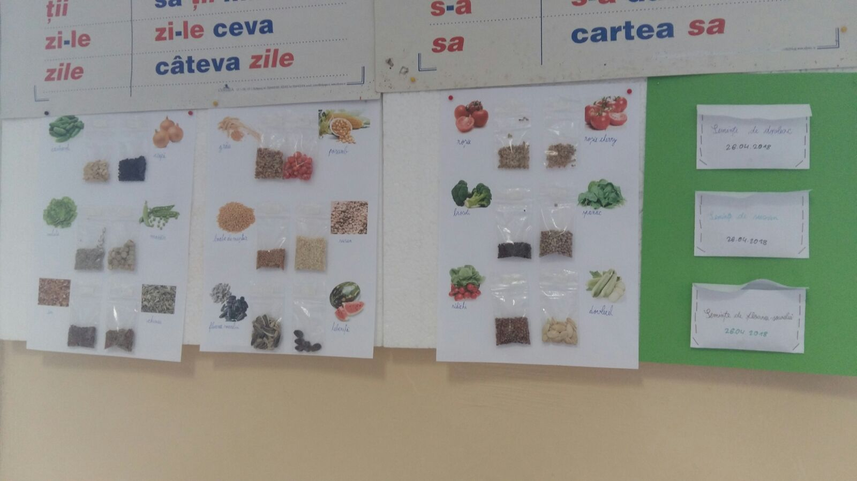

Slide 8
ORGANISATION
RESOURCES
Musical instrument: piano
Flower pots with different plants / seeds
Classical music: F. Chopin, Spring Waltz
Songs: The Rose, The Snowdrop, The Fir Tree, Edelweiss (Ducu Bertzi), Ana Lugojana (I. Vidu)- folkloric song
Portfolios with various information regarding plans and their specific elements
Boxes with different seeds (vegetables, fruit, medical plants, trees)
Individual
Pair/Group work
Class interaction

Slide 9
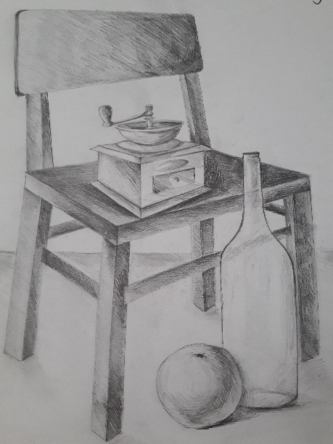
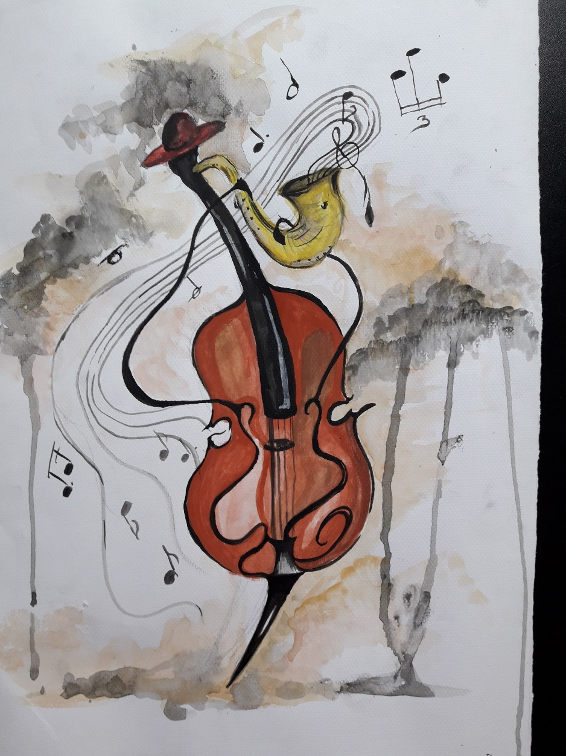
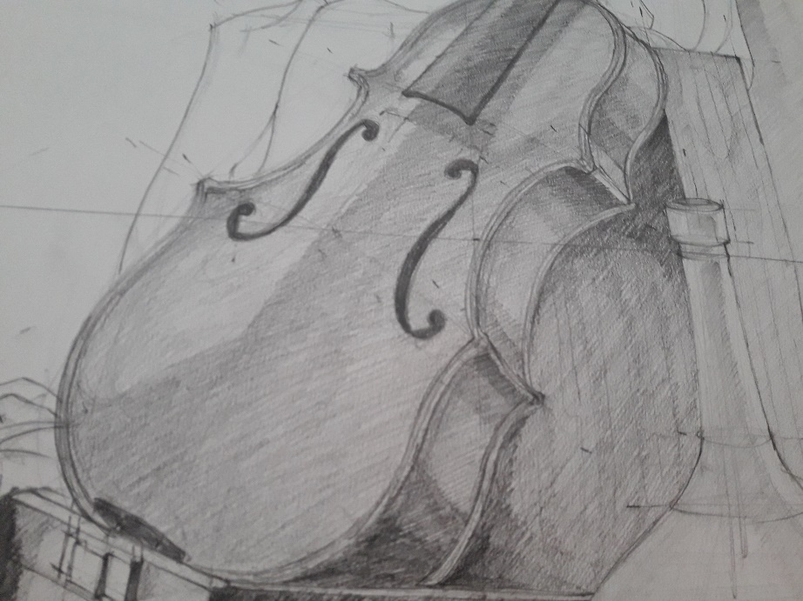
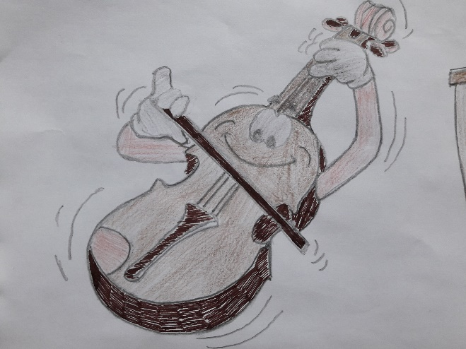

Slide 10
EVALUATION of competences
Observation of pupils
Identification of the parts of different plants (vegetables, flowers, trees etc.)
Song interpretations according to each activity
Description of the observations made in connection to the basic needs of plants
Presentation of the information acquired in pupils’ portfolios
Identification of criteria while comparing the characteristics of seeds
Participation in the role play: at the market

Slide 11
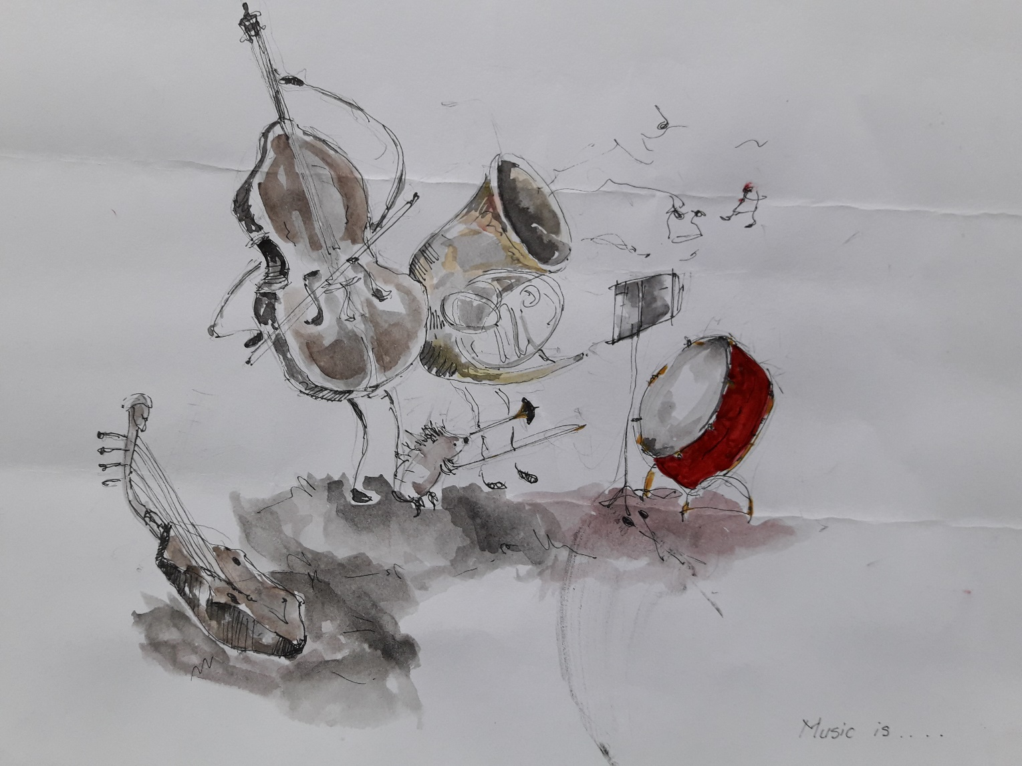

Slide 12
PRIMARY – 3rd grade, +ART: architecture students (drawings)
Childhood Adventures
PERIOD: 23rd April - 4th May 2018
Number of pupils: 29
SUBJECT: Incursion in Childhood Literary Texts
ACTIVITIES: identification of key elements in literary texts and song interpretation, poem structure with music, telling stories with music at the library, identification of the structure of a fairy tale and project anthem interpretation

Slide 13
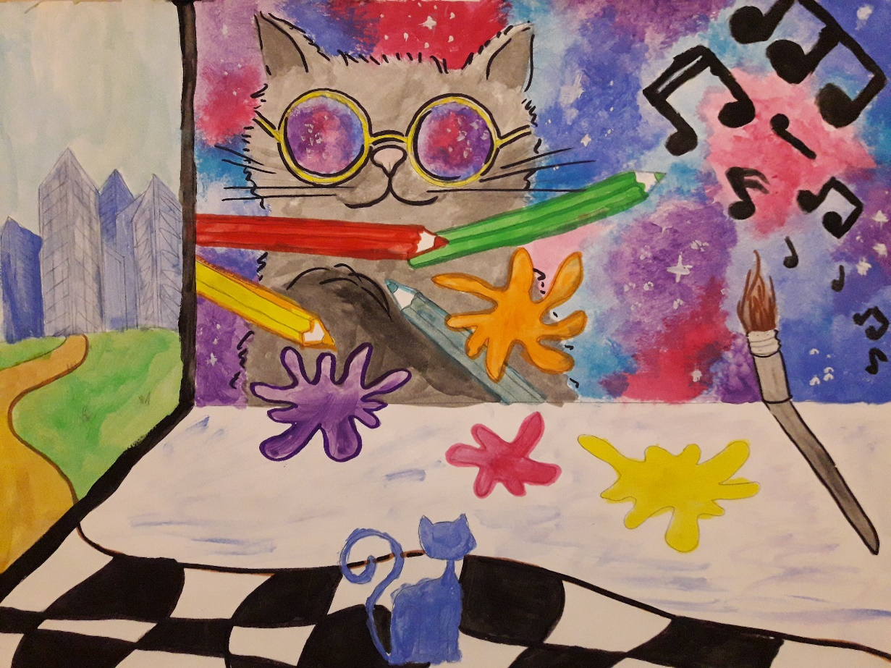
COMPETENCES
Identification of key elements in literary texts and manifestation of curiosity towards literary messages
Narration of familiar events or stories starting from the reading of different literary texts

Slide 14
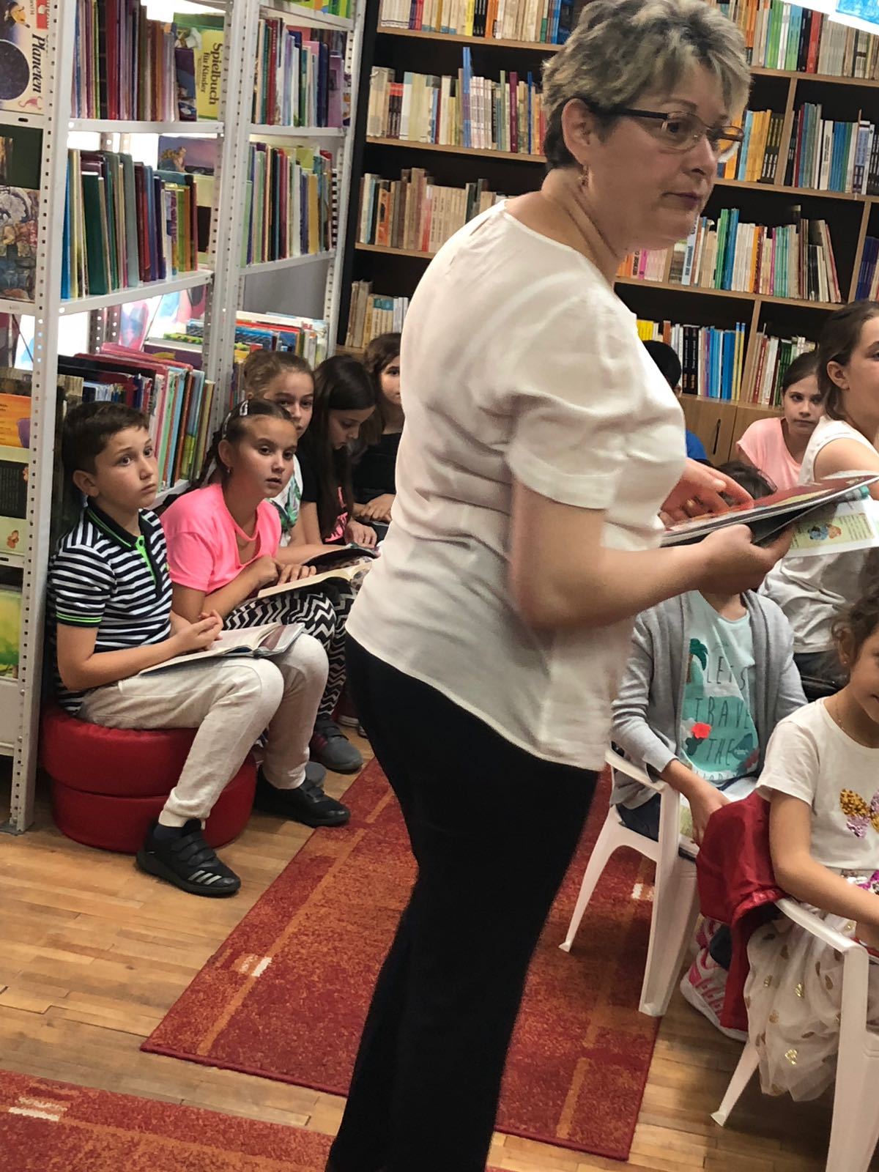
METHODOLOGY
Identification of key words, characters, main events/messages in literary texts (poems, short stories, fairy tales)
Poem interpretations in musical settings
Expressing feelings related to the texts discussed through music
Songs related to the themes of the selected literary texts
Creating drawings for each text discussed having music in the background

Slide 15
METHODOLOGY
Reading poems, fragments from stories/ fairy tales aloud
Pointing out the structures of fairy tales during reading and discussions
Characterization of characters and identification of the moral of stories
Performance of project’s anthem at the Alba County library

Slide 16
ORGANISATION
RESOURCES
Project’s anthem
Drawings inspired by poems, stories, fairy tales
Books from “Lucian Blaga” Alba County Library (O. Cazimir, For you, spring!, Ana Blandiana, One day as I was working, Mircea Santimbreanu, The little key, P. Ispirescu, The poor man’s smart daughter)
Reading and Borrowing Rooms from “Lucian Blaga” Alba County Library
Individual
Pair/Group work
Class interaction

Slide 17
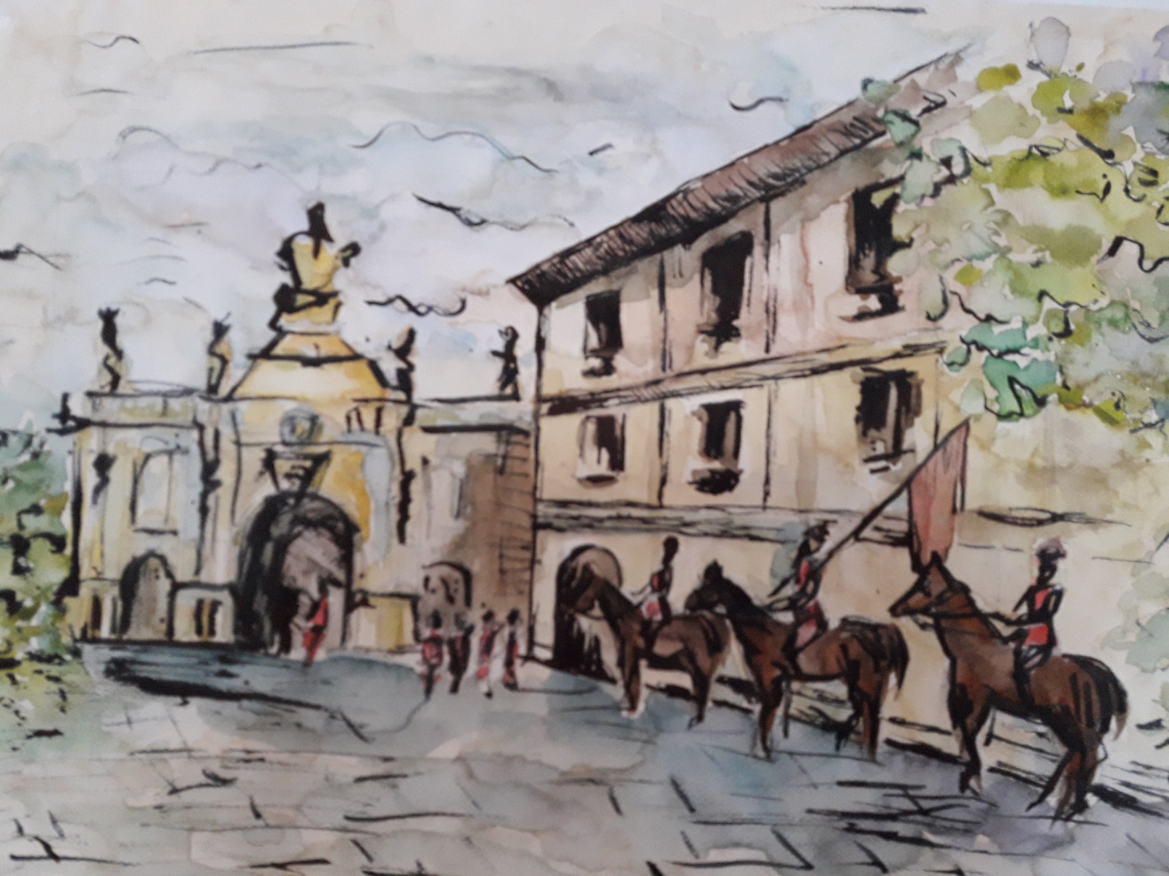

Slide 18
EVALUATION of competences
Observation of pupils
Identification of key words, characters, main events/messages, lessons in literary texts (poems, short stories, fairy tales)
Observation of the structure of fairy tales
Reading of poems, verses or stanzas aloud with intonation
Characterization of characters in stories, fairy tales
Drawings representing messages understood by pupils from poems, stories, fairy tales
Performance of the project’s hymn

Slide 19
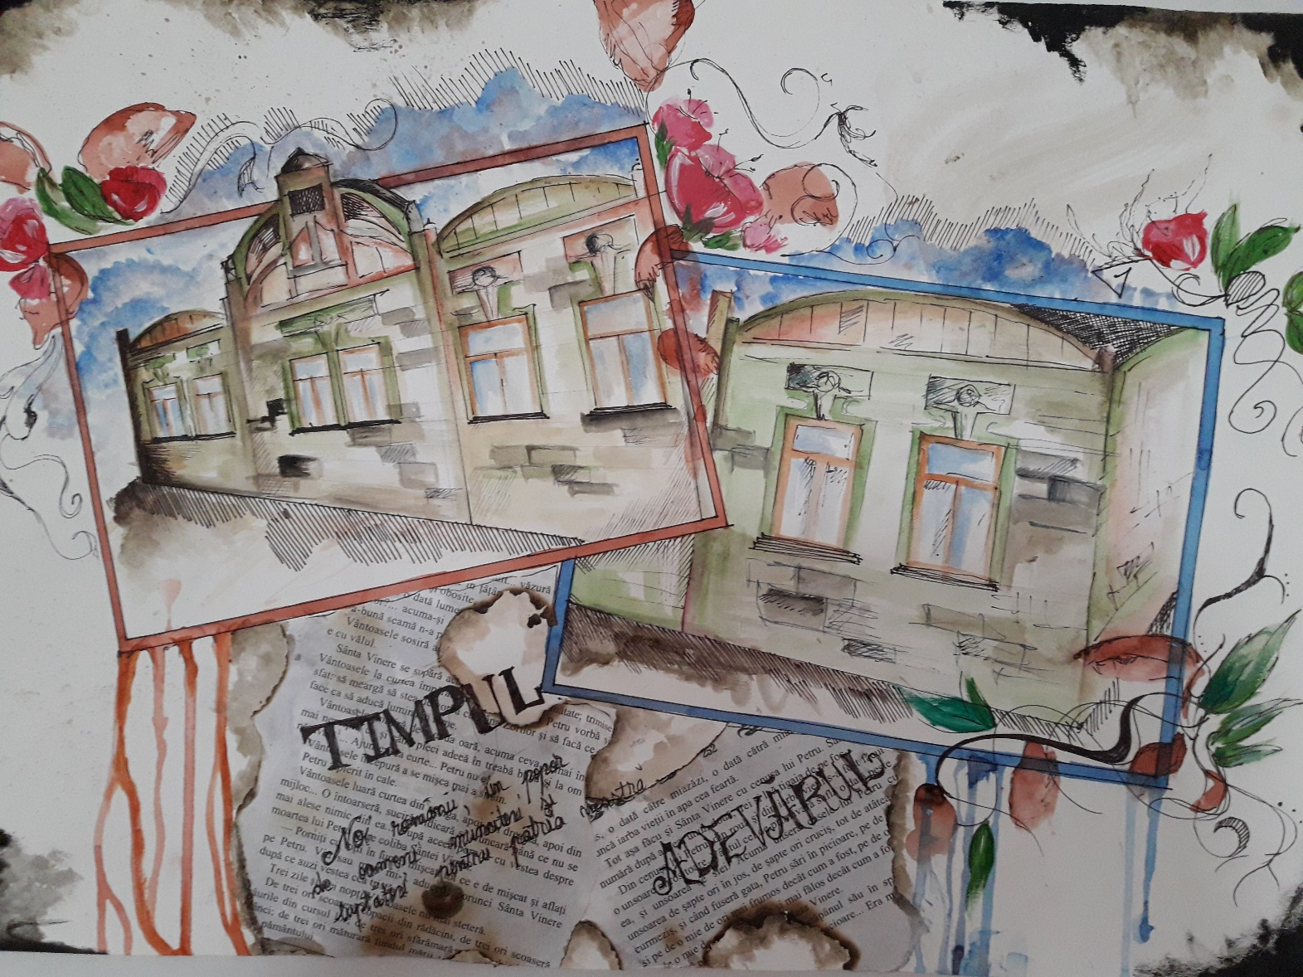

Slide 20
PRIMARY – 3rd grade
Practical skills: Quilling
PERIOD: 7th - 18th May 2018
Number of pupils: 29
SUBJECT: Practical skills: quilling design
ACTIVITIES: preparing various materials, combining different techniques of using materials, making use of material in artistic works having music in the background or performing songs adapted to the work carried out

Slide 21
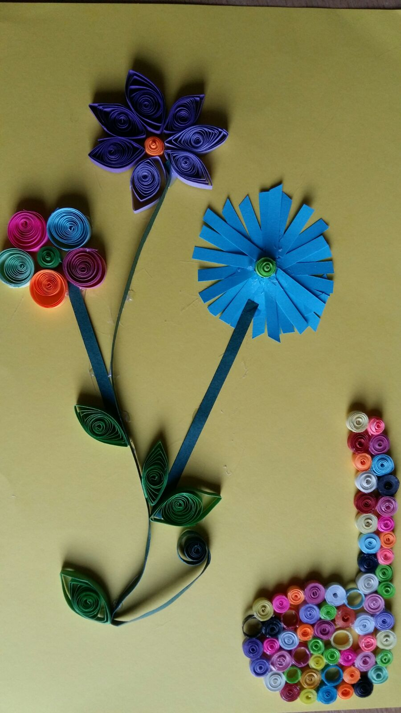
COMPETENCES
Using materials according to their properties and working techniques in various contexts
Manifestation of receptivity towards visual expression

Slide 22
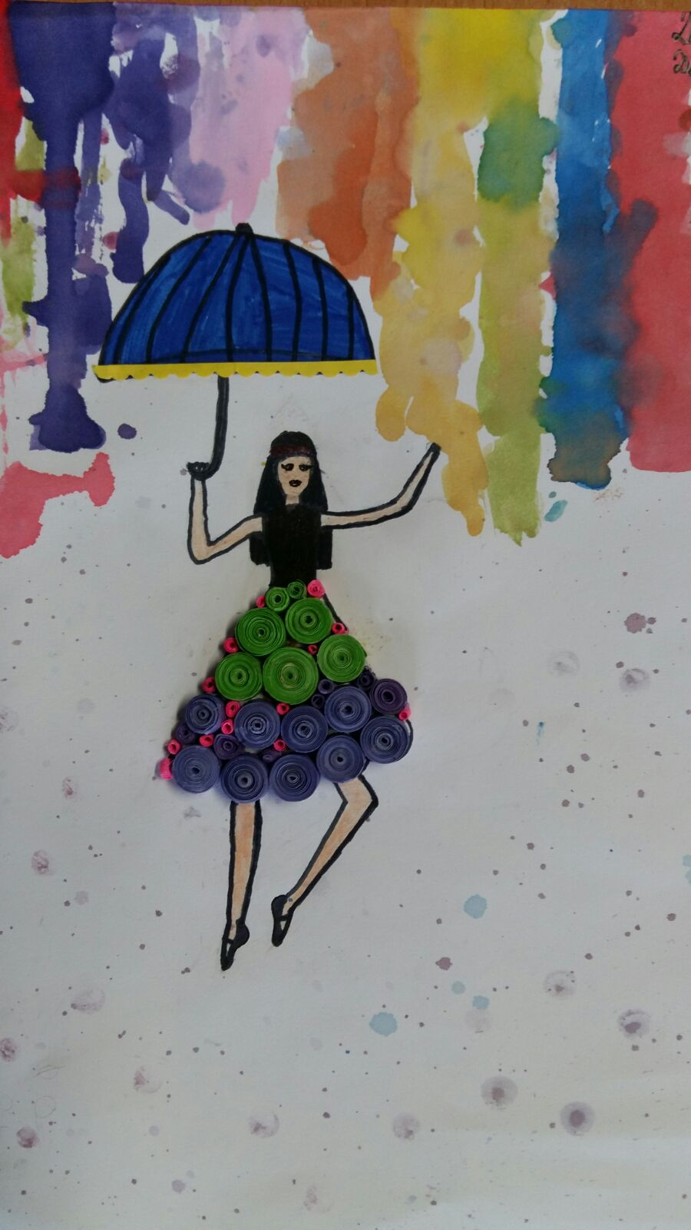
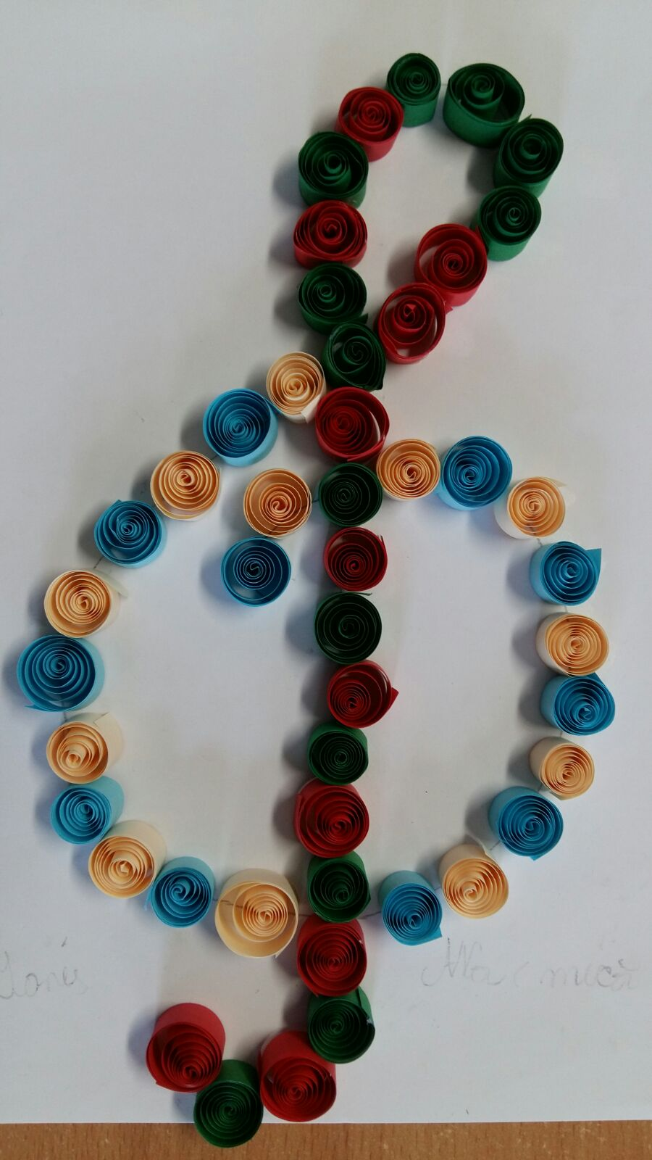

Slide 23
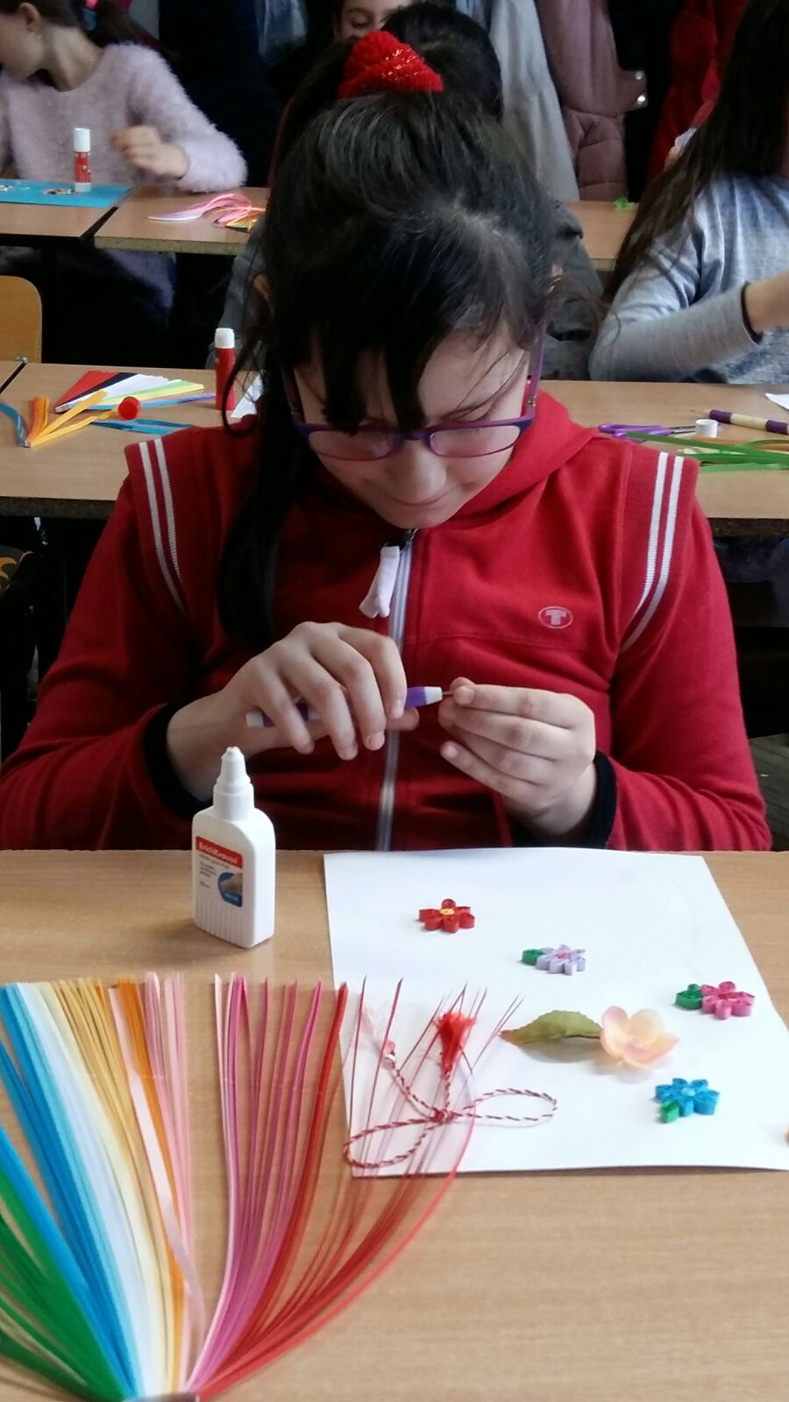
METHODOLOGY
Pupils choose the materials they want to use (paper sheets – different colours, different types of glue, scissors, paper bands for rolling etc. ), the spacial frames they want to build on, the themes they want to represent (spring, flowers, insects, musical notes etc.)
Classical music: Vivaldi, Spring, Beethoven, Moonlight Sonata, Tchaikovsky, The Waltz of the Flowers
Song performance using various musical instruments: piano, cello, violin, guitar

Slide 24
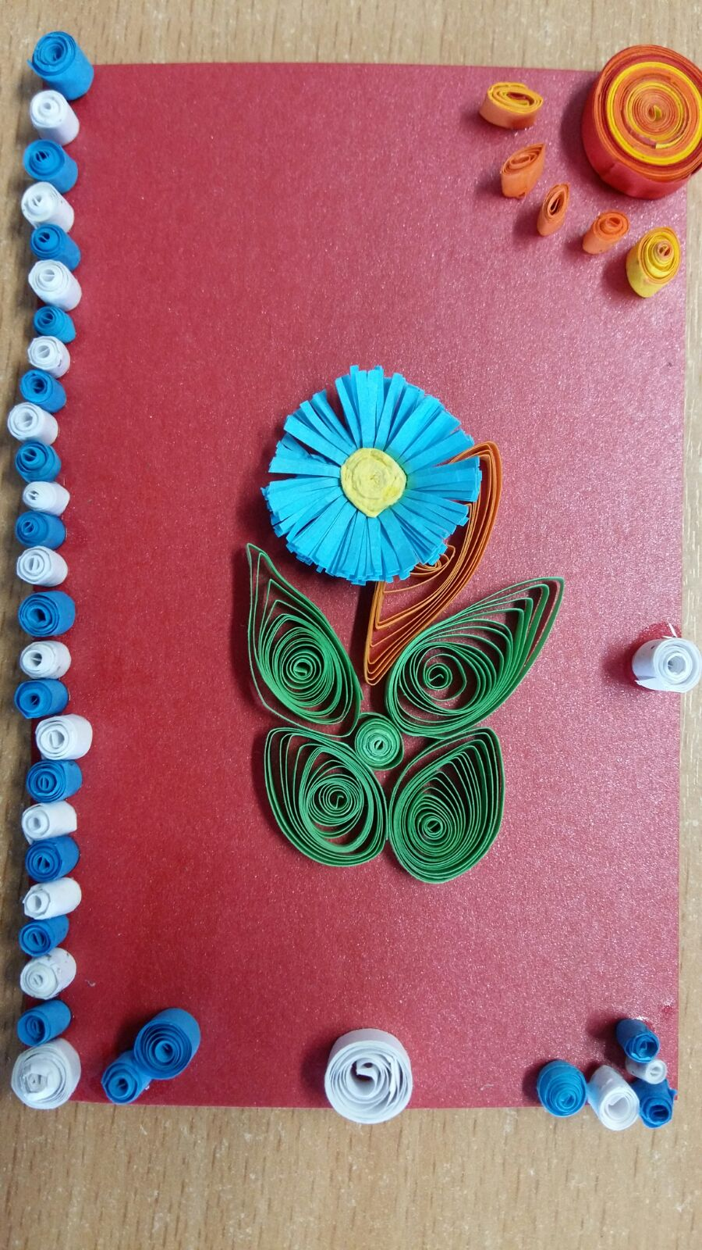
METHODOLOGY
Pupils work individually and in groups in order to complete the pictures using the quilling technique and having classical music in the background
Exhibition with pupils’ works in musical setting (J. Strauss, The Blue Danube Waltz)
Performing the project’s hymn Like a little flower

Slide 25
ORGANISATION
RESOURCES
Materials: sheets of paper of different colours, shaped frames, different types of glue, scissors, needles, paper bands
Classical music: Vivaldi, Spring, Beethoven, Moonlight Sonata, Tchaikovsky, The Waltz of the Flowers, J. Strauss, The Blue Danube Waltz
The project’s anthem: Like a little flower
The quilling technique
Individual
Pair/Group work
Class interaction

Slide 26
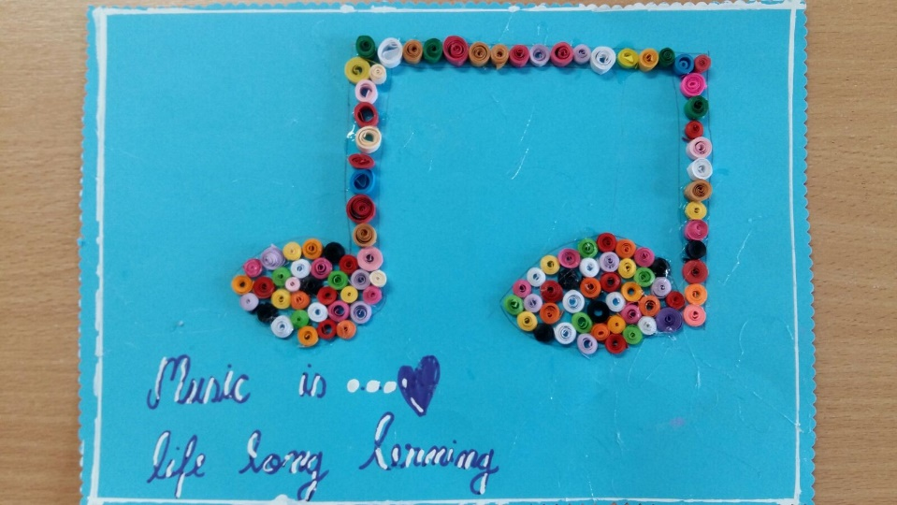

Slide 27
EVALUATION of competences
Observation of pupils
Combination of materials in order to create the pictures
Use of materials in order to render a message through the quilling technique
Selection of themes to be represented and the arrangement of materials in rendering the themes
Involvement in the creation of the pictures and willingness to collaborate and discover new perspectives
Performance of the project’s hymn: Like a little flower

Slide 28
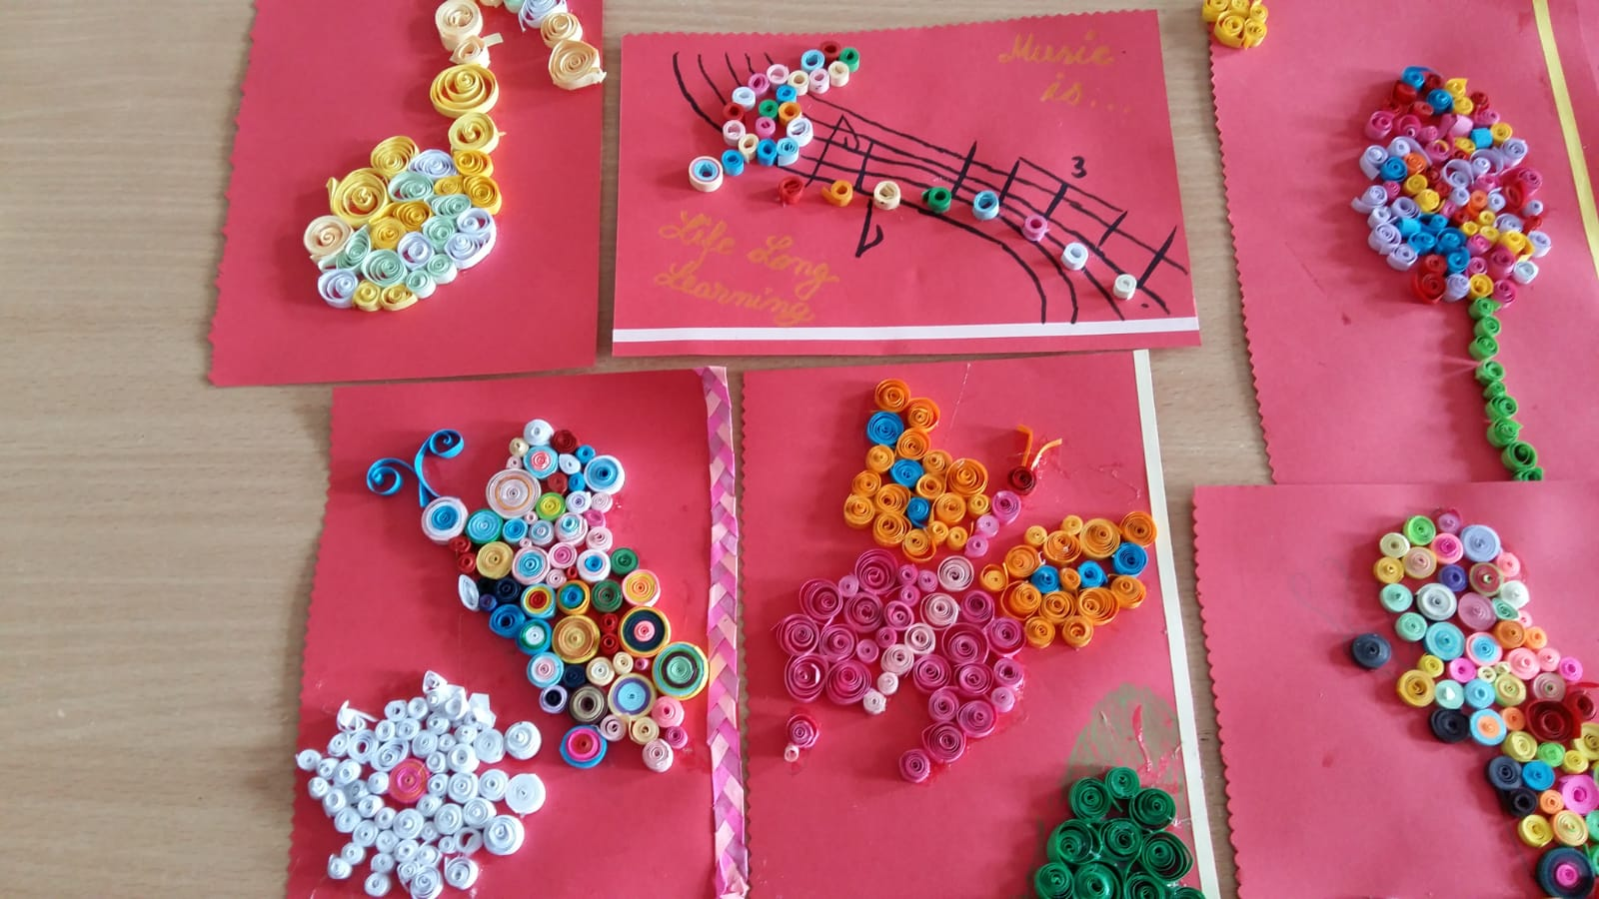
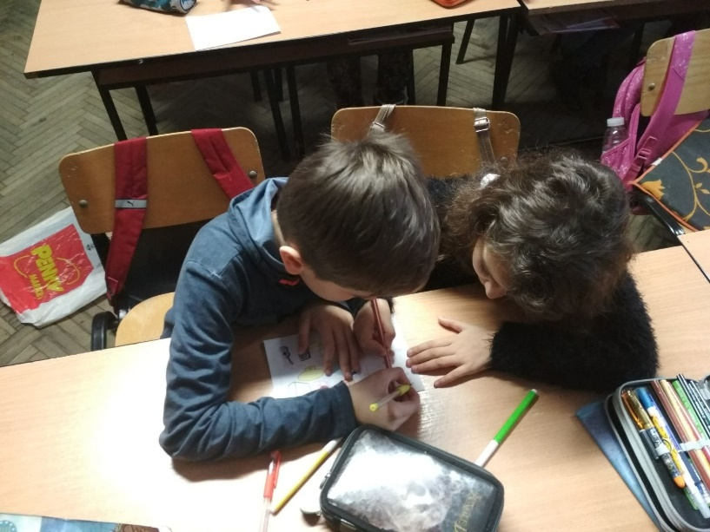

Slide 29
PRIMARY – 3rd grade, + ART: architecture (drawings)
Music and Movement: Music and Body
PERIOD: May 2018
Number of pupils: 29
SUBJECT: Physical education
ACTIVITIES
EACH ACTIVITY IN A DIFFERENT LESSON: in the house of an old lady (pupils in 2 circles sing and dance), musical chairs, aerobics, harmonic sounds and movement

Slide 30
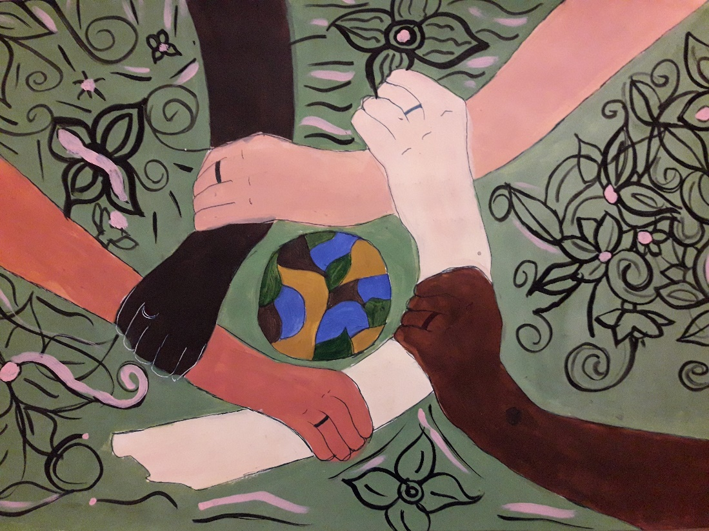
COMPETENCES
Improvement of body coordination and motor skills with view to achieving harmonious growth
Development of attention and concentration capacity

Slide 31
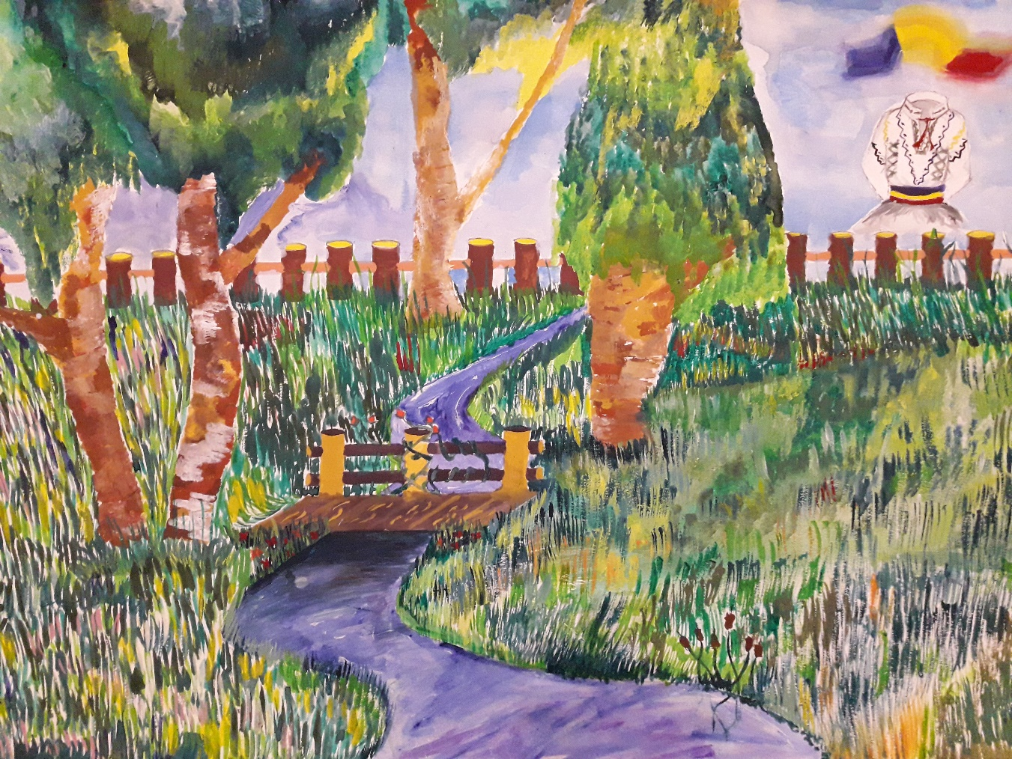
Students from 8th grade created paintings for the Erasmus+ activity

Slide 32
METHODOLOGY
Film: In casa Babei
“In the old lady’s house” – pupils are arranged in 2 circles and they sing and perform various movements (clapping, jumping, turning round etc.) while a pupil plays the piano

Slide 33
METHODOLOGY
Film: Scaunele dansatoare
“Musical chairs” – several chairs are arranged in a circle with space between them, but one pupil does not have a chair. A pupil plays the piano and the others have to move around the chairs. When the music stops they have to find a seat very quickly. Who misses the chair is eliminated.

Slide 34
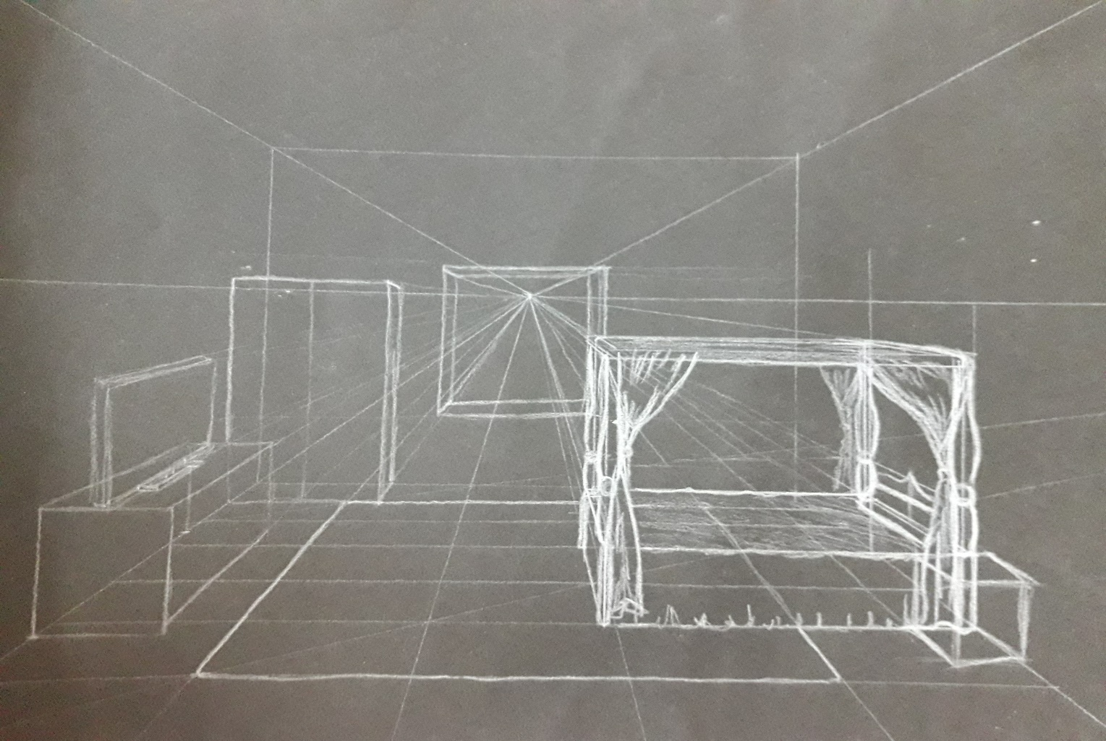
The Erasmus+ Old Lady House

Slide 35
METHODOLOGY
Film: Pompoane
“Aerobics- dancing steps are combined with Tae-Bo exercises trying to follow the musical rhythm of the melody played
“Harmonic sounds and movement” – arms and legs movements in a selected rhythm (butterflies dancing, birds chirping, bees dancing)

Slide 36
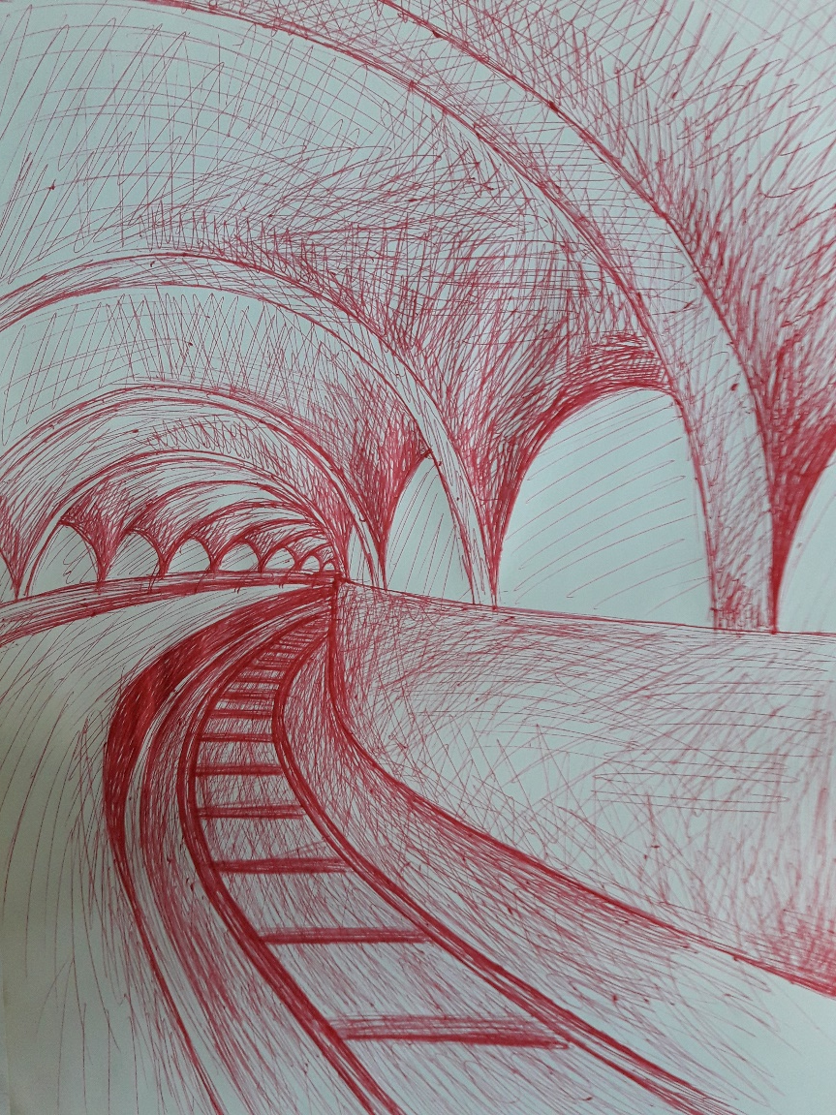
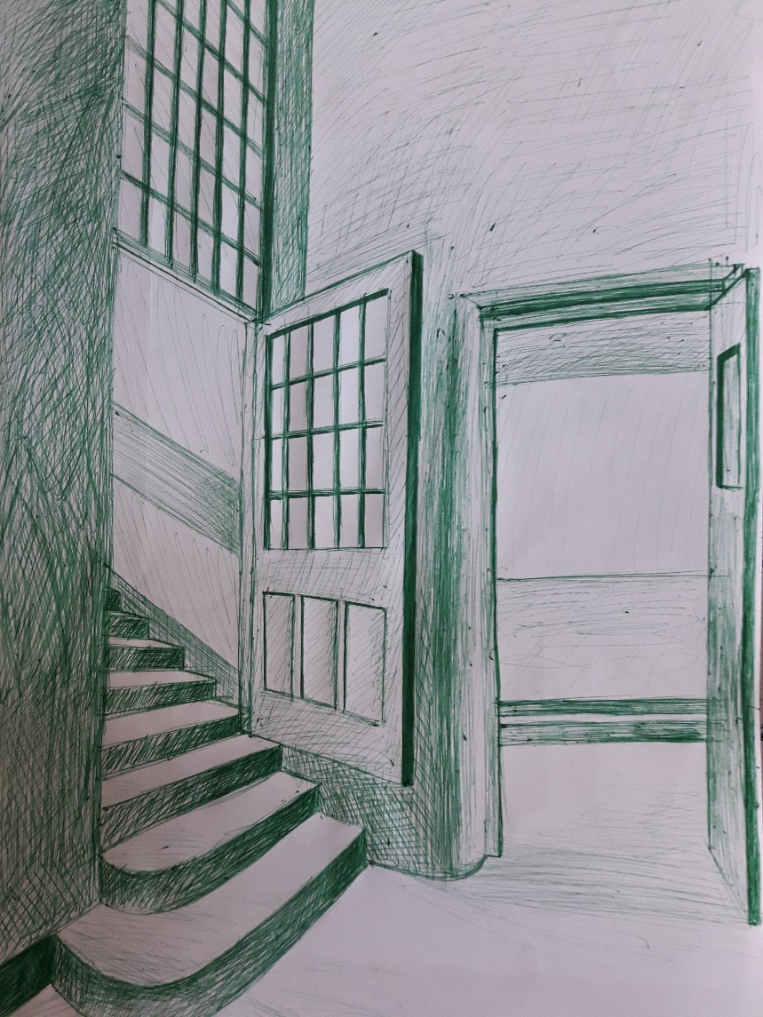

Slide 37
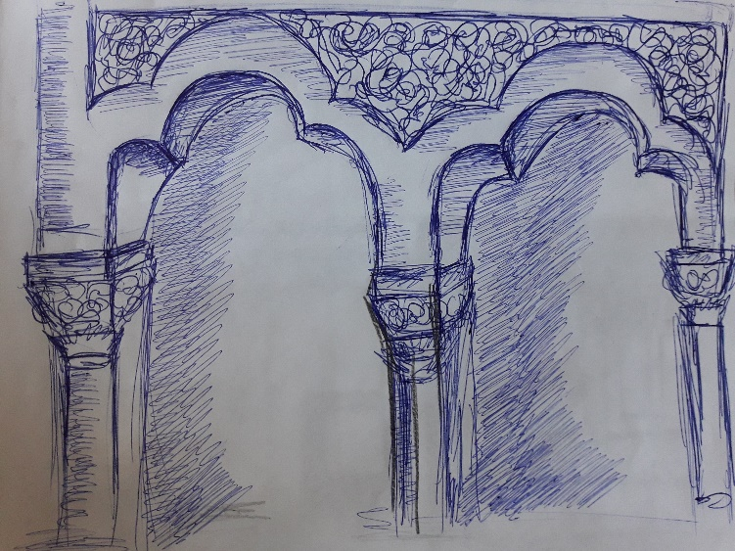
ORGANISATION
RESOURCES
Musical instrument: piano
Laptop. loudspeakers
Musical pieces with various rhythms
Selection of movements adapted to the age, abilities and flexibility of pupils
Rules for the musical games
Articles on the combination of harmonic sounds and movement
Individual
Class interaction

Slide 38
EVALUATION of competences
Coordination of body movement with musical pieces
Performance of movements according to the musical rhythms
Respecting the rules of the musical games
Arms and legs movements in musical settings
Expressing feelings through movement performance and sound associations
Ability to focus on the movement and music and attention paid to the rules of the games

Slide 39
